Slide 1

Synthesizing View Definitions from Data
Aditya Parameswaran
Stanford University
(Joint work with A. Das Sarma, H. Garcia-Molina and J. Widom)

Slide 2

Motivation
Database
Similar Database
Programs / Manual
Selection
??
complex process
SQL Query
SQL Query
View
View ’
View Inspector

Slide 3
Database Triplets
D, Q → V : Query Proc. and Optimization
V, Q → D : (Loosely) Data Integration
D, V → Q : ??

Slide 4
View Definitions Problem (VDP)
Database
View Definitions Problem
Input: Database D, View V
Output: Find Q such that:
  Closeness: Q(D)≈ V (“level of approximation”)
  Succinctness: Q is “succinct”
Q ?
View
(1) What class of queries?
(2) What is Closeness?
(3) What is Succinctness?

Slide 5
1. Classes of Queries
R,V
Q ; Q(R)≈V
Single Predicate
Conjunctive Query (CQ)
Unions of CQs
At most unions of ‘k’ CQs
Equality Predicates
Range Predicates
2. Closeness
Simple: d = |Q(R)-V| + |V-Q(R)|
Subset: d = ∞|Q(R)-V| + |V-Q(R)|
Superset: d = |Q(R)-V| + ∞|V-Q(R)|

Slide 6
3. Succinctness
R,V
Q ; Q(R)≈V
Conjunctive Query: s = Number of predicates
Unions of CQs: s = Number of unions
Exact View Definition. Given R,V, find Q s.t. Q(R)=V.
Best View Definition. Given R,V, find Q s.t.
Q’, d(Q(R),V) ≤ d(Q’(R),V)
Q’, d(Q’(R),V) = d(Q(R),V) ➔ s(Q) ≤ s(Q’)
Approximate View Definition. Given R,V, τ, find Q s.t.
d(Q(R),V) ≤ τ
Q’, d(Q’(R),V) ≤ τ ➔ s(Q) ≤ s(Q’)

Slide 7
Example
R
V
Movie | Genre | Box Office
Kill Bill | Action | Hit
Pulp Fiction | Comedy | Hit
Snatch | Comedy | Hit
1941 | Comedy | Flop
The Godfather | Action | Hit
Movie | Genre | Box Office
Kill Bill | Action | Hit
Pulp Fiction | Comedy | Hit
Snatch | Comedy | Hit
Q
CQ: (Box office = Hit)
Dist = 1
UCQ: ((Box office = Hit)∧(Genre=Comedy))
∨ (Movie=Kill Bill)
Dist = 0

Slide 8
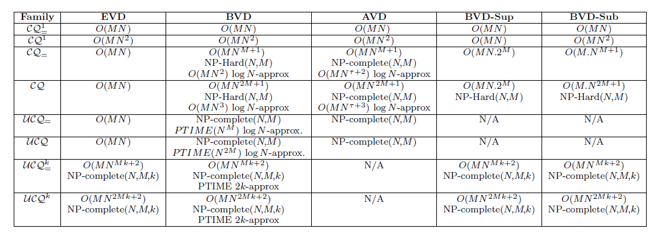
Summary of Results
1. Conjunctive queries
2. k-Unions of CQs

Slide 9
Conjunctive Queries: BVD
Finding best view definition is NP-hard
Reduction from Set Cover
Set Cover Instance:
Universe: U = {1, 2, …, n}
Sets: S₁ ,S₂ ,..., S_{m}
Fewest sets covering U
VDP:
R(A₁ ,A₂ ,…, A_{m} )
t_{0,} t_{1,} …, t_{n} є R. V= {t₀}
Find smallest CQ: Q(R)=V
R | A₁ | A₂ | …A_{j} | A_{m}
t₀
t₁
.. t_{i}
t_{n}
Step-1: 0 if i not in S_{j}
0
0
0
0
1) A_{j} = 0 <==> picking S_{j}
Step-2: t₀ .A_{j} = 0
0
1
0
2
3
0
0
4
2) Eliminate all t_{i}, i>0
=> Cover all i =1..n
Step-3: all distinct
5
6
7
0
Step-4: V = {t₀}

Slide 10
Conjunctive Queries ➔ Set Cover
R
U=R-V
P₁
P₂
All P_{i}(R) V
|U
P₃
V
P_{k}
If EVD exists => Exact BVD
Else Approximate (BVD/AVD)
Cover U with fewest sets

Slide 11
K-Unions: Greedy Pickings
V
R(A₁, A₂, …, A_{m}), V ➔ Find k-unions Q s.t. d(Q(R),V) minimized
C₁
good
Naïve Algorithm EXP(m, k)
Greedy pickings algorithm => weak guarantee
Inapproximability of general greedy algorithms
Greedy Pickings algorithm:
At each step, pick C_{i} with
max (good – bad)
C₂
C₃
R-V
bad
C_{r}

Slide 12
K-Unions
V
Distance metrics:
d: X+Z
gb: Y-X
Y
good
Approximation ratios:
R_{d} = d*/d_{o}
R_{gb} = gb_{o}/gb*
Q
Z
bad
X
No greedy algorithm can achieve sub-linear (in |V|) approximation ratio R_{d} or R_{gb}
Proof Idea: (bad case)
Greedy algorithms pick C_{i} do well on a greedy f
but have distinct bad tuples
Optimal solution picks C_{i} that do less well
but share bad tuples
Good News: Greedy Pickings ensures min (R_{d},R_{gb}) ≤ 2k
R-V

Slide 13
2k-approx: Proof Sketch
V
d_{o}=X+Z; gb_{o}=Y-X
Y
good
Exists C_{i}* with ≥Y/k good and ≤ X bad tuples
Q_{opt}
Z
d* ≤ (X + Y + Z - Y/k)
gb*≥ (Y/k - X)
bad
X
Setting β = (Y-X)/(Y/k-X):
R_{gb} ≤ β
R_{d} ≤ 1 + (k-1)(β-1)/(β-k)
R-V
For all β: min (R_{gb}, R_{d}) ≤ 2k

Slide 14
Future Work
Database
Better algorithms?
Multiple relations: joins, π, γ, union, …
Multiple instances: (V₁,D₁), …, (V_{n},D_{n})
Incremental or interactive VDP
  “20 questions” for View Synthesis
Q ??
View

Slide 15
Thanks!
Aditya Parameswaran
adityagp@cs.stanford.edu
View Inspector

