Slide 1


Optimal Schemes for Robust Web Extraction
Aditya Parameswaran
Stanford University
(Joint work with: Nilesh Dalvi, Hector Garcia-Molina,
Rajeev Rastogi)

Slide 2
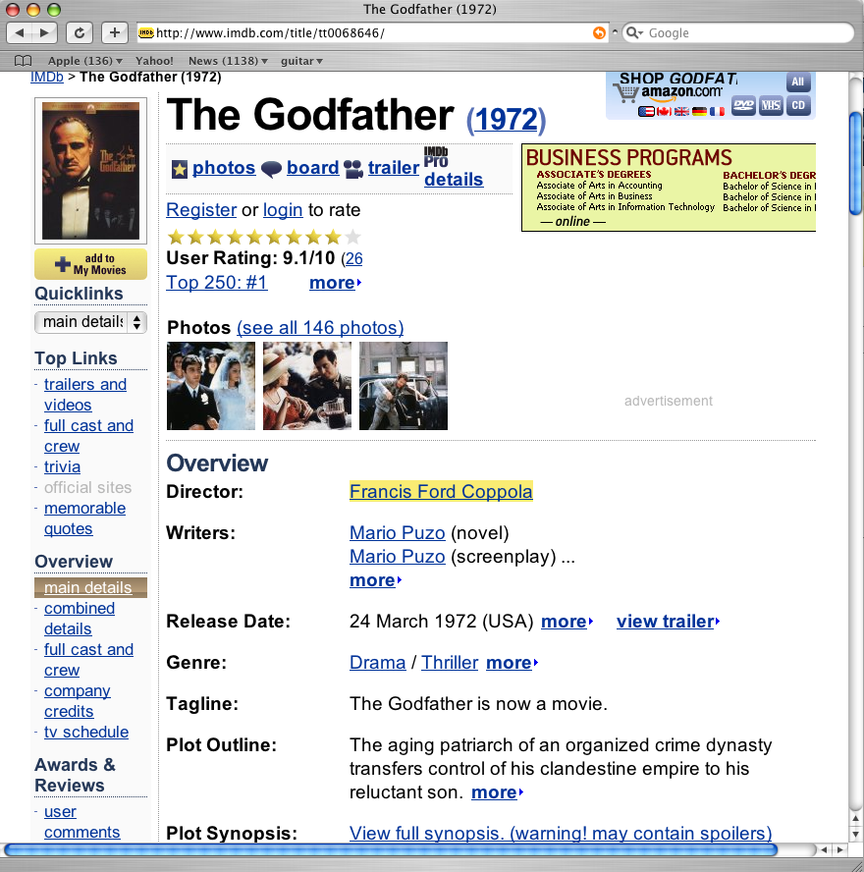
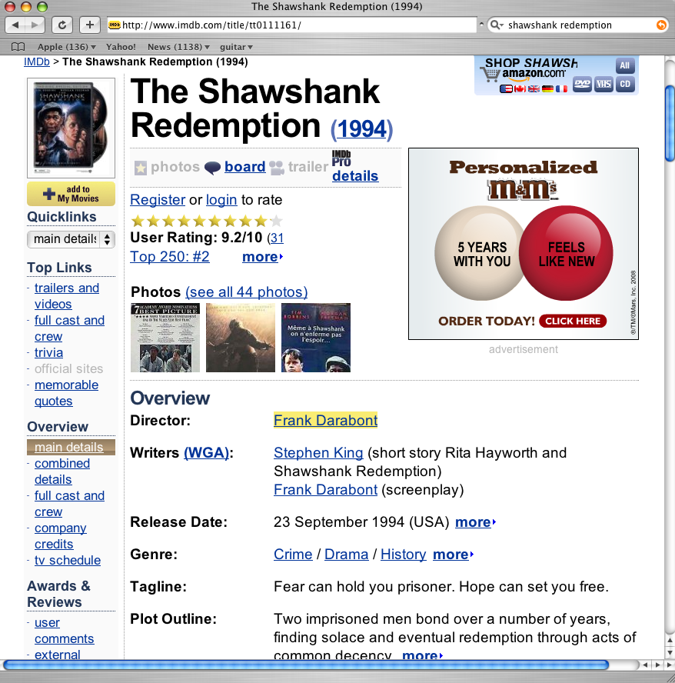


Slide 3
html
head
body
div
div
class=‘head’
div
class=‘content’
title
Godfather
table
table
width=80%
ad
content
td
td
td
td
td
td
td
Title :
Godfather
1972
Director :
Coppola
Runtime
118min
We can use the following Xpath wrapper to extract directors
  W1 = /html/body/div[2]/table/td[2]/text()
Problem : Wrappers break!

Slide 4
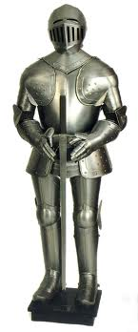
html
head
body
div
class=‘head’
div
class=‘content’
title
Godfather
table
table
width=80%
td
td
td
td
td
td
Title :
Godfather
Director :
Coppola
Runtime
118min
Several alternative wrappers are “more robust”
  W2 = //div[class=‘content’]/table/td[2]/text()
  W3 = //table[width=80%]/td[2]/text()
  W4 = //td[preceding-sibling/text() = “Director”]/text()
But how do we find the most robust wrapper?

Slide 5
Focus on Robustness
Generalize
Labeled Pages
Unlabeled Pages
t = 0
w₁
w₂
…
…
w_{k}
w_{k+1}
w_{k+2}
w_{n}
?
?
?
Generalize
Unlabeled Pages
t = t₁
…
…
w₁’
w₂’
w_{k}’
w_{k+1}’
w_{k+2}’
w_{n}’

Slide 6

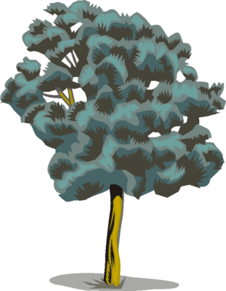
Page Level Wrapper Approach
Compute a wrapper given:
  Old version (ordered labeled tree) w
  Distinguished node d(w) in w (May be many)
  On being given a new version (ordered labeled tree) w’:
Our wrapper returns:
  Distinguished node d(w’) in w’
  Estimate of the confidence

Slide 7
Two Core Problems
Problem 1: Given w find the most “robust” wrapper on w
Problem 2: Given w, w’, estimate the “confidence” of extraction

Slide 8
Change Model
Adversarial:
  Each edit: insert, delete, substitute has a known cost
  Sum costs for an edit script
Probabilistic: [Dalvi et. al. , SIGMOD09]
  Each edit has a known probability
  Transducer that transforms the tree
  Multiply probabilities

Slide 9

Summary of Theoretical Results
Finding the wrapper is EASIER than estimating its robustness!
Focus on these problems
PART 1
PART 3
PART 4
Will touch upon this if there is time
PART 2, 5
Adversarial has better complexity
Experiments!

Slide 10
Part 1: Adversarial Wrapper: Robustness
Recall: Adversarial has costs for each edit operation
Given a webpage w, fix a wrapper
Cost
Robustness
Script 1: del(X), ins(Y), subs (Z, W)
Script 2: ….
…
Robustness of a wrapper on a webpage w :
  Largest c such that for any edit script s with cost < c, wrapper can find the distinguished node in s(w)

Slide 11
How do we show optimality?
Robustness
Proof 1: Upperbound on Robustness
w₀
c
Proof 2: Lowerbound of robustness of w₀
w₄
w₁
Thus, w₀ is optimal!
w₂
w₃

Slide 12
Adversarial Wrapper: Upper Bound
s₁
w’
BAD CASE:
Same structure
(i.e., S₁ (w) = S₂ (w))
Different locations of distinguished nodes.
w
s₁
s₂
s₂
Let c be the smallest cost such that
  S₁<= c, S₂<= c, so that this “bad” case happens
Then, c is an upperbound on the robustness of any wrapper on w!

Slide 13
Adversarial Optimal Wrapper
Given w, d(w), w’:
  Find the smallest cost edit script S such that S(w) = w’
  Return the location of d(w) on applying S to w
S
w
w’

Slide 14
Robustness Lowerbound Proof
s₁
s₂
w
w’
Assume the contrary (robustness of our wrapper is < c)
Then, there is an actual edit script S₁ where it fails
  and cost(S₁) < c
Let the min cost script be S₂
  Then: cost(S₂) <= cost(S₁) < c
  But then this situation cannot happen!

Slide 15
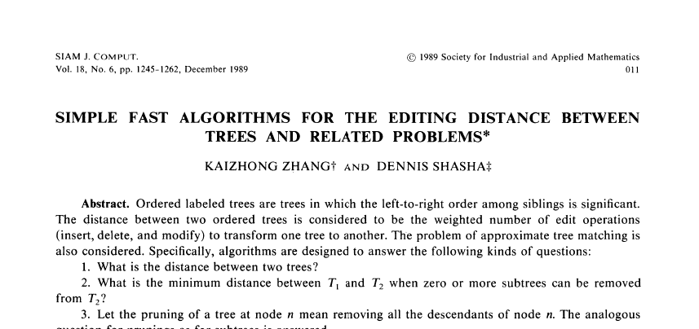
Detour: Minimum Cost Edit Script
Classical paper by Zhang-Shasha
Dynamic programming over subtrees
Complexity: O(n₁ n₂ d₁ d₂)

Slide 16
Part 2: Evaluation
Crawls from internet-archive.org
  Domains: IMDB, CNN, Wikipedia
  Roughly 10-20 webpages per domain
  Roughly 100’s of versions per webpage
Finding distinguished nodes
  We looked for unique patterns that appear in all webpages, like <Number> votes
  Allows us to do automatic evaluation
How do we set the costs?
  Learn from prior data…

Slide 17
Evaluation (Continued)
Baseline comparisons
  XPATH: Robust XPath Wrapper [SIGMOD09]
  FULL: Entire Xpath
Two kinds of experiments
  Variation with difference in archive.org version number
    A proxy on time
    How do wrappers perform as the time gap is increased?
  Precision/Recall of the confidence estimates provided
    Can I use the confidence values to decide whether to refer the web-page to an editor?

Slide 18
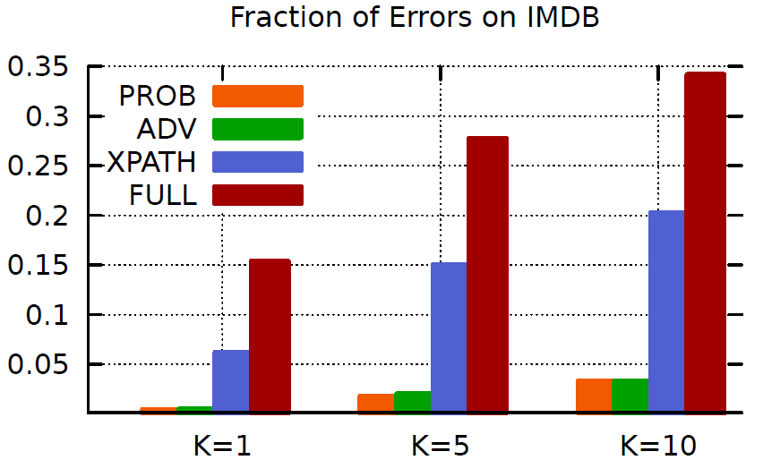

Slide 19
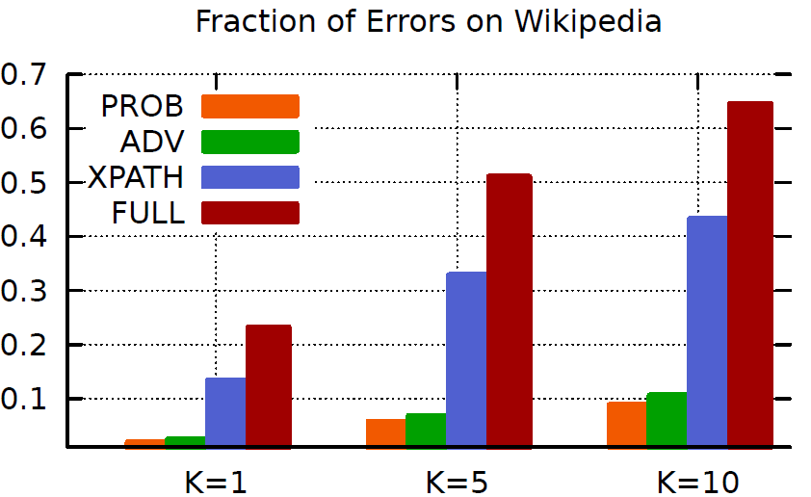

Slide 20
Part 2: Computation of Robustness
NP-Hard via a reduction from the partition problem. {x_{1,} x_{2,} …, x_{n}}
Costs: d(a₀) = 0 and d(a_{n}) = 0
Costs: s(a_{i},b_{i}) = 0; s(a_{i}, b_{i-1}) = x_{i}; s(a_{i}, b_{i+1}) = x_{i}; Everything else infty.
c = sum(x_{i})/2
iff there is a partition
a₀
…
a₁
a_{n}
…
…
a₁
a₂
a₀
a₁
a_{n-1}
a_{n}
…
b_{0/1}
b_{1/2}
b_{n/n+1}

Slide 21
Part 3: Confidence in Extraction
s₁
w
w’
s₂
Let s₁ be the min cost edit script
Let s₂ be the min cost edit script that has a different location of distinguished node
Confidence = cost(s₂) - cost(s₁)
Also computed in O(n₁ n₂ d₁ d₂)

Slide 22
Probabilistic Wrapper
No single “edit script”
All “edit scripts” have some non-zero probability
Location of node is
  Argmax_{s} Pr(w, w’, d(w), s)
Simple algorithm: For each s, compute above.
Problem: Too slow!
Solution: Share computation…

Slide 23
Evaluation (Continued)
Baseline comparisons
  XPATH: Most robust XPath Wrapper [SIGMOD09]
  FULL: Entire Xpath
Two kinds of experiments
  Variation with difference in archive.org version number
    A proxy on time
    How do wrappers perform as the time gap is increased?
  Precision/Recall of the confidence estimates provided
    Can I use the confidence values to decide whether to refer the web-page to an editor?

Slide 24
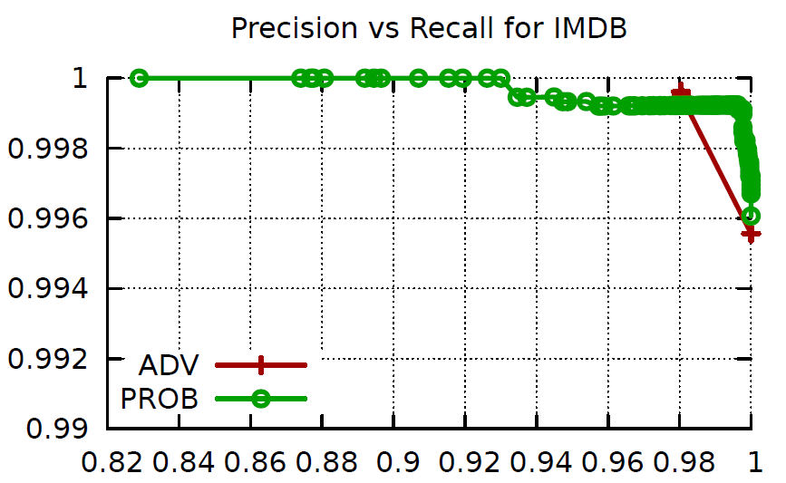

Slide 25
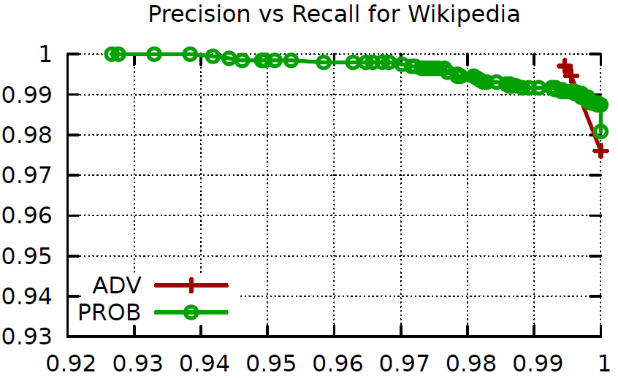

Slide 26
Conclusions
Our wrappers provide provable guarantees of optimal robustness under
  Adversarial change model
  Probabilistic change model
Experimentally, too:
  Perform much better in terms of correctness considerations
  Plus, they provide reliable confidence estimates

Slide 27
Thanks for coming! www.stanford.edu/~adityagp

