Slide 1
Towards the Web of Concepts: Extracting Concepts from Large Datasets
Aditya G. Parameswaran
Stanford University
Joint work with:
Hector Garcia-Molina (Stanford) and Anand Rajaraman (Kosmix Corp.)

Slide 2
Motivating Examples
tax assessors san antonio
tax
13706
assessors
324
san
14585
antonio
2855
tax assessors
273
assessors san
< 5
san antonio
2385

Slide 3
Motivating Examples
Lord of the rings
Lord of the
Of the rings
Microsoft Research Redmond
Microsoft Research
Research Redmond
Computer Networks
Computer
Networks

Slide 4
The Web of Concepts (WoC)
Japanese restaurants in Palo Alto
Homma’s
Sushi
Fuki Sushi
Teriyaki bowl
Concepts are:
Entities, events and topics
People are searching for
Web of concepts contains:
Concepts
Relationships between concepts
Metadata on concepts
Hours: M-F 9-5
Expensive
Hours: M-S 5-9
Cheap

Slide 5
How does the WoC help us?
Improve search
Find concepts the query relates to
Return metadata
E.g., Homma’s Sushi Timings, Phone No., …
Return related concepts
E.g., Fuki Sushi, …
Rank content better
Discover intent
Japanese restaurants in Palo Alto
Fuki Sushi
Teriyaki bowl
Homma’s
Sushi
M-F 9-5
Expensive
M-S 5-9
Cheap

Slide 6
How to construct the WoC?
Standard sources
Wikipedia, Freebase, …
Small fraction of actual concepts
Missing:
restaurants, hotels, scientific concepts, places, …
Updating the WoC is critical
Timely results
New events, establishments, …,
Old concepts not already known
Japanese restaurants in Palo Alto
Fuki Sushi
Teriyaki bowl
Homma’s
Sushi
M-F 9-5
Expensive
M-S 5-9
Cheap
6

Slide 7
Desiderata
Web-pages
Concepts
K-grams
With
frequency
Concept
Extraction
Tweets
Blogs
Query Logs
Tags
Be agnostic towards
Context
Natural Language

Slide 8
Our Definition of Concepts
Concepts are:
k-grams representing
Real / imaginary entities, events, … that
People are searching for / interested in
Concise
E.g., Harry Potter over The Wizard Harry Potter
Keeps the WoC small and manageable
Popular
Precision higher
Concepts
K-grams
With
frequency
Concept
Extraction

Slide 9
Previous Work
Frequent Item-set Mining
Not quite frequent item-sets
k-gram can be a concept even if k-1-gram is not
Different support thresholds required for each k
But, can be used as a first step
Term extraction
IR method of extracting terms to populate indexes
Typically uses NLP techniques, and not popularity
One technique that takes popularity into account

Slide 10
Notation
K-gram | Frequency
San | 14585
Antonio | 2855
San Antonio | 2385
Sub-concepts of San Antonio : San & Antonio
Sub-concepts of San Antonio Texas :
San Antonio & Antonio Texas
Super-concepts of San : San Antonio, …
Support (San Antonio) = 2385
Pre-confidence of San Antonio: 2385 / 14585
Post-confidence of San Antonio: 2385 / 2855

Slide 11
Empirical Property
Lord of the Rings
Manhattan Acting School
Microsoft Research Redmond
Computer Networks
Observed on Wikipedia
If k-gram a₁a₂…a_{k} for k > 2 is a concept then at least one of the sub-concepts a₁a₂…a_{k-1} and a₂a₃…a_{k} is not a concept.
k | Both Concepts | One concept or More
2 | 55.69 | 95.63
3 | 7.77 | 50.69
4 | 1.78 | 29.57
5 | 0.51 | 18.44
6 | 0.31 | 13.23

Slide 12
“Indicators” that we look for
Popular
Scores highly compared to sub- and super-concepts
“Lord of the rings” better than
“Lord of the” and “Of the rings”.
“Lord of the rings” better than
“Lord of the rings soundtrack”
Does not represent part of a sentence
“Barack Obama Said Yesterday”
Not required for tags, query logs

Slide 13
Outline of Approach
S = {}
For k = 1 to n
Evaluate all k-grams w.r.t. k-1-grams
Add some k-grams to S
Discard some k-1-grams from S
Precisely k-grams until k = n-1 that satisfy indicators are extracted
Under perfect evaluation of concepts w.r.t. sub-concepts
Proof in Paper

Slide 14
Detailed Algorithm
S = {}
For k = 1 to n
For all k-grams s (two sub-concepts r and t)
If support(s) < f(k)
Continue
If min (pre-conf(s), post-conf(s)) > threshold
S = S U {s} – {r, t}
Elseif pre-conf(s) > threshold & >> post-conf(s) & t Є S
S = S U {s} – {r}
Elseif post-conf(s) > threshold & >> pre-conf(s) & r Є S
S = S U {s} – {t}
Indicator 1 1
Indicator 2: r & t are not concepts
Indicator 2: r is not a concept
Indicator 2: t is not a concept

Slide 15
Experiments: Methodology
AOL Query Log Dataset
36M queries and 1.5M unique terms.
Evaluation using Humans (Via M.Turk)
Plus Wikipedia
(For experiments on varying parameters)
Experimentally set thresholds
Compared against
C-Value Algorithm:
a term-extraction algorithm with popularity built in
Naïve Algorithm:
simply based on frequency

Slide 16
Raw Numbers
25882 concepts extracted
an absolute precision of 0.95 rated against Wikipedia and Mechanical Turk.
For same volume of 2, 3, and 4-gram concepts, our algorithm gave
Fewer absolute errors (369) vs.
C-Value (557) and Naïve (997)
Greater Non-Wiki Precision (0.84) vs.
C-Value (0.75) and Naïve (0.66)

Slide 17
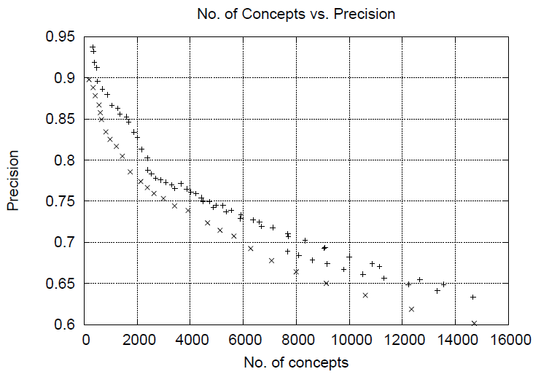
Head-to-head Comparison

Slide 18
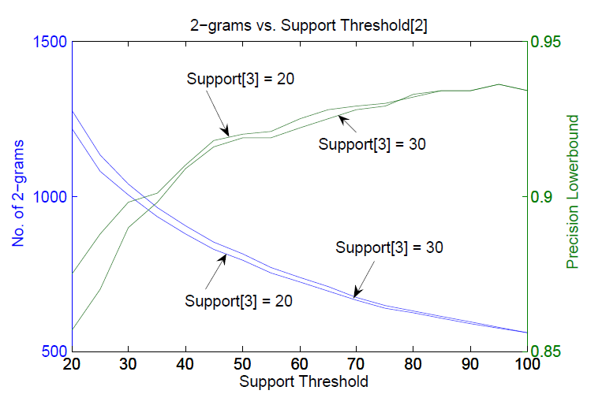
Experiments on varying thresholds

Slide 19
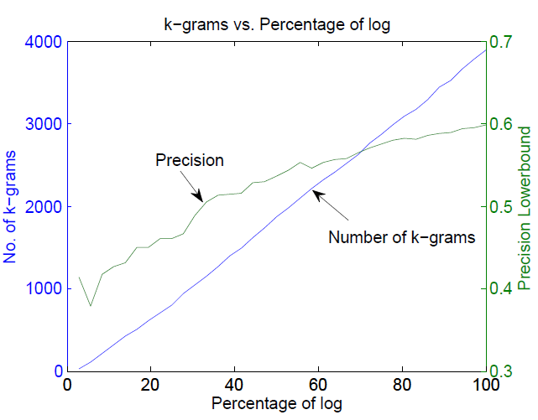
On Varying Size of Log

Slide 20
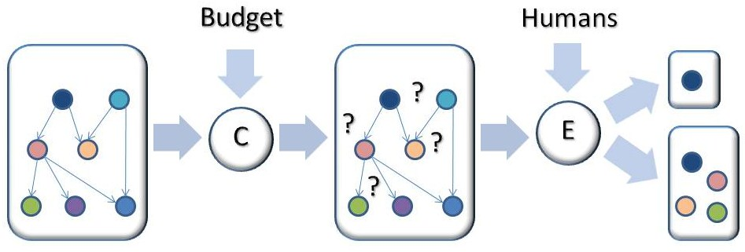
Ongoing Work (with A. Das Sarma, H. G.-Molina, N. Polyzotis and J. Widom)
How do we attach a new concept c to the web of concepts?
Via human input
But: costly, so need to minimize # questions
Questions of the form: Is c a kind of X?
Equivalent to Human-Assisted Graph Search
Algorithms/Complexity results in T.R.

Slide 21
Conclusions & Future Work
Adapted frequent-itemset metrics to extract fresh concepts from large datasets of any kind
Lots more to do with query logs
Relationship extraction between concepts
Parent-Child
Sibling
Metadata extraction
Automatic learning of thresholds

