Slide 1
Data-Centric
Human Computation
Jennifer Widom
Stanford University

Slide 2
Mega-Trends in C.S. Research
2000’s
Crowd
Cloud
2010’s

Slide 3
Human Computation
Augmenting computation with the use of human
abilities to solve (sub)problems that are difficult
for computers
  Object/image comparisons
  Information extraction
  Data gathering
  Relevance judgments
  Many more…
≈ “Crowdsourcing”

Slide 4

Crowdsourcing Research
Complex ops
Sort
Cluster
Clean
Data Gathering /
Query Answering
Get data
Verify
Algorithms
Basic ops
Compare
Filter
Interfaces
Incentives
Trust, reputation
Spam
Pricing
Platforms
…
…
Marketplace #1
Marketplace #2
Marketplace #n

Slide 5
New Considerations & Tradeoffs
How long can I wait?
Latency
What is my desired quality?
Uncertainty
Cost
How much am I willing to spend?

Slide 6
Live Experiment ‒ Human Filter
Are there more than 40 dots?

Slide 7
Computing the Answer
Yes or No ?
With what confidence?
Should I ask more questions?
  More cost (‒)
  Higher latency (‒)
  Higher accuracy (+)

Slide 8
Live Experiment ‒ Filter #2
Are more than half of the dots blue?

Slide 9
Live Experiment ‒ Two Filters
Are there more than 40 dots
and are more than half of the dots blue?

Slide 10
Computing the Answer
Ask questions separately or together?
  Together ➔ lower cost, lower latency, lower accuracy?
If separately, in sequence or in parallel?
If in sequence, in what order?
Different filters may have…
  different cost
  different latency
  different accuracy

Slide 11
Crowd Algorithms
Design fundamental algorithms involving human
computations
  Filter a large set (human predicate)
  Sort or find top-k from a large set (human comparison)
Which questions do I ask of humans?
Do I ask sequentially or in parallel?
How much redundancy in questions?
How do I combine answers?
When do I stop?
Latency
Uncertainty
Cost

Slide 12
Algorithms We’ve Looked At
Filtering [SIGMOD 2012]
Graph search [VLDB 2011]
Find-Max [SIGMOD 2012]
Entity Resolution (= Deduplication)

Slide 13
Sample Results: Filtering
No
Given:
  Large set S of items
  Filter F over items of S
  Selectivity σ of F on S
  Human false-positive rate ρ
  Human false-negative rate ν
Find strategy for asking F that:
  Asks no more than m questions per item
  Guarantees overall expected error less than e
  Minimizes overall expected cost c (# questions)
5
4
Exhaustive search
Pruned search
Probabilistic strategies
3
2
1
1
2
3
4
5
Yes

Slide 14
Human-Powered Query Answering
Find the capitals of five
Spanish-speaking countries
Give me a Spanish-speaking
country
What language do they speak in
country X?
What is the capital of country X?
Give me a country
Give me a capital
Is this country-capital-language
triple correct?
Give me the capitals of five
Spanish-speaking countries
DBMS
Country | Capital | Language
Peru | Lima | Spanish
Peru | Lima | Quechua
Brazil | Brasilia | Portugese
… | … | …

Slide 15
Human-Powered Query Answering
Find the capitals of five
Spanish-speaking countries
Inconsistencies
What if some humans say Brazil
is Spanish-speaking and others
say Portugese?
What if some humans answer
“Chile” and others “Chili”?
DBMS
Country | Capital | Language
Peru | Lima | Spanish
Peru | Lima | Quechua
Brazil | Brasilia | Portugese
… | … | …

Slide 16
Key Elements of Our Approach
Exploit relational model and SQL query language
Configurable fetch rules for obtaining data from humans
Configurable resolution rules for resolving inconsistencies in fetched data
Traditional approach to query optimization
  But with many new twists and challenges!
Latency
Uncertainty
Cost

Slide 17
Deco: Declarative Crowdsourcing
Schema Designer (DBA)
1) Schema for conceptual relations
Restaurant(name,cuisine,rating)
2) Fetch rules
name ⇒ cuisine
cuisine,rating ⇒ name
3) Resolution rules
name: dedup()
rating: average()
DBMS

Slide 18
Deco: Declarative Crowdsourcing
User or Application
Declarative queries
select name from Restaurant
where cuisine = ‘Thai’
and rating >= 3
atleast 5
Query semantics
  Relational result over
  “some valid instance”
Valid instance
  Fetch + Resolve + Join
DBMS

Slide 19
Deco: Declarative Crowdsourcing
Query
Processor
Generate query execution plan that
orchestrates and optimizes fetches
and resolutions to produce answer
Different possible objectives:
• N tuples, minimize cost (fetches)
• F fetches, maximize tuples
• T time, minimize/maximize ??
DBMS
Latency
Uncertainty
Cost

Slide 20
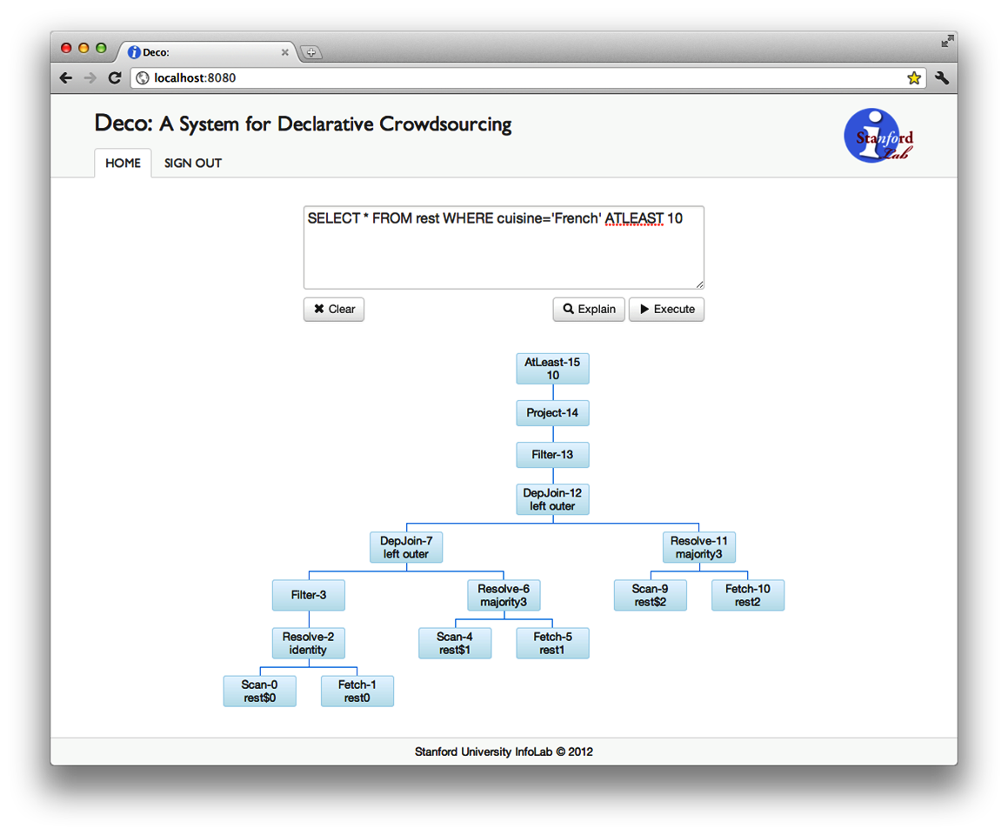
Deco: Declarative Crowdsourcing
Query
Processor
DBMS

Slide 21
Crowdsourcing Research
Data Gathering /
Query Answering
Humans As
Data Providers
Humans As
Data Processors
Algorithms
Platforms
…
…
Marketplace #1
Marketplace #2
Marketplace #n

Slide 22
Data-Centric
Human Computation
Joint work with:
Hector Garcia-Molina, Neoklis Polyzotis,
Aditya Parameswaran, Hyunjung Park

