Slide 1
Making Database Systems Usable
Slides courtesy Jagadish

Slide 2
This paper…
Unusual, provocative paper
  More problems than solutions
  A showcase of the work the group has done
    Naturally, very far from solving the problems
Better to judge the paper for the questions it raises rather than the solutions it provides!

Slide 3
Status Quo
Users don’t interact with databases directly
  Databases are hard to use!
  Technical Support necessary to get “data” in and out of databases
    Expensive DBAs to administer
    Expensive Programmers to place a layer on databases
Analogy with Flight Booking
  Past: Travel agents
  Now: Everyone books flights by themselves

Slide 4
Why are Databases not the same as Search?
Question especially relevant because keyword search on databases was in vogue
Complex semantics often needed to search through data
Precise and complete answers needed
Expectation of structured results from databases
Creation and Updating is essential

Slide 5
Current Approaches for DB Usability
Visual Interfaces for Querying Data:
  QBE (We saw this last time)
  Other Visual Query Builder tools
Textual Interfaces
  Keyword search in DB
    DBXplorer, Banks, DISCOVER
  Natural language querying
    Still far from perfect
Context and Personalization: Sparse…

Slide 6
In addition…
We have seen a few more “new approaches to database usability”
  DBTouch and GestureDB
None of these is the “right answer” yet. Database Systems are still hard to use

Slide 7
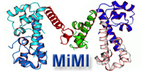
Context
MiMI: a System for biologists to integrate, model, and query data.
An integrated database of protein interactions.
http://mimi.ncibi.org

Slide 8
Challenges
Unknown Query Language
Unknown Schema
Complex Schema
Unknown Data Values
Unknown Provenance

Slide 9

Challenge 1: Unknown Query Language
for $a in doc()//author,
$s in doc()//store
let $b in $s/book
where
$s/contact/@name = “Amazon” and $b/author = $a/id
return { $a/name, count($b) }
$a ??
What is let?
Do I need a semi-colon?
How do I start writing a query?

Slide 10
Challenge 1: Unknown Query Language
Solutions:
  Forms
  Natural Language Query

Slide 11
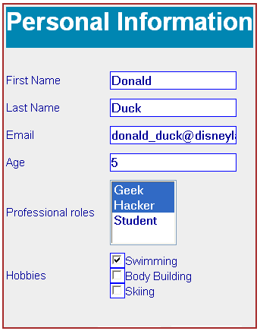
Forms
Simple, but limited.
How do we create a form to query a database?
When would it be appropriate to use?
Discuss!

Slide 12
Forms
Simple, but limited.
How do we create a form to query a database?
When would it be appropriate to use?
Discuss!
  Small number of types of queries
  Small number of predicates
  Small number of joins
  Possibly many values for attributes
  Conceptual schema need not be same as actual schema (e.g., flight database)

Slide 13
Natural Language Query
A generic interface supporting English queries to a database.
Follow Up Queries: conversational iterative specification of queries.
Add Domain Knowledge learning component to improve the generic interface.
Some more recent work from the same group …
EDBT 06
TODS 07
AAAI 07

Slide 14
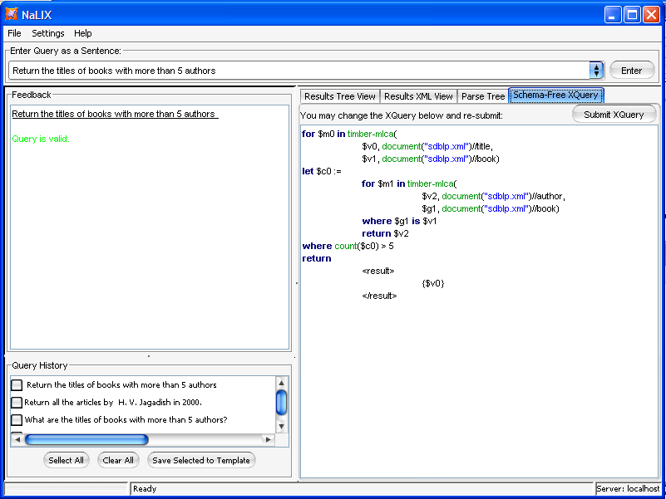
Example – Nesting
Q: Return the titles of books with more than 5 authors.

Slide 15
Natural Language Interfaces
Pros/Cons?

Slide 16
Natural Language Interfaces
Pros/Cons?
  No need for SQL:
    But not clear how much one can do without knowledge of schema
  Only short queries
  Probably a wider space of queries than forms
  Sometimes can be annoying
    Imagine having to specify flight searches via NL
  The feeling of less control
    Lack of understanding of knobs

Slide 17
Key Challenges in Natural Language Querying
• Challenge 1:
Understand user intent given an arbitrary natural language query.
• Challenge 2:
Map user intent to database schema.
  Is “Gone with the wind” a book or a movie (or a person)?
  Are books grouped by year or by author in the bibliography?

Slide 18
Challenge 2: Unknown Schema
Often attributes are codified in obscure or esoteric ways
  Often the problem solved by keyword search in databases
  People often
    make mistakes while referring to attribute
The group has done some work in merging keyword search + traditional Xquery
  Still a far way to go
Any solutions that we can borrow from web search?

Slide 19
Challenge 2: Unknown Schema
The group has done some work in merging keyword search + traditional Xquery
  Still a far way to go
Any solutions that we can borrow from web search?
  A “did you mean”?
  Map to the closest attribute?
  Map to the semantically closest attribute?
  “relaxed” queries

Slide 20
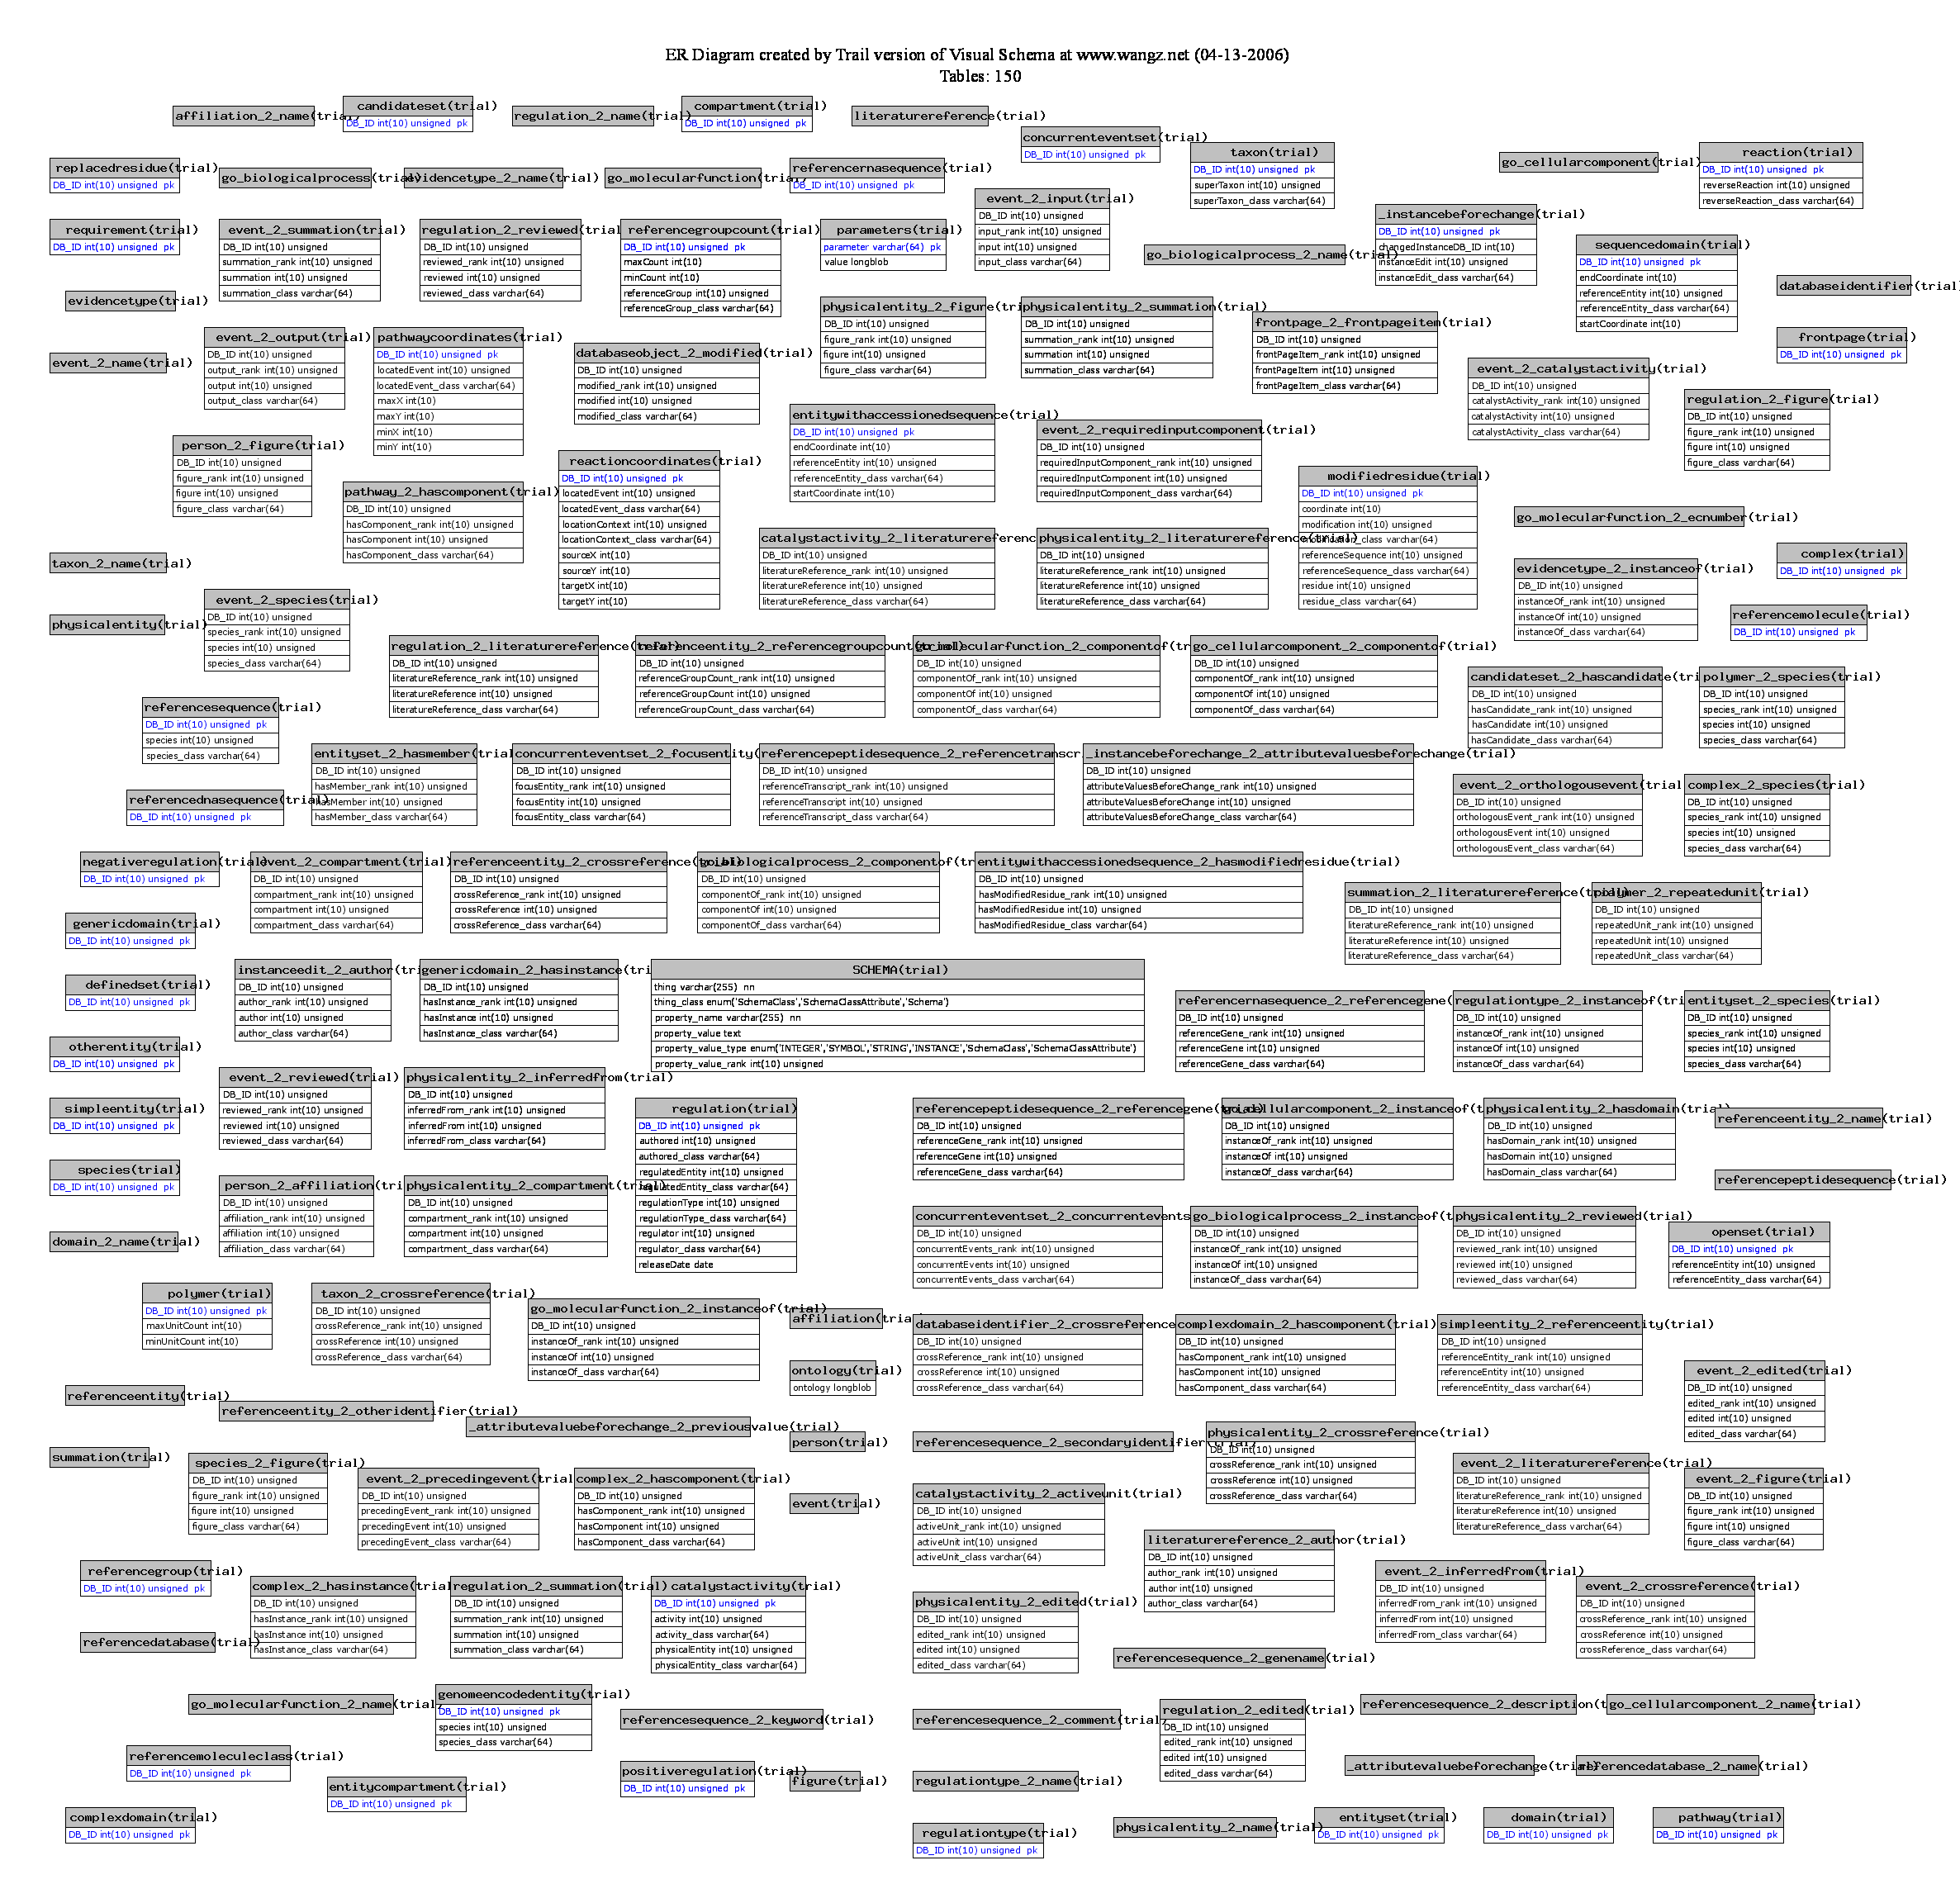
Challenge 3: Complex Schema
Source | Type | # of Elements
BioWarehouse | Relational | 382
MiMI | XML | 289 and counting
Reactome | Relational | 679
MAGE-ML | XML | 1,581
ATDG | Relational | 2,177

Slide 21
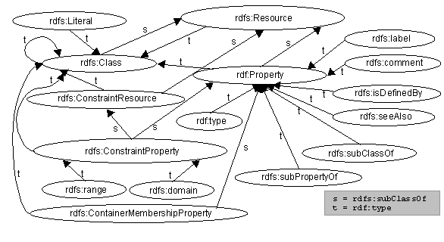
Schema Summarization
Schema are often too large and too complex.
Can we present the user with an informative summary?
Can the user effectively query the database using this summary alone?
VLDB 06
VLDB 07

Slide 22
Schema Summarization
Basic Idea:
  Represent the original complex schema with a smaller and conceptually simpler schema – a summary of the original schema.
  Each element in the summary naturally corresponds to a subschema of the original schema.
Helps users explore the schema:
  Illustrates the main topics of the database.
  Filters away irrelevant parts of the schema.

Slide 23
Schema Summary
warehouse
Summary is a schema:
  Contains abstract elements and abstract links;
  Smaller in size.
Abstract element:
  Represents a subschema, i.e., a group of original elements.
Abstract link:
  Connects abstract elements.
state*
authors
@name
store*
author*
author*
contact
book*
book*
@id
@name
@name
isbn
price
@address
title
author*

Slide 24
Challenge 4: Unknown Data Values
warehouse
state*
for $a in doc()//author,
$s in doc()//store
let $b in $s/book
where
$s/contact/@name = “Amazon” and $b/author = $a/id
return { $a/name, count($b) }
authors
store*
@name
Amazon Inc.?
AMZN?
amazon.com?
author*
contact
book*
@id
@name
@name
isbn
price
@address
title
author*
Any solutions from Web Search?

Slide 25
Autocompletion
Help the user along with “instant” feedback as they type.
Provide insights into schema, data and familiar syntax during query formulation.
Guide them to perform better queries, correctly.
VLDB 07

Slide 26
Challenge 5: Unknown Provenance
Seuss | 23
Smith | 755
Wang | 1233
for $a in doc()//author,
$s in doc()//store
let $b in $s/book
where
$/contact/@name = “Amazon” and $b/author = $a/id
return { $a/name, count($b) }
Is that one prolific Smith?
Or is this the summation of multiple authors with the same name?

Slide 27
Lots of work on Provenance
Fine grained – store origin of every single record
Coarse grained – store at a schema level: this table came from these two tables
Pros/Cons?

Slide 28
Lots of work on Provenance
Fine grained – store origin of every single record
Coarse grained – store at a schema level: this table came from these two tables
Pros/Cons?
Fine-grained: too much data: all-all mappings
Coarse-grained: cannot ask interesting questions

Slide 29
Provenance Management
Capture:
  What actions did a user take?
  What actors (sensors, equipment, etc) created this data?
  What query generated this view?
  Where did this data come from?
Storage and Querying:
  Provenance information can quickly grow larger than data size
    The MiMI dataset is 270MB
    The Provenance for MiMI is 6GB
  Provenance information must be queriable with the underlying data for use in the scientific community
SIGMOD 06

Slide 30
Outline
Some challenges they tackled
A research agenda for the future
  Some points of pain
  Some directions for success

Slide 31
Pain Points
Too many joins
Too many options
Lack of explanation
No direct manipulation
Difficulty of defining structure for data

Slide 32
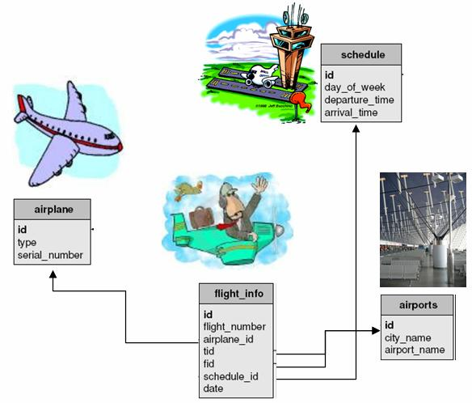
1. Too Many Joins: Painful Relations

Slide 33
1. Too Many Joins: Painful Relations
Single user concept (Flight) has been normalized into four tables.

Slide 34
1. Too Many Joins: Painful Relations
id
tid
Names of tables and attributes are not self-explanatory, particularly where references are involved (fid, tid).

Slide 35
1. Too Many Joins: Painful Relations
Find departure times for flights from Beijing to Detroit.
SELECT s.departure_time
FROM schedule AS s,
flight_info AS f, airports AS d,
airports AS a
WHERE s.id = f.schedule_id
AND f.fid = d.id
AND d.city_name = “Beijing”
AND f.tid = a.id
AND a.city_name = “Detroit”
Even simple queries are not easy to express.

Slide 36
1. Solution: No Joins
The typical user will only be able to express selection/projection: no joins.

Slide 37
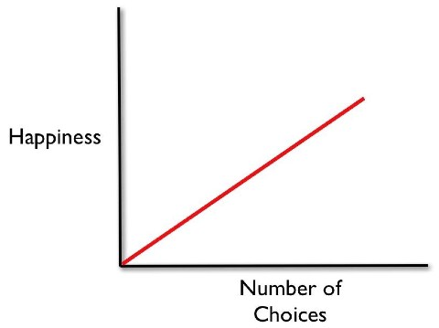
2. Too Many Options
What a software designer thinks is true

Slide 38
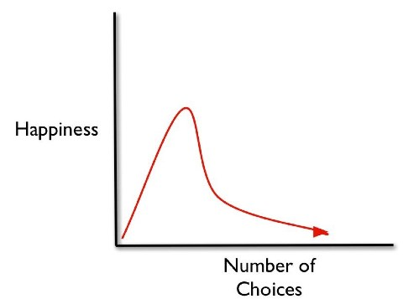
2. Too Many Options: The Fallacy of Greater Choice
Barry Schwartz, The tyranny of choice. Scientific American, April 2004, pp. 71-75

Slide 39
2. Too Many Options: Less is More!
Commercial database systems provide a zillion tuning knobs and ensure full employment for an army of expensive DBAs.
The most popular interfaces to databases today are forms-based, greatly limiting user choice (and hiding schema details, such as joins).

Slide 40

2. Solution: Limited Options
An ideal system will provide just enough options for the user to get their work done, but no more.
Or provide a gradual migration path with more options for the more advanced user.

Slide 41
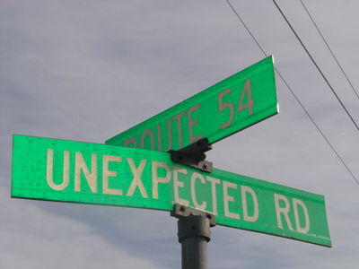
3. Lack of Explanations: Unexpected Pain
Real systems will produce unexpected results at times.
Good systems must be able to explain why.

Slide 42
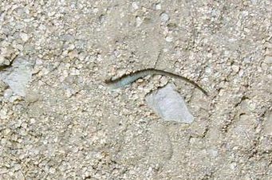
3. Solution: Adequate Explanation
A query for “cheap flights” returns: Los Angeles $75, Boston $100, San Francisco $400. Why is SF in this list?
Explanation: $400 was less than half the average price for a ticket to San Francisco.

Slide 43
4. No Direct Manipulation
Find departure times for flights from Beijing to Detroit.
SELECT s.departure_time
FROM schedule AS s,
flight_info AS f, airports AS d,
airports AS a
WHERE s.id = f.schedule_id
AND f.fid = d.id
AND d.city_name = “Beijing”
AND f.tid = a.id
AND a.city_name = “Detroit”
Even small changes can be difficult to make.

Slide 44
4. No Direct Manipulation
Find departure times for 747 flights from Beijing to Detroit.
SELECT s.departure_time
FROM schedule s,
flight_info AS f, airports AS d,
airports AS a, airplane AS p
WHERE s.id = f.schedule_id
AND f.fid = d.id
AND d.city_name = “Beijing”
AND f.tid = a.id
AND a.city_name = “Detroit”
AND f.airplane_id = p.id
AND p.type = “747”
SELECT s.departure_time
FROM schedule s,
flight_info AS f, airports AS d,
airports AS a
WHERE s.id = f.schedule_id
AND f.fid = d.id
AND d.city_name = “Beijing”
AND f.tid = a.id
AND a.city_name = “Detroit”

Slide 45
4. Solution: Admit Direct Manipulation
Do not expect users to write queries in one window and see results in another.
  Even most visual query builders require abstraction.
Allow users to specify the queries iteratively by manipulating the “current” (intermediate) result set shown
GestureDB and DBTouch allow this
So does Tableau.

Slide 46
5. Birthing Pain
When creating a database, its quite hard to specify structure.
  May not have the structure figured out in advance.
  Requires abstraction if the structure is to be created before there is data.
Barrier to database adoption by the ordinary users.

Slide 47
5. Solution: Casual Schema
Can we evolve schemas?
  Just throw the data in, with as much organization as desired and available.
  Structure more, as needed, over time.

Slide 48
Desiderata
No Joins
Limited Options
Adequate Explanation
Direct Manipulation
Casual Schema
Which of these do you think is more important?

Slide 49
Outline
A research agenda for the future
  Some points of pain
  Some directions for success

Slide 50
Presentation Data Model
The logical data model provides physical data independence.
  User does not have to worry about indices, file structure, access methods, …
The presentation data model provides logical data independence.
  User does not have to worry about relations, joins, keys, SQL, …
  A conceptually simple view of database.

Slide 51
Presentation Data Model
Layer
Layer
Layer
Presentation
Data Model + Algebra
Data Model + Algebra
Data Model + Algebra
Logical
Physical

Slide 52
Flights Database Logical Schema

Slide 53
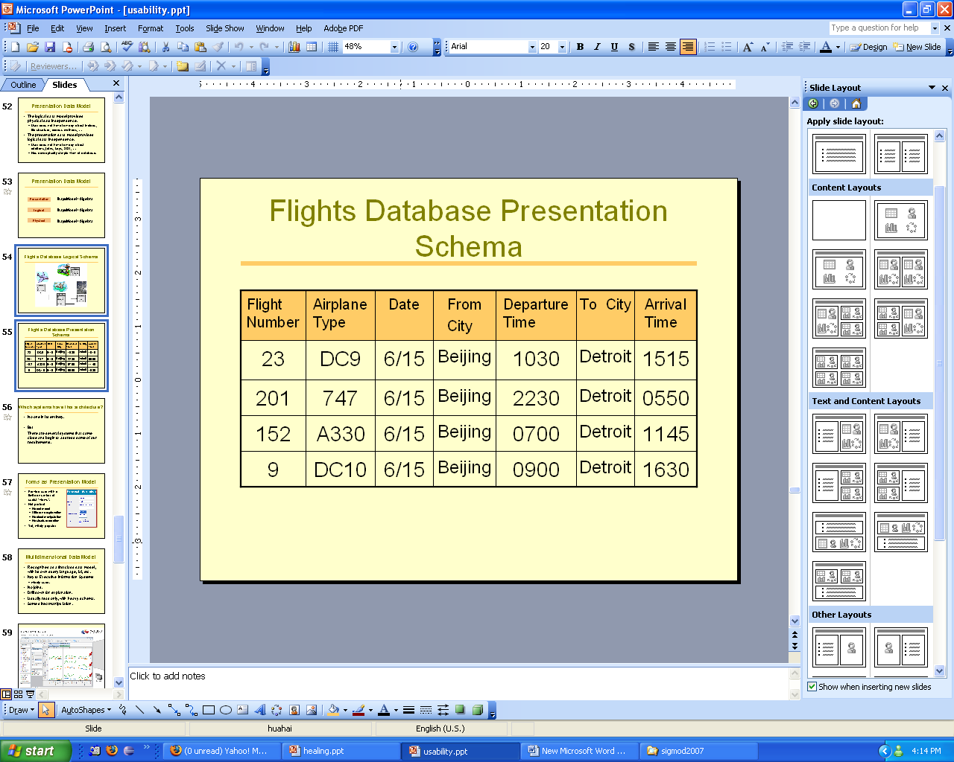
Flights Database Presentation Schema
Comprises multiple presentations.
Flight

Slide 54
Relieving Pain from Relations
User queries the concept of flight in this presentation.
  No need to understand the underlying joins
  No need even to know there are joins
  E.g., “Give me flights from Beijing to Detroit, leaving on June 15th afternoon.”
The system translates the presentation level query into the underlying logical query.

Slide 55
Relieving Pain From Options
The Flights “relation” allows far fewer queries (in a join-free manner) than is possible with arbitrary joins over the logical relations.
User (at most) specifies:
  Selection predicates;
  Attributes retained in projection.
Further restrictions may be appropriate.

Slide 56
Relief from Unexpected Pain
Explanations as first class citizens of presentation model.
Analogy with constraints in logical model.
When there are fewer ways of computing results, and these have been carefully selected, there is a lower likelihood for causing confusion.
Need to develop a theory of explanations.

Slide 57
Relief from Invisible Pain
Given a simple presentation model, it becomes possible to specify direct manipulation of results as new queries.
Flight Number | Airplane Type | Date | From City | Departure Time | To City | Arrival Time
201 | 747 | 6/15 | Beijing | 2230 | Detroit | 0550

Slide 58
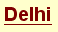
Relief from Invisible Pain
Given a simple presentation model, it becomes possible to specify direct manipulation of results as new queries.

Slide 59
Relief from Invisible Pain
Given a simple presentation model, it becomes possible to specify direct manipulation of results as new queries.
Flight Number | Airplane Type | Date | From City | Departure Time | To City | Arrival Time
275 | 767 | 6/15 | Beijing | 1000 | Delhi | 1345
277 | 767 | 6/15 | Beijing | 1800 | Delhi | 2150

Slide 60
Relief from Birthing Pain
Presentation schema also allows independence from the logical schema.
  User can manipulate the concept whenever necessary, and delay the materialization of the concept in the underlying logical schema.

Slide 61
Relief from Birthing Pain
Presentation Schema Evolution
Logical Schema Evolution
flight
001
flight
001

Slide 62
Relief from Birthing Pain
Presentation Schema Evolution
Logical Schema Evolution
flight | attribute name | attribute value
001 | from airport | PVG
001 | … | …
001 | arrival time | 2200
…
flight | from airport | to airport | depart time | arrival time
001 | PVG | DTW | 1000 | 2200
… | … | … | … | …
flight
001
flight
001

Slide 63
Relief from Birthing Pain
Presentation Schema Evolution
Logical Schema Evolution
flight | from airport | to airport | schedule
001 | PVG | DTW | P01
… | … | … | …
flight | attribute name | attribute value
001 | from airport | PVG
001 | … | …
001 | arrive time | 2200
…
flight | from airport | to airport | depart time | arrival time
001 | PVG | DTW | 1000 | 2200
… | … | … | … | …
schedule | depart time | arrival time
P01 | 1000 | 2200
… | … | …

Slide 64
Relieving the Birthing Pain
Presentation schema also allows independence from the logical schema.
  The user can manipulate the concept whenever necessary, and delay materialization of the concept in the underlying logical schema.
The logical schema evolves for better performance and data organization; the presentation schema evolves for better user interaction.

Slide 65
What a Presentation Model Is Not
Not an API definition
  Driven by human user interaction
Not user model, not conceptual model
  Not just something in the user’s head
  Computed, precise specification
Not just a set of views
  Has additional properties
Need not be relational, for an RDBMS.

Slide 66
Open Questions
Are all presentations for a database in the same data model?
If not, how do we manage consistency between presentations?
Can users modify presentations or define new presentations?
The value of a presentation layer for application program “users”, as opposed to human users.

Slide 67
Which systems have this architecture?
No one in its entirety.
But
There are several systems that come close and begin to address some of our requirements.

Slide 68
Forms as Presentation Model
Provide user with a limited number of useful “views”.
Not perfect:
  No real model;
  Little or no explanation;
  No direct manipulation;
  No structure creation.
Yet, wildly popular.

Slide 69
Multidimensional Data Model
Recognized as a first class data model, with its own query language, UI, etc.
Key to Executive Information Systems
  widely used.
No joins.
Drill down for explanation.
Usually read only, with heavy schema.
Some direct manipulation.

Slide 70
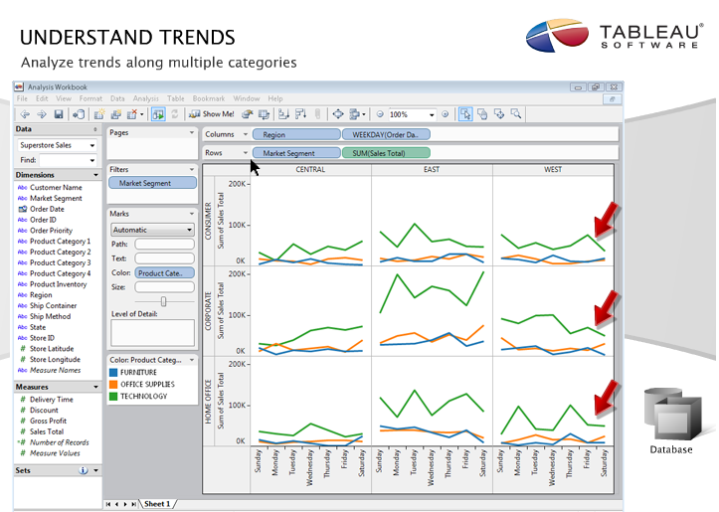

Slide 71
Spreadsheet Presentation
Immensely popular for simple data representation and manipulation.
Desired UI for multidimensional systems.
Join-free.
Direct manipulation.
Somewhat extensible structure.
Limited explanation.
Still too many options.

Slide 72
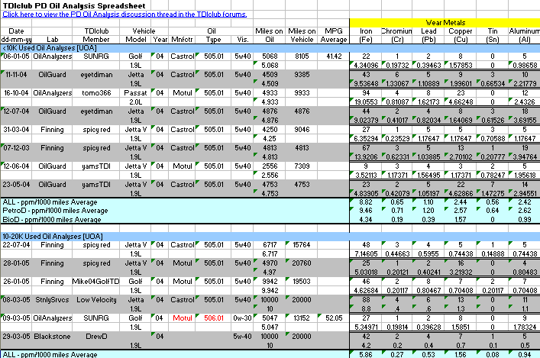
A Spreadsheet

Slide 73
Many Other Models
Network presentation
Geographic presentation
  Mash-ups
…
Usually not fully developed models.
Don’t meet all desiderata.
But are good starting points.

Slide 74
Conclusion
A usable data management system must have, at the presentation level:
  No joins
  Limited options
  Adequate explanation
  Direct manipulation
  Casual schema

