Slide 1
Trust Me, I’m Partially Right: Incremental Visualization Lets Analysts Explore Large Datasets Faster
Shengliang Dai

Slide 2
Background
Queries over large scale (petabyte) data bases often mean waiting overnight for a result to come back.
Scale costs time. Potential avenues of exploration are ignored because the costs are perceived to be too high to run or even propose them.
SampleAction:
Accelerate and open up the query process with incremental visualizations.

Slide 3
Problems
Trading off speed of exploring and richness of questions for time and resources when running queries over vast arrays of data.
The number and types of queries are still restricted.
Incremental queries: Analysts are accustomed to seeing precise figures, rather than probabilistic results

Slide 4
Goals
In order to let incremental analysis to be a viable technique
Complementing technical aspects of the back-end with an investigation of the interaction design
Visualize estimates on incremental data.

Slide 5
METHOD
Hypothesis:
Users working with incremental visualizations will be able to interpret the confidence intervals comfortably.
This will allow them to act rapidly on their queries.
Incremental results will allow users to carry out exploratory queries.
SampleAction
Simulating the experience of using a very large dataset.
Incrementally displaying results based on ever-larger portions of the dataset.

Slide 6
SampleAction
Simulating the effects of interacting with very large datasets while supporting an iterative query interaction for large aggregates.
Error bars: show the values of the estimate.

Slide 8
SampleAction shows how the bounds are changing over time

Slide 9
Bounded uncertainty based on samples

Slide 10
The Back-End Database
Industrial DBMS do not currently support incremental queries of the type required
Constraine this initial evaluation to deploying sampleAction on a database small enough to query interactively:

Slide 11
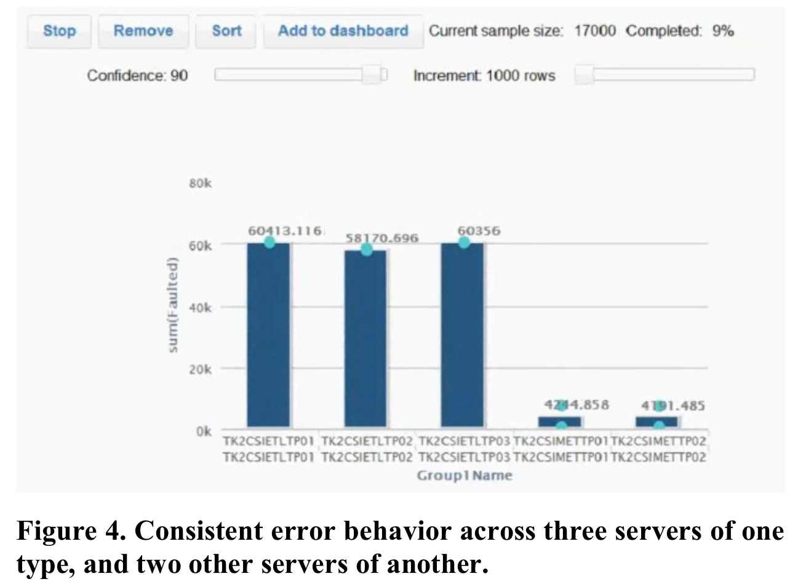
USER STUDY
Bob: Server Operations
Allan: Online Game Reporting
Sam: Twitter Analytics

Slide 12
ANALYSIS
The value of seeing a first record fast
users found value in getting a quick response to their queries:
Sam and Allan realized they had entered an incorrect query, and were able to repair it quickly by adding appropriate filters.

Slide 13
ANALYSIS
New Behaviors around Data
data in a static, non-interactive form
real exploration of the dataset
If the first few samples had not converged, they would decide whether it was worth the trade-off of waiting longer, sometimes checking the convergence view to decide.

Slide 14
ANALYSIS
Difficulties with Error Bar Convergence
Big variance
Past literature on visualizing uncertainty has emphasized visualizations that fit the entire uncertainty range on screen; these were not sufficient for some of bounds.
Noisy values
Incremental systems can be slowed by datasets that are not clean.
Solution: Using additional domain knowledge during the execution, such as discarding values that fall outside meaningful constraints

Slide 15
ANALYSIS
Non-Expert Views of Confidence Intervals
Error bars sometimes are confusing for users.
For example, the interval would shrink toward a converged value.
Two very different adjacent columns might have identical confidence intervals.

Slide 16
Implications
Users seem to be able to interpret confidence intervals, which opens opportunities for using uncertainty visualization tied to probabilistic datasets.

Slide 17
Limitations of Incremental Visualization
There some genres of queries that are structurally going to be difficult.
Outlier Values
For example, there is no probabilistic answer to “which item has the highest value”.
Table Joins
When joins against a rare or unique key, using samples from joining tables may not work at all.

Slide 18
Future Work
Representations of confidence, eliminating downsides of error bars
More types of visualizations
More types of data analysis

Slide 19
Conclusion
While the concept of approximate queries has been known for some time, the visualization implications have not been explored with users.
Showing the utility of these approximations will encourage further research on both the front- and back-ends of these systems.
HCI researchers have also been limited in their ability to explore these concepts. Simulating large data systems may help them explore realistic front-ends without needing to build full-scale computation back-ends.

