Slide 1
Human-powered Sorts and Joins

Slide 2
At a high level
Yet another paper on crowd-algorithms
  Probably the second to be published (so keep that in mind when you think about kinks in the paper)
If the previous paper(s) can be viewed as “theoretical”, this paper definitely falls on the “practical” side.
  Lots of “practical” advice and algorithms
  Testing on real crowds
Hard to point at “one” algorithm here because there are multiple problems, optimizations and ideas.

Slide 3
Three Key Components
Their system, Qurk
Sorting
Joins

Slide 4
Qurk
Declarative “workflow” system encapsulating human predicates as UDFs
  User-defined functions
  Commonly also used by relational databases to capture operations outside relational algebra
  Typically external API calls
We’ll see other comparable systems later on

Slide 5
Why such a system?

Slide 6
Why such a system?
Take away repeatable code and redundancy
Lack of manual optimization
Less cumbersome to specify

Slide 7
Query model
SQL

Slide 8


Qurk filter: inappropriate content
photos(id PRIMARY KEY, picture IMAGE)
Query =SELECT * FROM photos WHERE
isSmiling(photos.picture);
UDF
First paper to represent crowd calls as UDF invocations!

Slide 9
UDFs as Tasks
Instead of writing code for UDFs, can be described at a high level using Tasks
Tasks = High level-templates for commonly occurring crowd-operations and or algorithms
Filter, Generate, Sort, Joins

Slide 10
TASK isSmiling(picture)
Prompt: “<img src=‘%s’><br>
Is the cat above
smiling?”, picture
Combiner: MajorityVote
TYPE Filter:
Note: here, a task is an interface description for a crowd operation PER ITEM, coupled with accuracy combiner PER ITEM …
In Crowdscreen, we had accuracy OVERALL and we expected the system to guarantee it.
Generate
Sort
Join
Group
…

Slide 11
QualityAdjust
Yet another primitive they leverage from prior work
  Using the EM (Expectation Maximization) algorithm
  Repeated iterations until convergence

Slide 12
Is the cat above smiling?
Yes
No
Is the cat above smiling?
Yes
No

Slide 13
Template: Generative
Goal: labels, text passages, ph. no., open-ended answers (e.g., enumeration)

Slide 14
At its heart…
Generate/Filter
  sequence of questions (one per tuple)
  “procedure” for solving each question
  per question cost
  per question procedure
Sort/Join is different…

Slide 15
SORTS/JOINS is somewhat confusing…
This is no longer a task PER ITEM; you’re sorting a group of items!
Why specify accuracy (i.e., combiner function) for FILTER but not for RANK?
What guarantees will you get? How much are you spending?

Slide 16
Joins: the possibly clause
Akin to “hints” for the optimizer
Is this confusing?

Slide 17
MTurk
User
Queries
Results
Compiled
HITs
Statistics Manager
Query Optimizer
HIT results
Results
Task Manager
Results
Executor
HIT Compiler
Task₄
Task₅
Task₆
a₁
a₂
σ
b₁
in_{A}
in_{B}
Internal
HIT
Tasks
A
B
Task Cache
Saved Results
Input Data
DB

Slide 18
Some drawbacks…
Qurk (somewhat) sweeps accuracy and latency under the rug, in favor of cost.
  Qurk may be better designed to reason about accuracy than the user
  Should we always use MV per question, or should we have fewer instances spread across many questions (e.g., in ranking)
Even for cost, it is not clear how to specify this in a query, and how the system should use this across operators…

Slide 19
Three Key Components
Their system, Qurk
Sorting
Joins

Slide 20

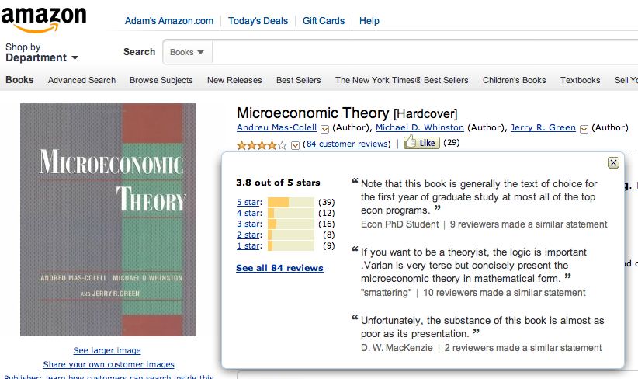
Sort
Super Important problem!

Slide 21
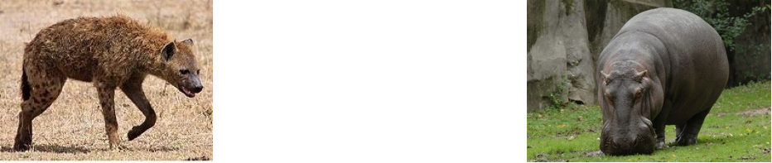
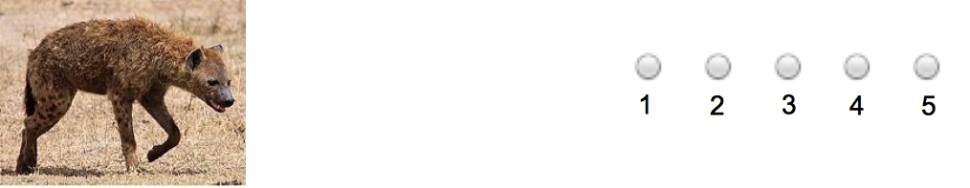
Interfaces
The first paper to clearly articulate the use of multiple interfaces to get similar data!
Comparison
more
dangerous?
Rating
how
dangerous?

Slide 22
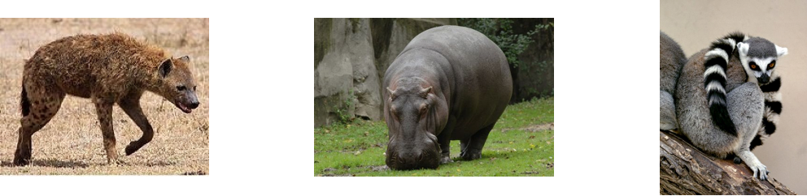
Batching
Novel Idea!
<
<

Slide 23
Problems with batching …
In some cases, same effect as batching can be achieved by simply reducing cost per task.
  Is this true?
How far can we go with this?
  Exploitative?

Slide 24
What are other issues with batching?

Slide 25
What are other issues with batching?
Correlated answers?
Fatigue?
Why is batching still done?
Instructions provided once: saved time/cost
Force all workers to attempt all questions (e.g., in a survey)

Slide 26
Measuring Quality of Results
  Kendall’s Tau rank correlation
  Range: [-1, 1]
a b c d
d c b a
a b c d
a b c d
-1
1

Slide 27

Completely Comparison-Based
  Tau = 1 (completely accurate)
  O(# items²)
  Q: Do we really need O(# items²)?
    Paper argues that cycles may be present and hence quicksort-like algorithms will not work.

Slide 28
Completely Comparison-Based
  Tau = 1 (completely accurate)
  O(# items²)
  Q: Do we really need O(# items²)?
    Paper argues that cycles may be present and hence quicksort-like algorithms will not work.
    But we can certainly repeat each question multiple times!
    Cn log n may still be < n²

Slide 29
Completely Comparison-Based
  Tau = 1 (completely accurate)
  O(# items²)
Completely Rating-Based
  Tau ≈ 0.8 (accurate)
  O(# items)
  Q: What if I scale up the number of ratings per item, can I approach quality of Comparison-based tasks?
  Interesting experiment!

Slide 30
Hybrid Schemes
First, gather a bunch of ratings
Order based on average ratings
Then, use comparisons, in one of three flavors:
  Random: pick S items, compare
  Confidence-based: pick most confusing “window”, compare that first, repeat
  Sliding-window: for all windows, compare

Slide 31
Notes:
/Users/marcua/adamdata/documents/research/mturkoutrageous/vldb2011-sortjoin/data/sort-hybrid-squares.xlsx

Slide 32
Notes:
/Users/marcua/adamdata/documents/research/mturkoutrageous/vldb2011-sortjoin/data/sort-hybrid-squares.xlsx

Slide 33
Results
Sliding Window > Confidence > Random
Weird results for window = 6 and 5 …

Slide 34
Can you think of other Hybrid Schemes?

Slide 35
Can you think of other Hybrid Schemes?
1: Divide ratings up into 10 overlapping buckets, compare all pairs in each bucket
2: Start with the current sort and compare pairs of items, and keep comparing pairs
3: Use variance to determine windows; e.g., an item is compared to all other items that its score +/- variance overlaps with.

Slide 36
Fail fast on bug or ambiguous task?
  Fleiss’ Kappa (inter-rater agreement)
  Range: [0, 1]

Slide 37
Ambiguity
less ambiguous
more ambiguous
adult size
dangerousness
likelihood to
be on saturn

Slide 39
Sort summary
2-10x cost reduction
Exploit humans’ ability to batch (but how does this affect price?)
Quality signal: tau
Fail fast signal: kappa
Hybrid algorithms balance accuracy, price

Slide 40
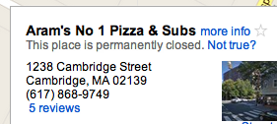
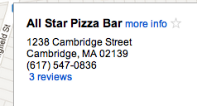
Join: human-powered entity resolution
International Business Machines
==
IBM

Slide 41
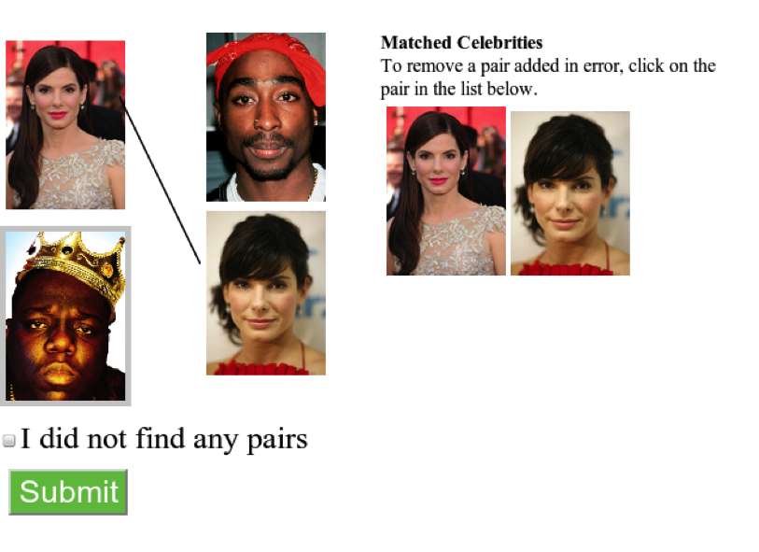

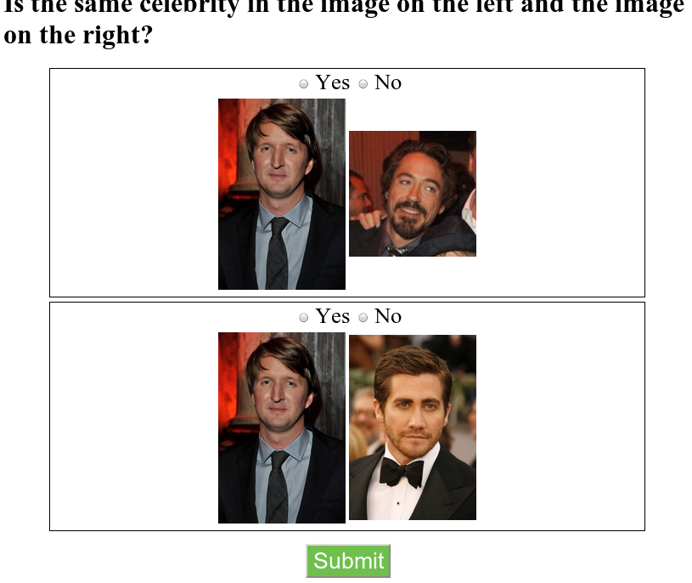
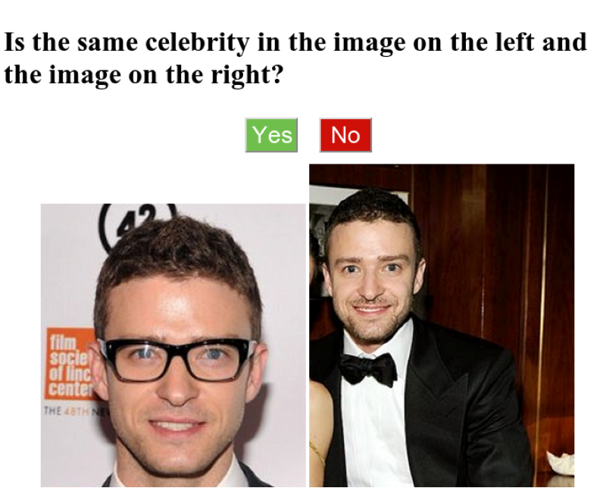
Matching celebrities

Slide 42
Simple join O(nm)

Slide 43
Naïve batching join O(nm/b)

Slide 44
Smart join O(nm/b²)
4-10x reduction in cost
Errors??

Slide 45
Can you think of better join algorithms?

Slide 46
Can you think of better join algorithms?
Exploit Transitivity!
Intuition: if
A joins with X
A does not join with Y
And
B joins with X
do we need to compare B and Y?
How much does skipping comparisons save us?

Slide 47
Join heuristics
gender
hair color
skin color
50-66% reduction in cost

Slide 48
Could go wrong!
If there are cases where
  Feature is ambiguous
  Feature equality does not imply join/not join
  Selectivity is not helpful

Slide 49
Q: What other techniques could help us?
Still O(n) to get these feature values
Machine learning?
  How do we apply it?

Slide 50
Q: What other techniques could help us?
Still O(n) to get these feature values
Machine learning?
  How do we apply it?
  Maybe use input as labeled data, and learn on other features?
  Maybe use the crowd to provide features?

Slide 51
Could features help in sorting?

Slide 52
Could features help in sorting?
E.g., if pictures taken outside are always better than pictures taken inside, then can you have that as a “feature”
  Can it be better than ratings?

Slide 53
Join summary
10-25x cost reduction
Exploit humans’ ability to batch
Feature extraction/learning to reduce work

Slide 54
Summary
System + workflow model: Qurk
Sort: 2-10x cost reduction
Join: 10-25x cost reduction

Slide 55
Exposition-Wise…
What could the paper have done better?
  Maybe get rid of Qurk altogether?
  More rigorous experiments?
  Other ideas?

Slide 56
Other Open Issues
Hard to extrapolate accuracy, latency, cost from a few experiments of 100 items each
Cannot reason about batch-size independent of cost per HIT
Not clear how batching affects quality
Not clear how results generalize to other scenarios

Slide 57
Questions/Comments?

Slide 58
Discussion Questions
Q: How can you help requesters reduce costs?

Slide 59
Discussion Questions
Q: How can you help requesters reduce costs?
Use optimized strategies
Batching + Reduce Price
Improve instructions & interfaces
Training and elimination
Only allow good workers to work on tasks
Use machine learning

Slide 60
Discussion Questions
Q. What are the different ways crowd algorithms like this can be used in conjunction with machine learning?

Slide 61
Discussion Questions
Q. What are the different ways crowd algorithms like this can be used in conjunction with machine learning?
Input/training
Active learning
ML feeds crowds

Slide 62
Discussion Questions
Q: How would you go about gauging human error rates on a batch of filtering tasks that you’ve never seen before?

Slide 63
Discussion Questions
Q: How would you go about gauging human error rates on a batch of filtering tasks that you’ve never seen before?
You could have the “requester” create “gold standard” questions, but hard: people learn, high cost, doesn’t capture all issues
You could try to use “majority” rule but what about difficulty, what about expertise?

Slide 64
30x30 Join
4-10x reduction in cost

Slide 65
Majority Vote vs. Quality Adjust
Simple Join: .933 vs .967
Naive Batch 10: .6 vs .867
Smart Batch 3 x 3: .5 vs .867

Slide 67
30x30 Join

Slide 68
Common questions in crowdsourcing
latency?
workflow design?
integration?
$/worker?
# workers?
worker quality?
correct answer?
design patterns?

