Slide 1
SeeDB

Slide 2
Data Visualizations
Data analyst studying census data
age, education, marital-status, sex, race, income, hours-worked etc.
  A = # attributes in table
Task: Compare on various socioeconomic indicators, unmarried adults vs. all adults
1st step in data analysis: visualization

Slide 3
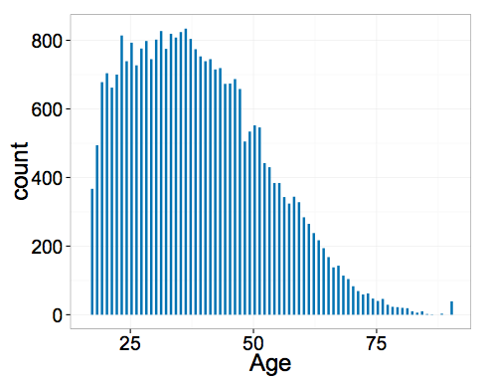
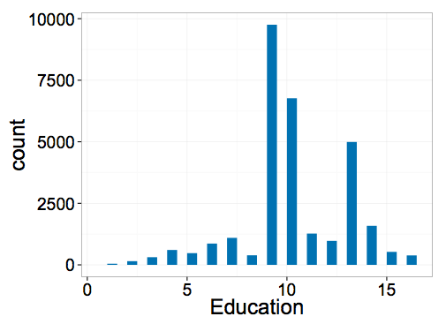
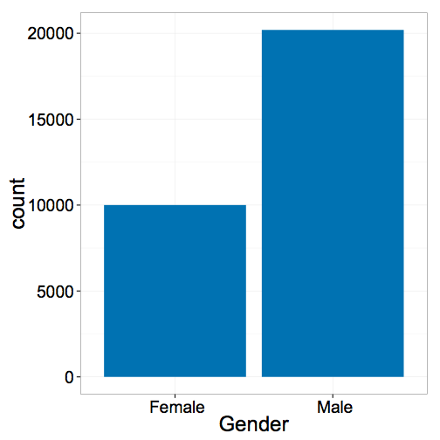
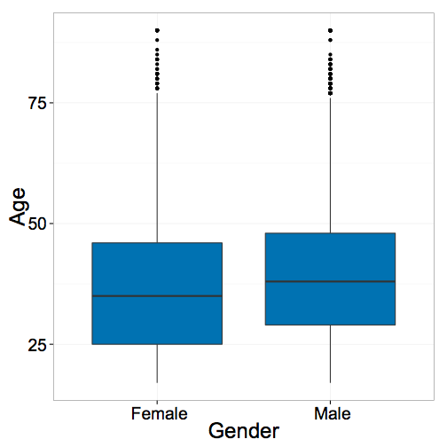
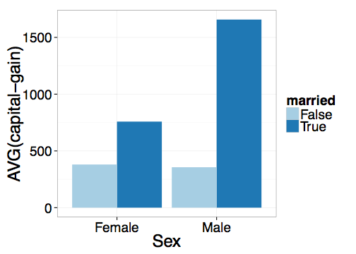
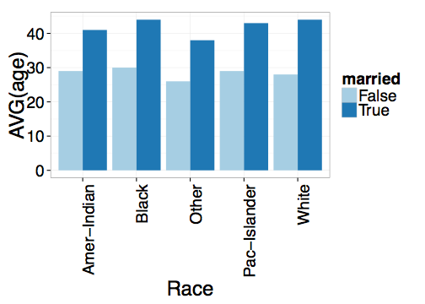
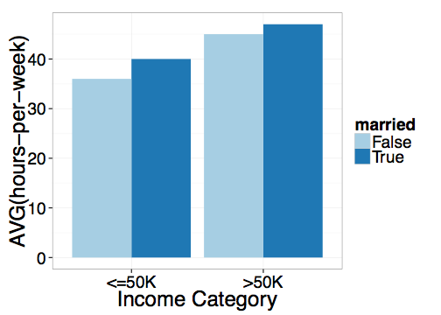
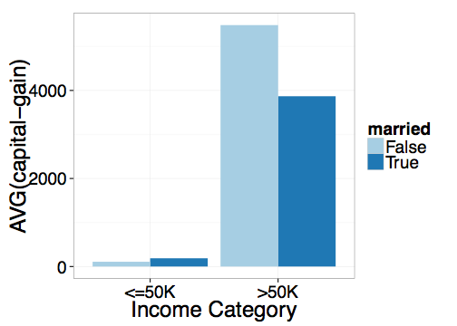
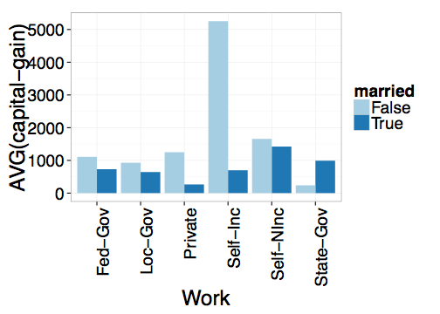
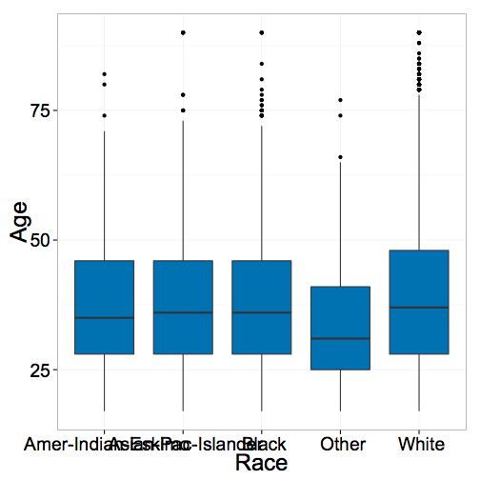
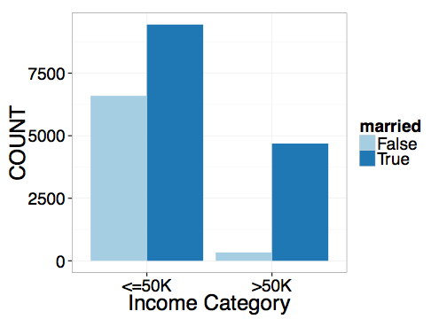
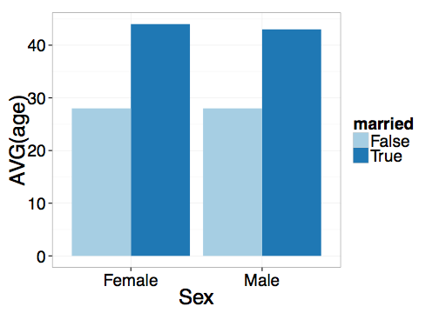
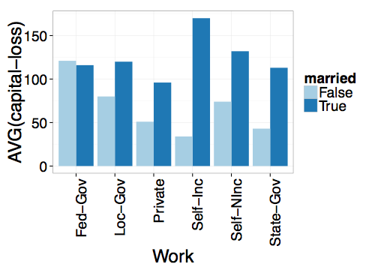
Standard Visual Data Analysis Recipe:
Consider every combination of attributes
  Generate a visualization
  Compare unmarried w/ rest
  Repeat until you find insights

Slide 4

Tedious and Time-consuming!
Notes:
Manually specifying a large number of visualizations is slow and tedious; also reviewing each visualization slows down the analysis process.

Slide 5
Too many visualizations to consider
Too many attributes

Slide 6
One Possible Solution
SeeDB: A Visualization Recommendation Tool

Slide 7
Outline
Scalable Visualization Recommendations
  Space of visualizations considered by SeeDB
  Building SeeDB
  Evaluating SeeDB

Slide 8
Related Work
Visualization tools:
  ManyEyes, Tableau/Polaris, Fusion Tables, Spotfire
  Tableau and Spotfire recommendations (Aesthetics)
Some Automation: VizDeck, Profiler, Voyager
Notes:
Finding trends in data and suggesting visualizations have both been studied extensively in the data mining literature as well as in some recent visualization tools
Data mining work examples
The closest to our work is in fact some early work don’t by Tukey on diagnostics for scatterplot (aka skagnostics)
Recent tools have also explored this space

Slide 9
SeeDB: a Visualization Recommendation System
Given a dataset and a task, automatically produce a set of visualizations that are
the most “interesting” given the task

Slide 10
Space of Visualizations
For simplicity, assume a single table (star schema)
Visualizations = agg. + grp. by queries
Vi = SELECT d, f(m)
FROM table
WHERE ___
GROUP BY d
(d, m, f):
dimension, measure, aggregate
Notes:
Why visualization vs. data mining?

Slide 11
Space of Visualizations
Vi = SELECT d, f(m)
FROM table
WHERE ___
GROUP BY d
(d, m, f):
dimension, measure, aggregate
{d} : race, work-type, sex etc.
{m} : capital-gain, capital-loss, hours-per-week
{f} : COUNT, SUM, AVG

Slide 12
Building SeeDB: Questions
Interestingness: How do we determine if a visualization is interesting?
  Utility Metric
Scale: How to make recommendations efficiently and interactively?
  Optimizations

Slide 13
Deviation-based Utility Metric
A visualization is interesting if it displays
a large deviation from some reference
Task: compare unmarried adults with all adults
Target
Reference
V1 = SELECT d, f(m) FROM table WHERE target GROUP BY d
V2 = SELECT d, f(m) FROM table WHERE reference GROUP BY d
V₁
V₁
Compare induced probability distributions!
V₂
V₂

Slide 14
Deviation-based Utility Metric
A visualization is interesting if it displays
a large deviation from some reference
Many metrics for computing distance between distributions
D [P( V1), P(V2)]
Earth mover’s distance
L1, L2 distance
K-L divergence
Any distance metric b/n distributions is OK!
V₁
V₂

Slide 15
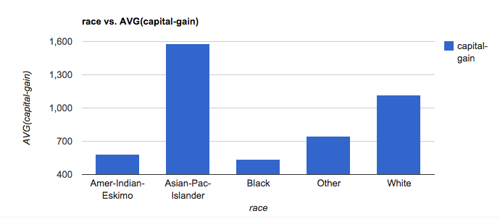
Computing Expected Trend
Race vs. AVG(capital-gain)
_{Reference Trend}
SELECT race, AVG(capital-gain) FROM census GROUP BY race
P(V₁)
Expected
Distribution
Notes:
So concretely, it means that deviations from expected trends are interesting and we use deviation as a proxy for the quality of the visualization.
What happens if we normalize the columns between 0 – 1?

Slide 16
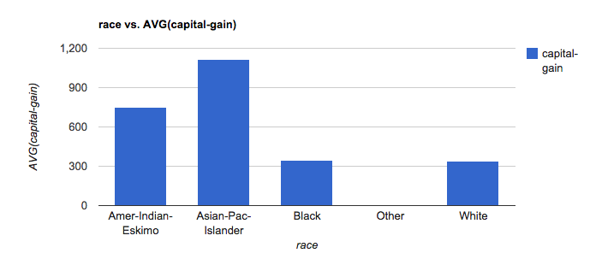
Computing Actual Trend
Race vs. AVG(capital-gain)
_{Target Trend}
SELECT race, AVG(capital-gain) FROM census GROUP BY race WHERE marital-status=‘unmarried’
P(V₂)
Actual
Distribution
Notes:
So concretely, it means that deviations from expected trends are interesting and we use deviation as a proxy for the quality of the visualization.
What happens if we normalize the columns between 0 – 1?

Slide 17
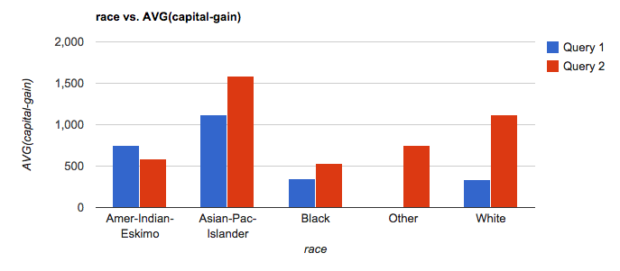
Computing Utility
U = D[P(V₁) , P(V₂)]
D = EMD, L2 etc.
Actual
Expected
Notes:
So concretely, it means that deviations from expected trends are interesting and we use deviation as a proxy for the quality of the visualization.
What happens if we normalize the columns between 0 – 1?

Slide 18

Low Utility Visualization
Actual
Expected
Notes:
More columns

Slide 19
High Utility Visualization
Actual
Expected

Slide 20
What else?
SeeDB opts for deviation from a reference as a utility metric. What else could we use?

Slide 21
Utility Metric: 5 axes
Data characteristics
Task or Insight
Semantics and Domain Knowledge
Visual Ease of Understanding
User Preference
Maximize Surprise (via deviation)
Current Work
Not the current focus

Slide 22
Why not?
When would a deviation-based metric not make sense?

Slide 23
Problem Statement
Across all (d, m, f), where
V1 = SELECT d, f(m) FROM table WHERE target GROUP BY d
V2 = SELECT d, f(m) FROM table WHERE reference GROUP BY d
Vi = (d: dimension, m: measure, f: aggregate)
10s of dimensions, 10s of measures, handful of aggregates
2* d * m * f
➔ 100s of queries for a single user task!
Goal: return k best utility visualizations (d, m, f),
(those with largest D[V1, V2])
Notes:
Now that we’ve described the utility metric, ready to formally state our problem

Slide 24
Problem Statement
Across all (d, m, f), where
V1 = SELECT d, f(m) FROM table WHERE target GROUP BY d
V2 = SELECT d, f(m) FROM table WHERE reference GROUP BY d
Vi = (d: dimension, m: measure, f: aggregate)
10s of dimensions, 10s of measures, handful of aggregates
2* d * m * f
100s of queries for a single user task!
Can be even larger. How?
Goal: return k best utility visualizations (d, m, f),
(those with largest D[V1, V2])
Notes:
Now that we’ve described the utility metric, ready to formally state our problem

Slide 25
Even larger space of queries
Binning
3 dimensional or 4 dimensional visualizations
Scatterplot or map visualizations
…
For simplicity, let’s stick to the current set …
Notes:
Could be even larger if we consider

Slide 26
Task
Visualizations
Utility Metric
Transformation
Queries (100s)
Optimizer
Notes:
Overall flow of our system

Slide 27
Naïve Approach
For each (d, m, f) in sequence
evaluate queries for V1 (target), V2 (reference)
compute D[V1, V2]
Return the k (d, m, f) with largest D values
Too long!!

Slide 28
Issues w/ Naïve Approach
Repeated processing of same data in sequence across queries
Computation wasted on low-utility visualizations
Sharing
Pruning

Slide 29
Systems-level optimizations
Each visualization = 2 SQL queries
Latency > 100s
Minimize number of queries and scans
Notes:
Every visualization that we consider corresponds to two DBMS queries on the underlying data.
Even if we prune data, we cannot imagine to achieve interactive latencies without optimizing DBMS queries.
We do so using simple but effective techniques from multi-query optimization. Specifically we adopt the following strategies.
I will describe the bin-packing strategy here but I’d be happy to discuss the others offline.

Slide 30
Systems-level optimizations
Combine aggregate queries on target and ref
Combine multiple aggregates
  (d1, m1, f1), (d1, m2, f1) → (d1, [m1, m2], f1)
Combine multiple group-bys*
  (d1, m1, f1), (d2, m1, f1) → ([d1, d2], m1, f1)
  Could be problematic…
Parallel Query Execution
Notes:
Every visualization that we consider corresponds to two DBMS queries on the underlying data.
Even if we prune data, we cannot imagine to achieve interactive latencies without optimizing DBMS queries.
We do so using simple but effective techniques from multi-query optimization. Specifically we adopt the following strategies.
I will describe the bin-packing strategy here but I’d be happy to discuss the others offline.

Slide 31
Combining Multiple Group-bys
Too few group-bys leads to many table scans
Too many group-bys hurt performance
  # groups = Π (# distinct values per attributes)
Optimal group-by combination ≈ bin-packing
  Bin volume = log S (max number of groups)
  Volume of items (attributes) = log (|a_{i}|)
  Minimize # bins s.t.
  Σ_{i} log (|a_{i}|) <= log S

Slide 32
Pruning Optimizations
Discard low-utility views early to avoid wasted computation
Keep running estimates of utility
Prune visualizations based on estimates
  Two flavors
    Vanilla Confidence Interval based Pruning
    Multi-armed Bandit Pruning

Slide 33
Multi-Armed Bandit
Slot
Machines
S1
S3
Sn
S1
S2
S3
S4
…
Sn
Reward
Distributions
R1
R2
R3
R4
Rn
Estimates
r1
r2
r3
r4
rn
Which machines to play and in what order to maximize reward?
Notes:
Add picture of prob distributions

Slide 34
Multi-Armed Bandit
Slot
Machines
S1
S2
S3
S4
…
Sn
Reward
Distributions
R1
R2
R3
R4
Rn
Estimates
r1
r2
r3
r4
rn
Use estimates to guide choice of machine
Notes:
Add picture of prob distributions

Slide 35
Multi-Armed Bandit Pruning
Visual-izations
V1
V3
Vn
V1
V2
V3
V4
…
Vn
Utilities
U1
U2
U3
U4
Un
Estimates
u1
u2
u3
u4
un
Rank views by utility
Compute various D
Discard V_{n} or accept V₁
Find maximum utility views

Slide 36
Interleaving Optimizations
Query Execution
Phase 1
Pruning
Query Execution
Phase 2
Pruning
Query Execution
Phase 3
Notes:
The pruning and systems optimizations are independent but must work together in order to provide acceptable latencies.
Therefore, we combine these optimizations by implementing a simple phased system.
During each phase, we apply systems optimizations to execute queries corresponding to the still viable visualizations.
At the end of each phase, we use pruning to eliminate low-utility visualizations.
Thus, we take advantage of both the pruning and sharing power of our optimizations
Why not sampling?

Slide 37
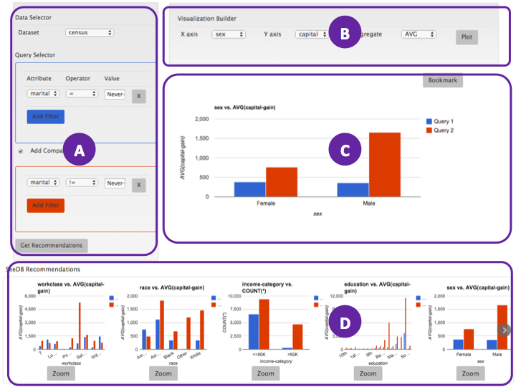
Visualizations
Middleware
Layer
Queries (100s)
Optimizer
DBMS
Sharing
Pruning
Notes:
Overall architecture
Middleware layer that sits between the UI and the DBMS
User task (compare married/un) is broken down into a collection of q;
Optimizer handles these q using a combination of … optimizations and makes repeated q to the DBMS

Slide 38
Manual Visualization Builder
Task Specification
Visualization Pane
Recommendation Bar

Slide 39
Evaluation: Performance
Metrics:
Time: Performance benefits of sharing and pruning
Accuracy: Impact of pruning on accuracy
Techniques:
All optimizations with early termination (COMB_EARLY)
All optimizations (COMB)
Only pruning (CI, MAB)
Only sharing (SHARING)
Baseline: Sequential Execution (NO_OPT)
Backend: Row/Column store
Datasets: Synthetic and Real; varying sizes, # attributes
Notes:
Small subset of results

Slide 40
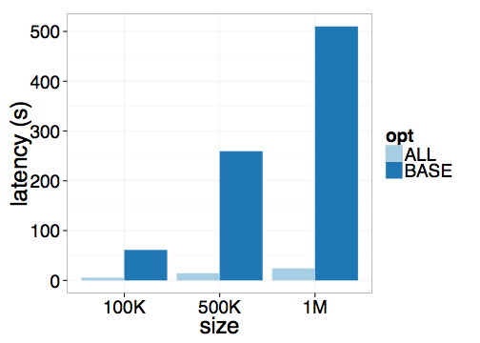
Sharing Performance
NO_OPT takes >500s for medium-sized dataset
6 — 40X speedup from all sharing optimizations
NO_OPT
SHARING
Notes:
Maybe add a break slide saying evaluation

Slide 41
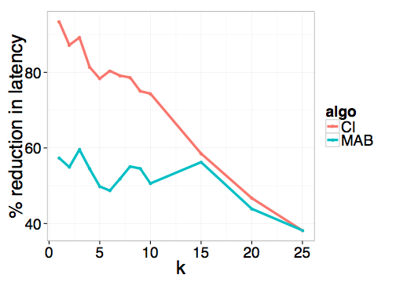
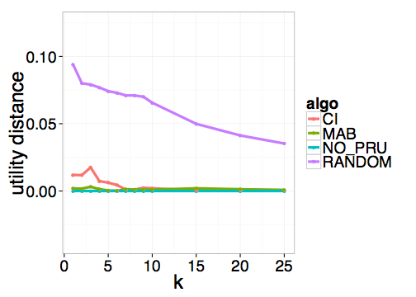
Pruning Performance
Pruning reduces latency by over 50% for k <= 15
without loss of accuracy

Slide 42
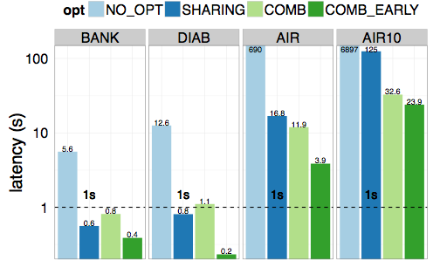
All together now
4 real datasets
50X — 300X speedup for ROW: <1s for SM, 4s for L

Slide 43
User Study
Part I : Validate utility metric vs. other metrics
  See paper!
Part II : Study impact of recommendations
  H1: SeeDB finds interesting visualizations faster
  H2: Users prefer tool w/recommendations

Slide 44
Manual
SeeDB
  16 participants, 45 min study
  Metrics: # charts, # bookmarks, survey questions

Slide 45
I. SeeDB enables faster analysis
 | # charts | # bookmarks | bookmark rate
Manual | 6.3 +/- 3.8 | 1.1 +/- 1.45 | 0.14 +/- 0.16
SeeDB | 10.8 +/- 4.41 | 3.4 +/- 1.35 | 0.43 +/- 0.23
Users view more visualizations with SeeDB
Users bookmark more visualizations with SeeDB
Bookmark rate 3X higher with SeeDB

Slide 46
II. Users prefer SeeDB
100% users prefer SeeDB over Manual
79% find recommendations “Helpful” or “Very Helpful”
87% find recommendations speed up visual analysis

Slide 47
II. Users Prefer SeeDB
  100% users prefer SeeDB over Manual
  “. . . quickly deciding what correlations are relevant” and “[analyze] . . . a new dataset quickly”
  “. . . great tool for proposing a set of initial queries for a dataset”
  “. . . potential downside may be that it made me lazy so I didn’t bother thinking as much about what I really could study or be interested in”
Notes:
Note of caution

Slide 48
SeeDB
Deviation-based Utility Metric
Sharing and pruning optimizations
Optimizations provide 50X — 300X speedup
SeeDB enables faster/more analysis
Users prefer recommendations

Slide 49
How could the paper be improved?

