Slide 1
Resilient Distributed Datasets: A Fault-Tolerant Abstraction for In-Memory Cluster Computing
Matei Zaharia, Mosharaf Chowdhury, Tathagata Das, Ankur Dave, Justin Ma, Murphy McCauley, Michael J. Franklin, Scott Shenker, Ion Stoica
712 citations
Notes:
Implementation on spark makes it very useful

Slide 2
Motivation
Map reduce based tasks are slow
Sharing of data across jobs is stable storage
Replication of data and disk I/O
Support iterative algorithms
Support interactive data mining tools – search

Slide 3
Existing literature on large distributed algorithms on clusters
General : Language-integrated “distributed dataset” API, but cannot share datasets efficiently across queries
Map Reduce
Map
Shuffle
Reduce
DyradLinq
Ciel
Specific : Specialized models; can’t run arbitrary / ad-hoc queries
Pregel – Google’s graph based
Haloop – iterative Hadoop
Notes:
Map - Each worker node applies the "map()" function to the local data, and writes the output to a temporary storage. A master node orchestrates that for redundant copies of input data, only one is processed.
Shuffle - Worker nodes redistribute data based on the output keys (produced by the "map()" function), such that all data belonging to one key is located on the same worker node.
Reduce - Worker nodes now process each group of output data, per key, in parallel.
Example : Count number of occurrence of words in text

Slide 4
(Cont)
Caching systems
Nectar – Automatic expression caching, but over distributed FS
Ciel – not explicit control over cached data
PacMan - Memory cache for HDFS, but writes still go to network/disk
Lineage
To track dependency of task information across a DAG of tasks

Slide 5
Resilient Distributed Datasets (RDDs)
Restricted form of distributed shared memory
Read only/ Immutable , partitioned collections of records
Deterministic
From coarse grained operations (map, filter, join, etc.)
From stable storage or other RDDs
User controlled persistence
User controlled partitioning
Notes:
Persistence - Users can specify which which RDD to keep in memory for later use
Partitioning – User can specify the hash over the clusters to use the

Slide 6
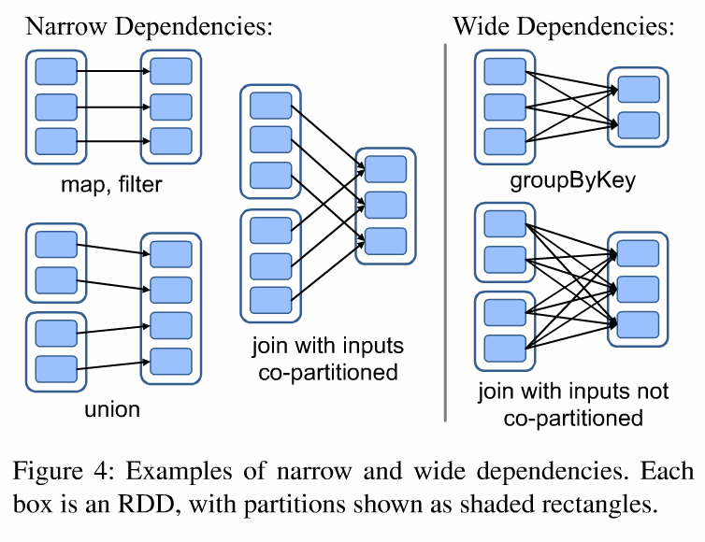
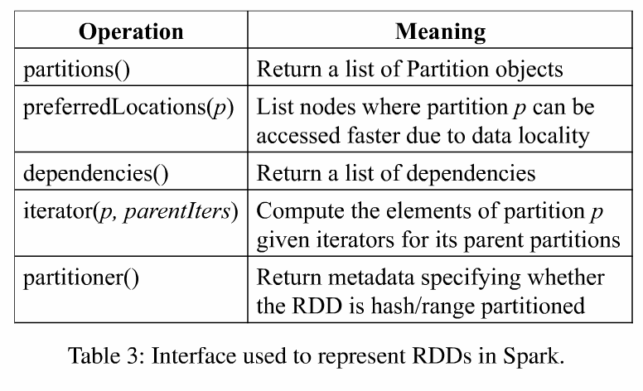
Representing RDDs
No need of check pointing
Checkpointing
Notes:
Partitions are atomic pieces of dataset
Dependency – set of function for computing on parent RDD
Partitioner – data placement
As a consequence of this, all standard issues related to main memory management comes up here – such a LRU, fault tolerance, checkpointed
partitions returns one partition for each block of the file (with the block’s offset stored in each Partition object), preferredLocations gives the nodes the block is on, and iterator reads the block.

Slide 7
Spark programming interface
Lazy operations
Transformations not done until action
Operations on RDDs
Transformations - build new RDDs
Actions - compute and output results
Partitioning – layout across nodes
Persistence – storage in RAM / Disc

Slide 8
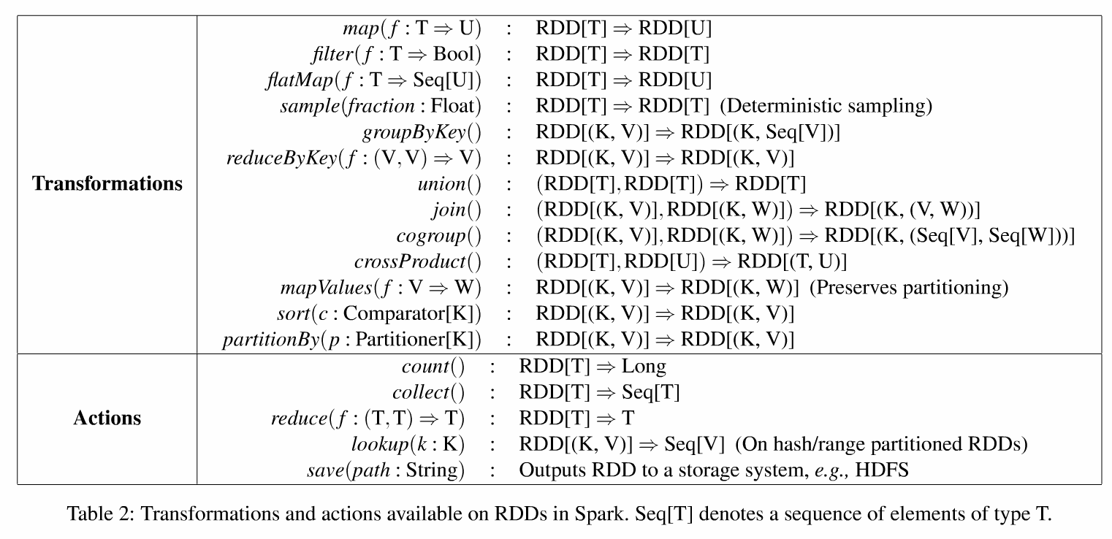
RDD on Spark
Notes:
Reduce by key is kind of aggregation on the sequence V

Slide 9
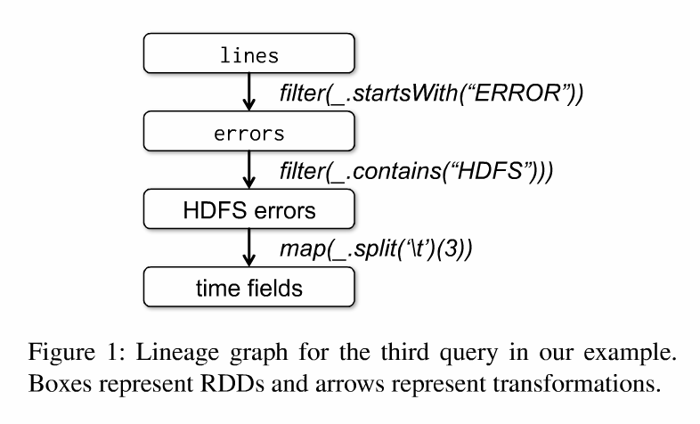
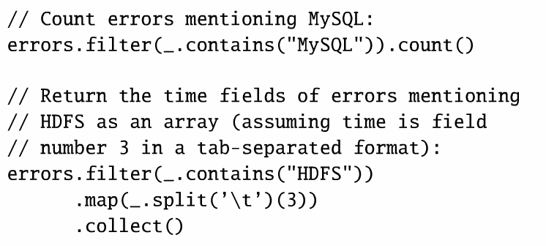
Example : Console Log mining

Slide 10
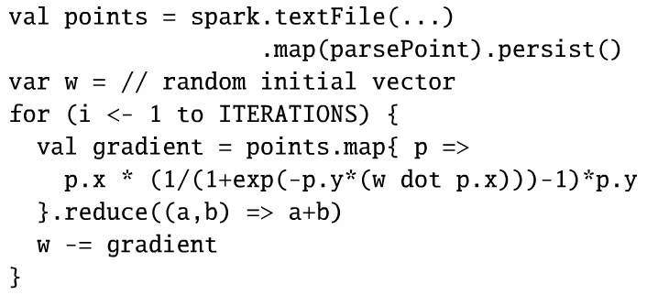
Example : Logistic regression
Classification problem that searches for hyper plane w
Transforms text to point objects
Repetitive map and reduce
to compute gradient

Slide 11
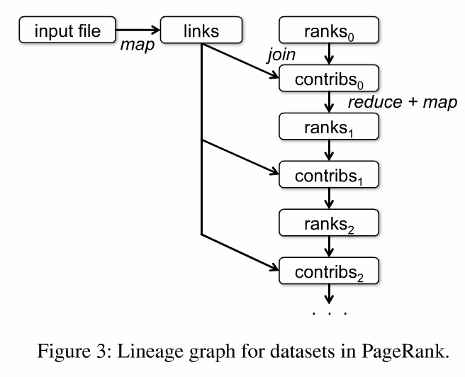
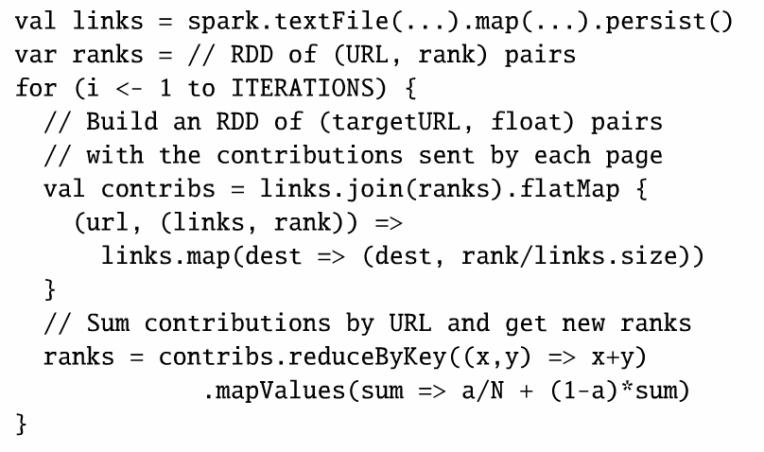
Example : PageRank
Start each page with rank 1/N.
On each iteration update the page rank
= Σ i∈neighbors ranki / |neighbors |
Notes:
links & ranks repeatedly joined Can co-partition them (e.g. hash both on URL) to avoid shuffles Can also use app knowledge, e.g., hash on DNS name

Slide 12
PageRank performance
Notes:
Over wikipedia dump of 1 TB, 10 iterations of page rank on 4 million articles

Slide 13
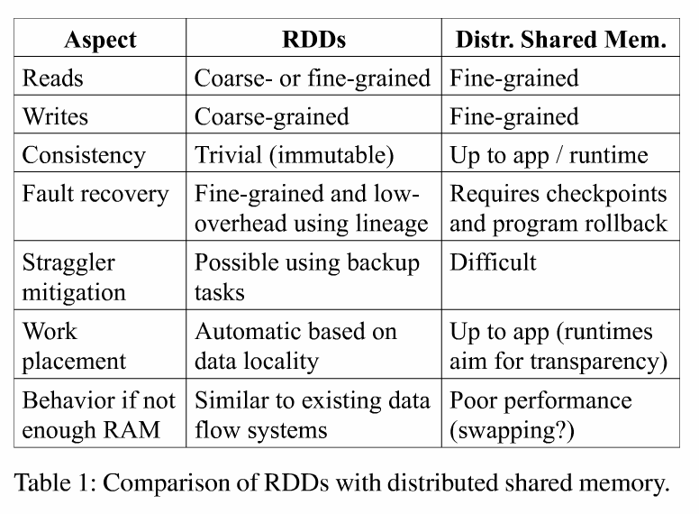
RDDs versus DSMs
Lookup by key
RDDs unsuitable for applications that make asynchronous
fine- grained updates to shared state,
-storage system for a web application
-an incremental web crawler

Slide 14
Implementation in Spark
Job scheduler
Data locality captured using delay scheduling
Interpreter integration
Class shipping
Modified code generation
Memory management
In memory and swap memory
LRU
Support for checkpointing
Good for long lineage graphs
Notes:
Interpreter works by compiling a class for each line and invoking a function to run an instance of the class

Slide 15
Evaluation
Runs on Mesos to share clusters with Hadoop
Can read from any Hadoop input source (HDFS or HBase)
RDD implemented in Spark
Ability to be used over any other cluster systems as well
Notes:
Job scheduler uses data locality based on delay scheduling - when the job that should be scheduled next according to fairness cannot launch a local task, it waits for a small amount of time, letting other jobs launch tasks instead
Memory management – in memory desearliszed for faster access and disc memory as well.

Slide 16
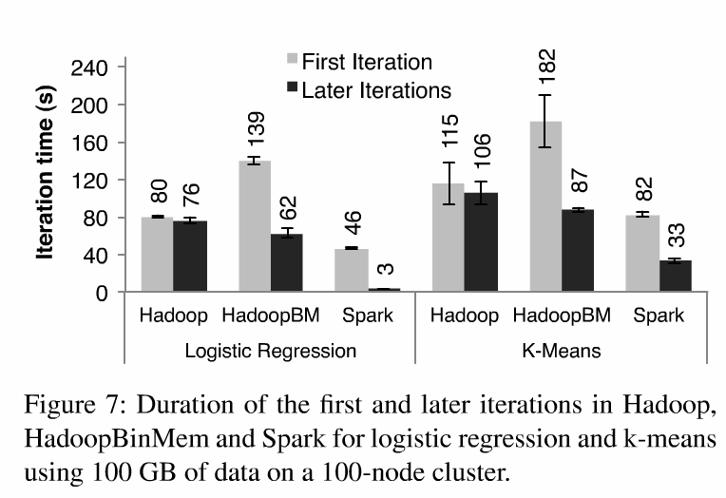
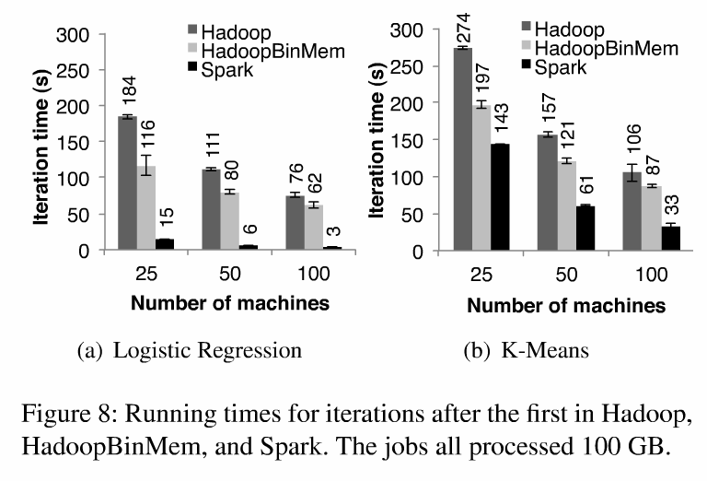
Iterative ML applications
scalability
No improvement in successive iterations
Slow due to heartbeat signals
Initially slow due to conversion of text to binary in-Mem and java objects
Notes:
Hadoop in-memory storage of binary data failed against spark also because:
Minimum overhead of the Hadoop software stack
Overhead of HDFS while serving data, and
Deserialization cost to convert binary records to us- able in-memory Java objects.

Slide 17
Understanding Speedup
Reading from HDFS costs 2 seconds
10 second difference
Text to binary parsing = 7 sec
Conversion of binary record to Java obj
3sec
Notes:
Minimum overhead of the Hadoop software stack
Overhead of HDFS while serving data, and
Deserialization cost to convert binary records to us- able in-memory Java objects.

Slide 18
Failure in RDD
RDDs track the graph of transformations that built them (their lineage) to rebuild lost data

Slide 19
In sufficient memory

Slide 20
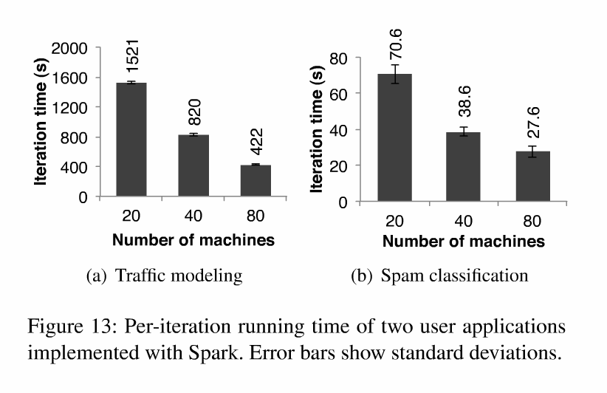
User applications using Spark
In memory analytics at Conviva : 40x speedup
Traffic modeling (Traffic prediction via EM - Mobile Millennium)
Twitter spam classification(Monarch)
DNA sequence analysis (SNAP)
Notes:
Scalibility - Linearly scales down algorithm with machines – this means overhead of the RDD is minimal and no effect on the size of data or computation

Slide 21
Good
RDDs offer a simple and efficient programming model
Open source and scalable implementation at Spark
Improves the speed to the memory bandwidth limit – good for batch processes
Improvements
Memory leak if too many RDDs loaded - garbage collection to be built in
Uses LRU – better memory replacement algorithms possible
Handling data locality using partition/hash and delay scheduling
Hybrid system for handling fine grained updates
Use for debugging

Slide 22
Thank you!

Slide 23
Job scheduler

