Slide 1
Potter’s Wheel: An Interactive Data Cleaning System
Vijayshankar Raman and Joseph M. Hellerstein, UC Berkley
Presented by Donald Cha
09/30/2015

Slide 2
Motivation
Unclean Database
Data often has inconsistencies in schema, formats, and adherence to constraints
Different organizations have different representation of a same item
Data entry errors
Merging from different sources
Data cleansing
Data must be in uniform format before being used or analyzed
A huge challenge for data warehouses

Slide 3
Current Approaches to Data Cleaning
Three components of Data cleaning
Audit data to find discrepancies
Choose transformations to fix discrepancies
Apply transformations on the data
Data cleaning solutions come in two forms
Auditing tools
Domain-specific algorithms
Transformation Tools
Writes a custom scripts
Uses ETL (Extraction/Transformation/Loading)
Might require multiple iterations for good data quality

Slide 4
Problems with Current Approaches
Lack of interactivity
Transformations done as a batch process
Long delays without knowing the effectiveness
Need significant user effort
Need users to specify rules for transformations
Regular expression or grammars
Discrepancy detection
Data domain dependent
Data values are combination of values from different domains
Ex. “Rebecca by Daphne du Maurier, et. al Hardcover (April 8, 1948) $22.00”

Slide 5
Potter’s Wheel Approach
Interactive Transformation
Transformations are visible and can be undone if effects are undesirable
Compiles a sequence of transformations into a program when satisfied
Sub-optimal transformations with a cost of only memory allocation
Extensible Discrepancy Detection
Detection is done automatically in the background
Detection runs on the latest transformed view of data
Define custom domains to enforce domain constraints

Slide 6
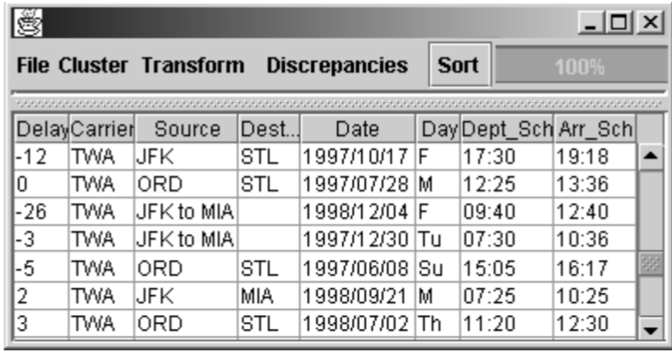
Interface for Displaying Data
No need to wait for completely reading the dataset
Continuously fetch tuples from the dataset and store to disk if not used
Use “buckets” to display data on particular scrollbar position
Very useful on Big Data

Slide 7
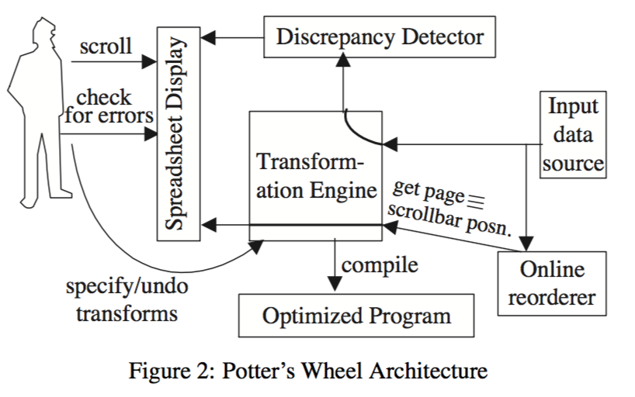
Potter’s Wheel Architecture

Slide 8
Extensible Discrepancy Detection
Find discrepancies in data with structure inference
Developer defines a custom domain
A combination of domains that best defines the data
Developer’s responsibility to specify domains and corresponding constraints.
Detect multi-row anomalies
Accumulate state about the data
Report anomalies if multiple rows violate some constraints

Slide 9
An Example of Custom Domain
Taylor, Jane, JFK to ORD on April 23, 2000 Coach”
Regular Expression example:
“[A-Za-z, ]∗ [A- Z]³ to [A-Z]³ on [A-Za-z]* [0-9]*, [0-9]* [A-Za-z]*
Not helpful and hard to understand
User-Defined example:
“[A-Za-z, ]* <Airport> to <Airport> on <Date> <Class>”
Helps detect logical errors

Slide 10
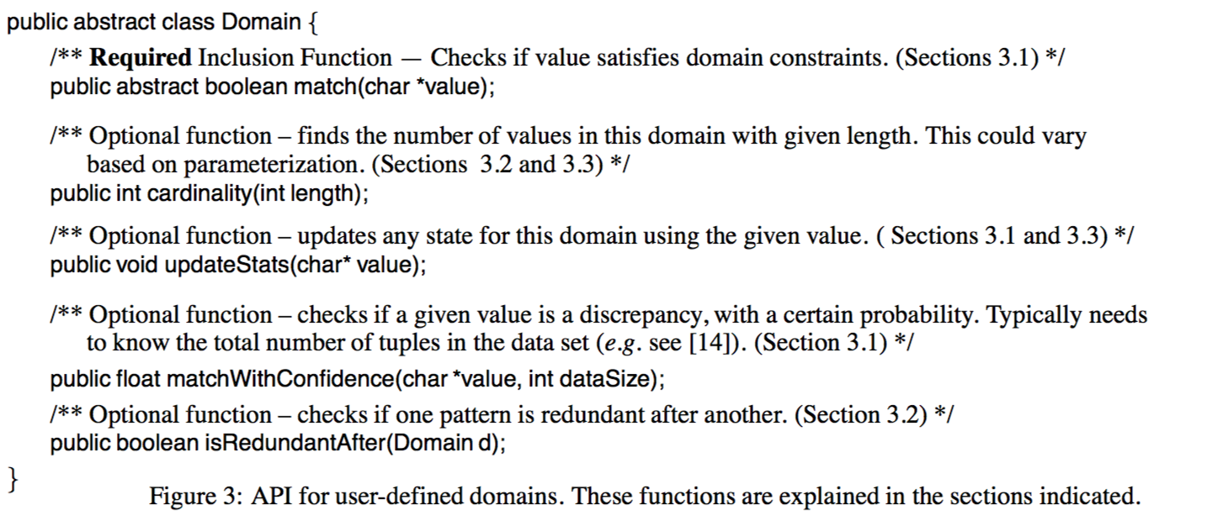
APIs of User-Defined Domains

Slide 11
Evaluating the Suitability of a Structure
Three Characteristics we want in a structure
Recall
Precision
Conciseness
Minimum Description Length (MDL) principle
DL(v_{i}, S) = length of theory for S + length to encode v_{i} given S
Computing DL(v, S)
Length of theory = p log (number of domains known)
If v matches S, encode v with its matching domain. Otherwise, encode explicitly
Use Cardinality function for the known domains.

Slide 12
Description Length equals…

Slide 13
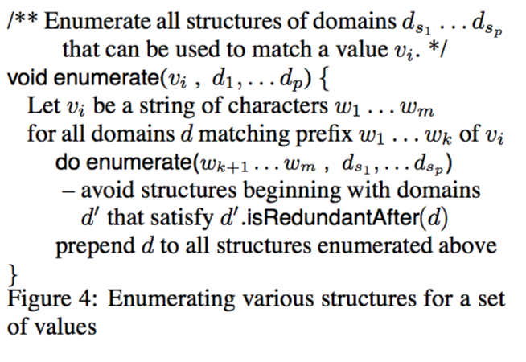
Choosing the Best Structure
Apply to set of values from the column, and seek for redundant domain
Exponential Search Algorithm

Slide 14
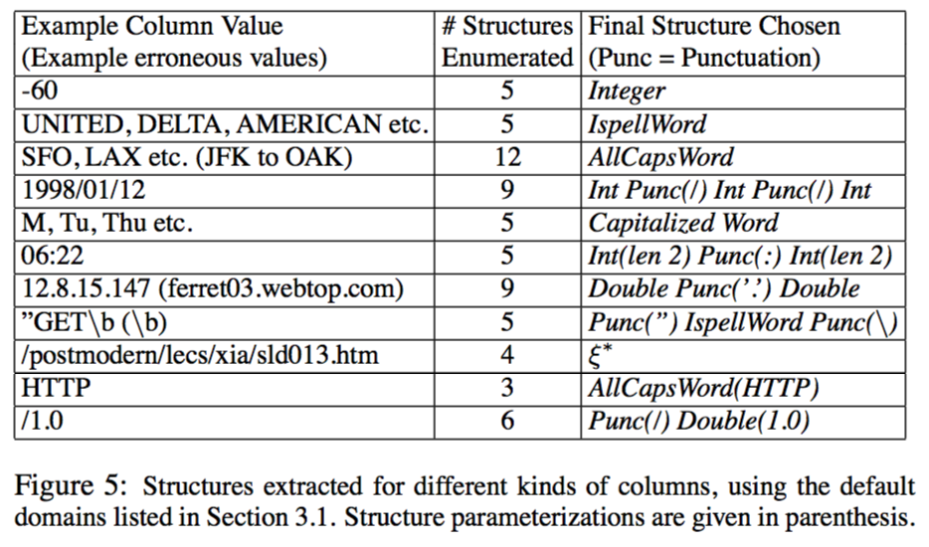
Sample Run of the Algorithm

Slide 15
Interactive Transformation
Ease of specification
Use graphical operations than custom programming
Avoid regular expressions or grammars
Ease of interactive application
Immediately applicable to data
Undos and Data Lineage

Slide 16
Transformations supported in Potter’s Wheel
Value Translation
Format: applies function to every value (i.e. regular expressions, arithmetic, user-defined)
One-to-one Mappings of Rows
Merge/Split/Drop/Copy/Add/Divide Columns
Many-to-Many Mappings of Rows
Fold/Unfold tables or columns

Slide 17
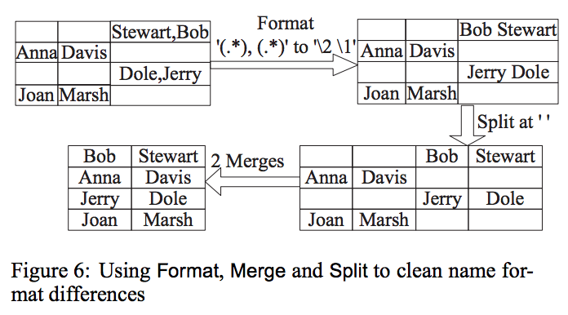
Example of Transforms

Slide 18
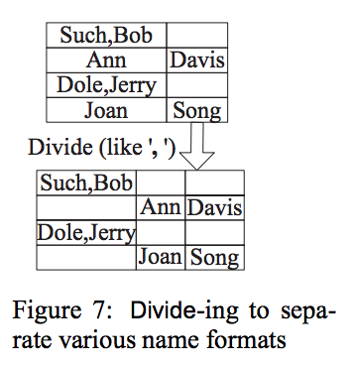
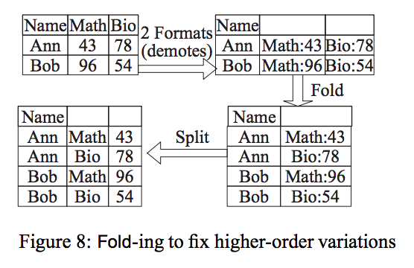
Example of Transforms

Slide 19
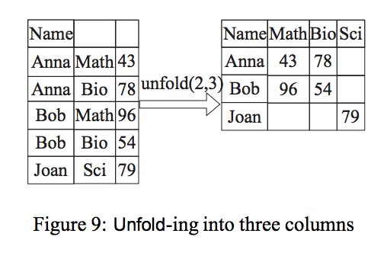
Example of Transforms

Slide 20
Split
Difficult to specify unlike other transforms
Split is needed to parse values
There exists ambiguous delimiter case

Slide 21
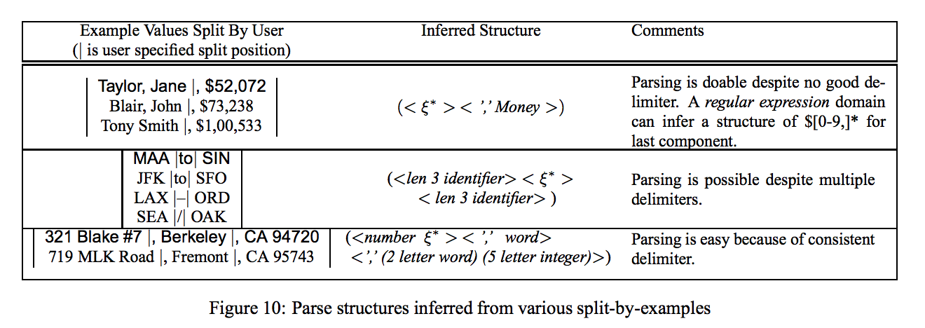
Split by Example
User marks split position on examples

Slide 22
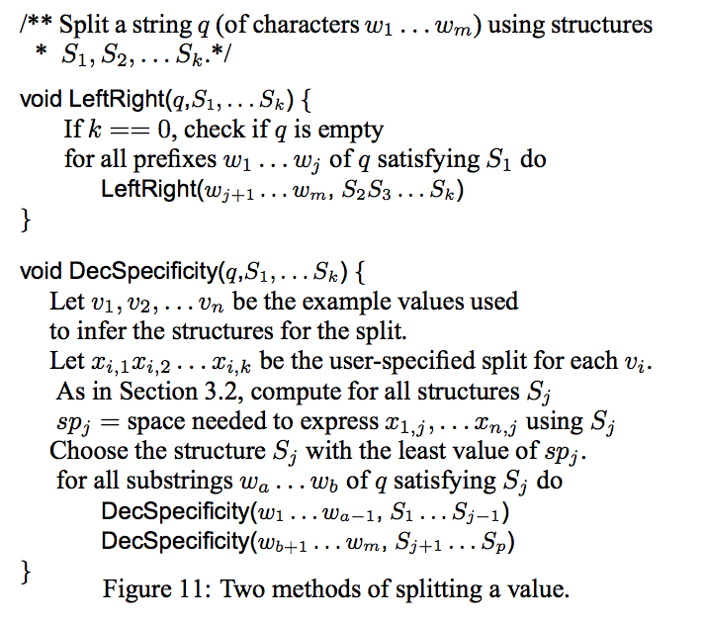
Splitting on Inferred Structures
LeftRight algorithm is very expensive for imprecise structures
DecSpecificity matches inferred structures in decreasing order of specificity.

Slide 23
Comparisons

Slide 24
Related Works
Transformation Languages
Horizontal transforms – SchemaSQL
Detecting discrepancies in data
Finding outliers, hidden dependencies, and duplications
Extracting structure tools
Users write custom scripts
Automatic text wrapping and segmentation

Slide 25
Conclusion
Interactive Data Cleaning System
Provide Transformation and discrepancy detection
Interactive tools
Immediately applies transform to data
Specify visually and can undo a transform if needed
User-defined Domains
Used for parsing values

Slide 26
Future Works
Investigate specification of complex transforms through examples
Use on nested data formats such as XML
Investigate graphical and example-based approaches on transformation
Possibly look into more complex domains

Slide 27
Image credit: http://saphanatutorial.com/wp-content/uploads/2013/12/SAP-HANA-Questions.jpg

Slide 28
Image credit: http://deedees-jazz.com/wp-content/uploads/2015/06/1421178042197.jpeg

