Slide 1
Polaris
Aditya Parameswaran

Slide 2
Key ideas
Relational like-language to translate between visualization specifications and database queries
The key idea behind Tableau
Richer than existing tools
  in terms of space of possible visualizations
Better than existing tools
  in that the connection to the underlying queries is more evident and directly captured

Slide 3
Data Visualizations: Why?
Analyze
  Discover trends
    Stock price is going up/down
  Develop hypotheses
    House prices are down due to the downturn
  Check hypotheses
  Detect errors
    Null values in a column
Share, record & communicate

Slide 4
At a high level
Table-based displays
Why are table-based displays good?
Different dimensions can be captured in the structure of the table
Naturally comparative
Common and easy to understand
Notes:
We can automate parts of the workflow by looking at potentially interesting views or visualizations
Thus, a view is potentially interesting if… like in this case
Given this idea, can we
Save significant work for the analyst of stepping through…

Slide 6
How do we get to Table-based displays?
Via a visual specification
Arrange attributes
on shelves
X shelf
Y shelf
Layer (Z) shelf
  Different datasets
  Different attributes
Notes:
We can automate parts of the workflow by looking at potentially interesting views or visualizations
Thus, a view is potentially interesting if… like in this case
Given this idea, can we
Save significant work for the analyst of stepping through…

Slide 7
The result of a visual specification
Selection of dataset sources ➔ layers
Selection of attributes ➔ shelves
  Plus relative order, number
Grouping and aggregation, sorting
Type of graphic shown on each pane
Mapping of data to marks in the graphic
Notes:
We can automate parts of the workflow by looking at potentially interesting views or visualizations
Thus, a view is potentially interesting if… like in this case
Given this idea, can we
Save significant work for the analyst of stepping through…

Slide 8
Visual Specification: High Level
Three components
Table configuration specification
  Via a “table algebra”
Type of graphic
Visual encodings
Notes:
We can automate parts of the workflow by looking at potentially interesting views or visualizations
Thus, a view is potentially interesting if… like in this case
Given this idea, can we
Save significant work for the analyst of stepping through…

Slide 9
Types of Data
Nominal
  =, ≠
Ordinal
  =, ≠, <, >
Quantitative Interval
  =, ≠, <, >, –
  Arbitrary zero
Quantitative Ratio
  =, ≠, <, >, –, %
  Physical quantities
Airlines, Genre
MPAA Rating,
Batteries
Year, Location
Sales, Profit
Temperature
Notes:
We can automate parts of the workflow by looking at potentially interesting views or visualizations
Thus, a view is potentially interesting if… like in this case
Given this idea, can we
Save significant work for the analyst of stepping through…

Slide 10
Conversion of Data Types
Nominal
  =, ≠
Ordinal
  =, ≠, <, >
Quantitative Interval
  =, ≠, <, >, –
  Arbitrary zero
Quantitative Ratio
  =, ≠, <, >, –, %
  Physical quantities
Hot, warm, cold
Well, so-so, badly
Grade
Temperature
Score
Notes:
We can automate parts of the workflow by looking at potentially interesting views or visualizations
Thus, a view is potentially interesting if… like in this case
Given this idea, can we
Save significant work for the analyst of stepping through…

Slide 11
Conversion of Data Types
Nominal
  =, ≠
Ordinal
  =, ≠, <, >
Quantitative Interval
  =, ≠, <, >, –
  Arbitrary zero
Quantitative Ratio
  =, ≠, <, >, –, %
  Physical quantities
This paper moves nominal ➔ ordinal
and
QI ➔ QR
Notes:
We can automate parts of the workflow by looking at potentially interesting views or visualizations
Thus, a view is potentially interesting if… like in this case
Given this idea, can we
Save significant work for the analyst of stepping through…

Slide 12

Table Algebra: Basic Operands
Ordinal fields: interpret domain as a set that partitions table into rows and columns:
Quarter = {(Qtr1),(Qtr2),(Qtr3),(Qtr4)} →
Quantitative fields: treat domain as single element set and encode spatially as axes:
Profit = {(Profit[-410,650])} →
Notes:
SHORTEN!

Slide 13

Concatenation (+) operator
Ordered union of set interpretations:
Quarter + ProductType
= {(Qtr1),(Qtr2),(Qtr3),(Qtr4)} + {(Coffee), (Espresso)}
= {(Qtr1),(Qtr2),(Qtr3),(Qtr4),(Coffee),(Espresso)}
Profit + Sales = {(Profit[-310,620]),(Sales[0,1000])}

Slide 14

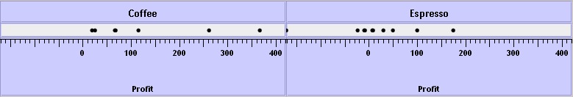
Cross (x) operator
Cross-product of set interpretations:
Quarter x ProductType =
{(Qtr1,Coffee), (Qtr1, Tea), (Qtr2, Coffee), (Qtr2, Tea), (Qtr3, Coffee), (Qtr3, Tea), (Qtr4, Coffee), (Qtr4,Tea)}
ProductType x Profit =

Slide 15
Nest (/) operator
Quarter x Month
  would create entry twelve entries for each quarter. i.e., (Qtr1, December)
Quarter / Month
  would only create three entries per quarter
  based on tuples in database not semantics
  can be expensive to compute

Slide 16
Type of Graphic
Option 1: Let the user decide
Option 2: Polaris picks the appropriate one
Types
O-O
O-Q
Q-Q
Notes:
We can automate parts of the workflow by looking at potentially interesting views or visualizations
Thus, a view is potentially interesting if… like in this case
Given this idea, can we
Save significant work for the analyst of stepping through…

Slide 17
Ordinal-Ordinal Graphics
Typically axes variables are independent of each other and the focus is on studying some external function:
F(O1, O2) → R
Notes:
We can automate parts of the workflow by looking at potentially interesting views or visualizations
Thus, a view is potentially interesting if… like in this case
Given this idea, can we
Save significant work for the analyst of stepping through…

Slide 18
Ordinal-Quantitative Graphics
Bar chart (plain, clustered, stack)
Dot plot
(typically for dependencies
F(O) → Q)
Gantt chart
(typically for independent)
Notes:
We can automate parts of the workflow by looking at potentially interesting views or visualizations
Thus, a view is potentially interesting if… like in this case
Given this idea, can we
Save significant work for the analyst of stepping through…

Slide 19
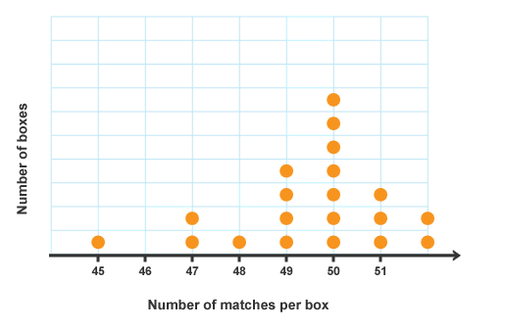
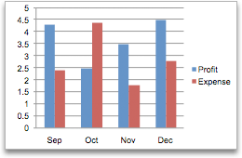
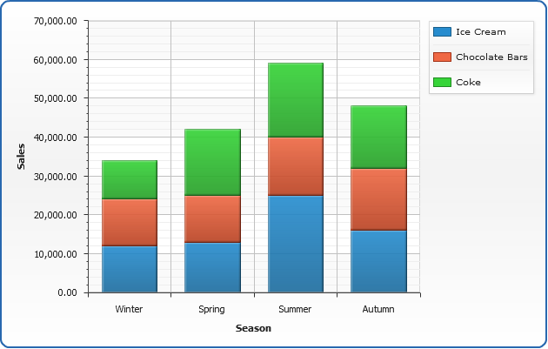
Ordinal-Quantitative Graphics
Notes:
We can automate parts of the workflow by looking at potentially interesting views or visualizations
Thus, a view is potentially interesting if… like in this case
Given this idea, can we
Save significant work for the analyst of stepping through…

Slide 20
Quantitative Quantitative Graphics
Scatterplots
Typically for studying causal relationships
Choropleths / Maps

Slide 21
Visual Mappings
Mappings from records to marks
Uses visual properties of the mark to encode differences:
Size, shape, orientation, color

Slide 22
Recap
Visual Specification
Table spec
Type of graphic
Encoding of marks
Now.. Additional manipulations needed for visualization composition
Notes:
We can automate parts of the workflow by looking at potentially interesting views or visualizations
Thus, a view is potentially interesting if… like in this case
Given this idea, can we
Save significant work for the analyst of stepping through…

Slide 23
Data Transformations
Why do we need this?
Generation of new fields
Simple aggregation
  Applied to a quant field
  Distinct count for an ord field
Discrete partitioning
  Binning (discussed next)
    Does not change the graph type (still quant)
  Partitioning → Arbitrary binning
Ad-hoc grouping
  Specific values can be grouped together
Thresholding
  Formation of an “other” category
Notes:
We can automate parts of the workflow by looking at potentially interesting views or visualizations
Thus, a view is potentially interesting if… like in this case
Given this idea, can we
Save significant work for the analyst of stepping through…

Slide 24
Data Transformations
Binning
Dealing with Large Cardinalities
Per Hour
Per Day
Per Week
Per Month
Bin by hour
Bin by day
Bin by week
Bin by month
Notes:
We can automate parts of the workflow by looking at potentially interesting views or visualizations
Thus, a view is potentially interesting if… like in this case
Given this idea, can we
Save significant work for the analyst of stepping through…

Slide 25
Data Transformations: Aggregation
Cumulative vs. Aggregate
Normalization
Logarithm
Power
Aid comparisons, reduce random variations
Notes:
We can automate parts of the workflow by looking at potentially interesting views or visualizations
Thus, a view is potentially interesting if… like in this case
Given this idea, can we
Save significant work for the analyst of stepping through…

Slide 26
Data Transformation: Subselection, Ordering
Filtering
Sorting
Brushing/linking
Tooltips
Notes:
We can automate parts of the workflow by looking at potentially interesting views or visualizations
Thus, a view is potentially interesting if… like in this case
Given this idea, can we
Save significant work for the analyst of stepping through…

Slide 27
Data Flow

Slide 28
Data Flow
Step 1:
SELECT * WHERE {filters}

Slide 29
Data Flow
Step 2: SELECT *
WHERE ROW(i) AND COLUMN(j) AND LAYER(k)

Slide 30
Data Flow
Step 3: SELECT dim, agg
GROUP BY g
HAVING f ORDER BY S

Slide 31
Data Flow
Does it make sense to split up the computation in this way?

Slide 32
Data Flow
Other Directions for Speeding Up
Materialized views
Progressive refinement
Sampling
Caching and prefetching

Slide 33
OLAP Terminology
Star Schema: for simplicity, consider as a single relation, with many dimensions and measures
Relation of transactions
Measures: values that can be
measured and aggregated
Sales, Profit
Dimensions: independent variables
Location, Category of Sale, Year
Notes:
All metrics essentially capture
Probability distributions
Like in this case..
So we can use any or all of these metrics. Of course we do not want to be tied down to any single metric.

Slide 34
Aggregation Operators
The measure attributes will be aggregated
Standard SQL aggregations:
COUNT, SUM, AVG, MAX/MIN, STD DEV
Notes:
All metrics essentially capture
Probability distributions
Like in this case..
So we can use any or all of these metrics. Of course we do not want to be tied down to any single metric.

Slide 35
Canonical OLAP Query
SELECT AGG(M), D
FROM R
WHERE …
GROUP BY D
SELECT SUM(Sales), Category
FROM R
GROUP BY Category
Notes:
All metrics essentially capture
Probability distributions
Like in this case..
So we can use any or all of these metrics. Of course we do not want to be tied down to any single metric.

Slide 36
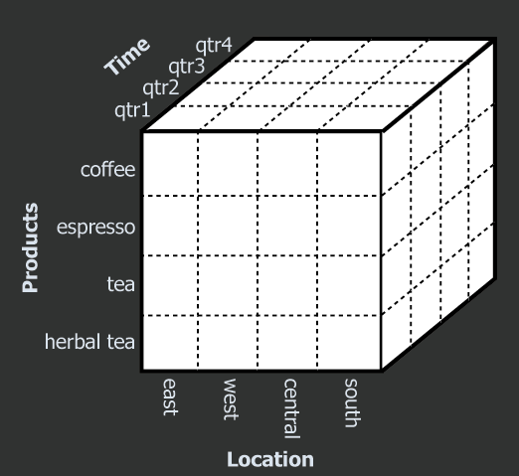
OLAP = Data Cubes
Each cell
summarizes
all measures for
those dimension values
Each cube dimension corresponds to a dimension in the relation

Slide 37
Types of Charts
Bar Charts
Line Charts
Scatter Plot
Choropleth
Notes:
We can automate parts of the workflow by looking at potentially interesting views or visualizations
Thus, a view is potentially interesting if… like in this case
Given this idea, can we
Save significant work for the analyst of stepping through…

Slide 38
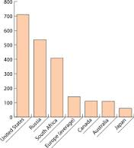
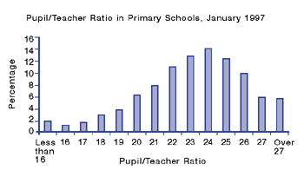
Bar Charts
Notes:
We can automate parts of the workflow by looking at potentially interesting views or visualizations
Thus, a view is potentially interesting if… like in this case
Given this idea, can we
Save significant work for the analyst of stepping through…

Slide 39
Bar Charts
Plotting a Q-R vs. either a N, O, Q-I, or Q-R
Emphasize more the difference in height than the distances in the x axis
Most fundamental chart
Notes:
We can automate parts of the workflow by looking at potentially interesting views or visualizations
Thus, a view is potentially interesting if… like in this case
Given this idea, can we
Save significant work for the analyst of stepping through…

Slide 40
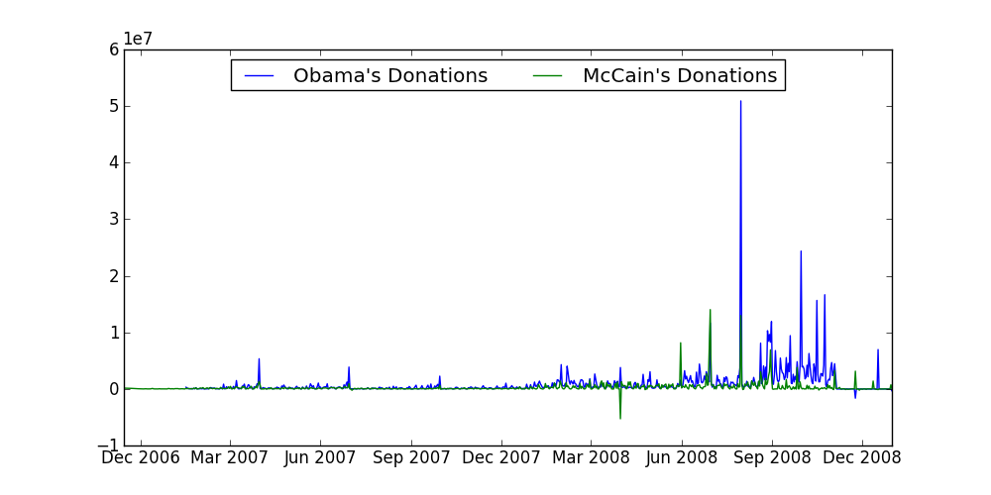
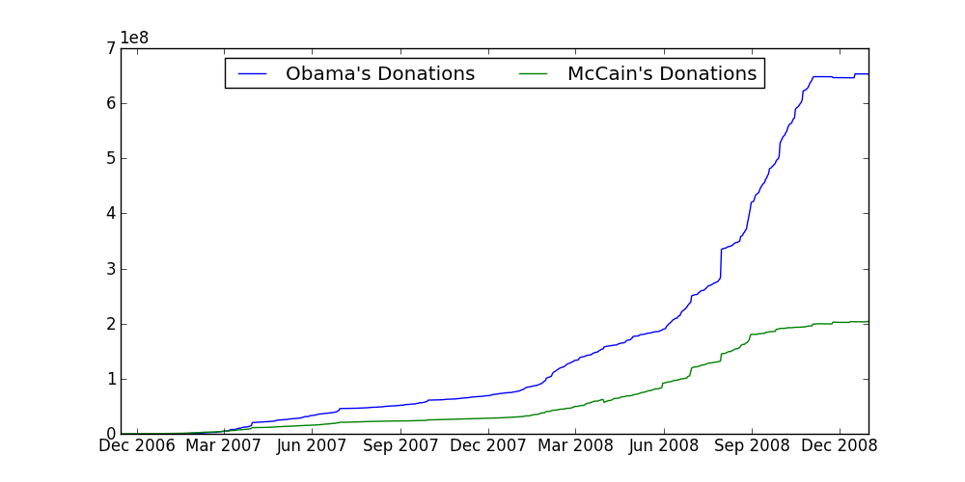
Line Charts

Slide 41
Line Charts
Plotting a Q-R vs. a Q-I, or Q-R
Mainly makes sense when the x-axis is ordered in some way
Want to be able to see “trends”
Assumption of interpolation, dependence
Notes:
We can automate parts of the workflow by looking at potentially interesting views or visualizations
Thus, a view is potentially interesting if… like in this case
Given this idea, can we
Save significant work for the analyst of stepping through…

Slide 42
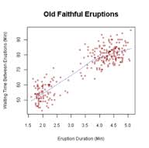
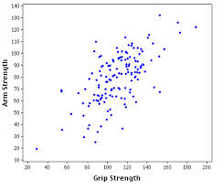
Scatter Plot
Notes:
We can automate parts of the workflow by looking at potentially interesting views or visualizations
Thus, a view is potentially interesting if… like in this case
Given this idea, can we
Save significant work for the analyst of stepping through…

Slide 43
Scatterplot
Plotting a Q-R vs. a Q-R
Unlike line graphs, no assumption of interpolation
Care more about “density”, understanding of “correlation”
Notes:
We can automate parts of the workflow by looking at potentially interesting views or visualizations
Thus, a view is potentially interesting if… like in this case
Given this idea, can we
Save significant work for the analyst of stepping through…

Slide 44
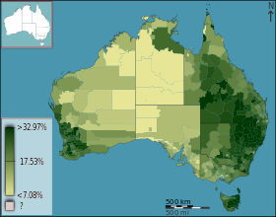
Choropleths
Notes:
We can automate parts of the workflow by looking at potentially interesting views or visualizations
Thus, a view is potentially interesting if… like in this case
Given this idea, can we
Save significant work for the analyst of stepping through…

Slide 45
Choropleth
Overlaid on a map
Q-R vs. Two-dimensional Q-I variable
Notes:
We can automate parts of the workflow by looking at potentially interesting views or visualizations
Thus, a view is potentially interesting if… like in this case
Given this idea, can we
Save significant work for the analyst of stepping through…

Slide 46
Data Visualization Software
d3
ggplot2
Google Charts
Gnuplot
Easier to use & learn
Customizable
Also, analytics software: Tableau, Spotfire
Notes:
We can automate parts of the workflow by looking at potentially interesting views or visualizations
Thus, a view is potentially interesting if… like in this case
Given this idea, can we
Save significant work for the analyst of stepping through…

Slide 47
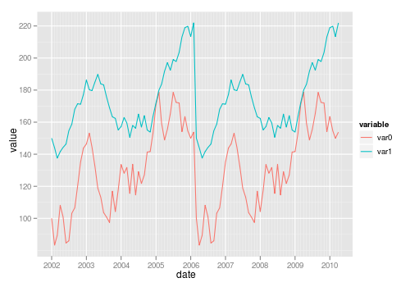
Data Visualization Software
Almost all the tools described will be able to plot something like this

Slide 48
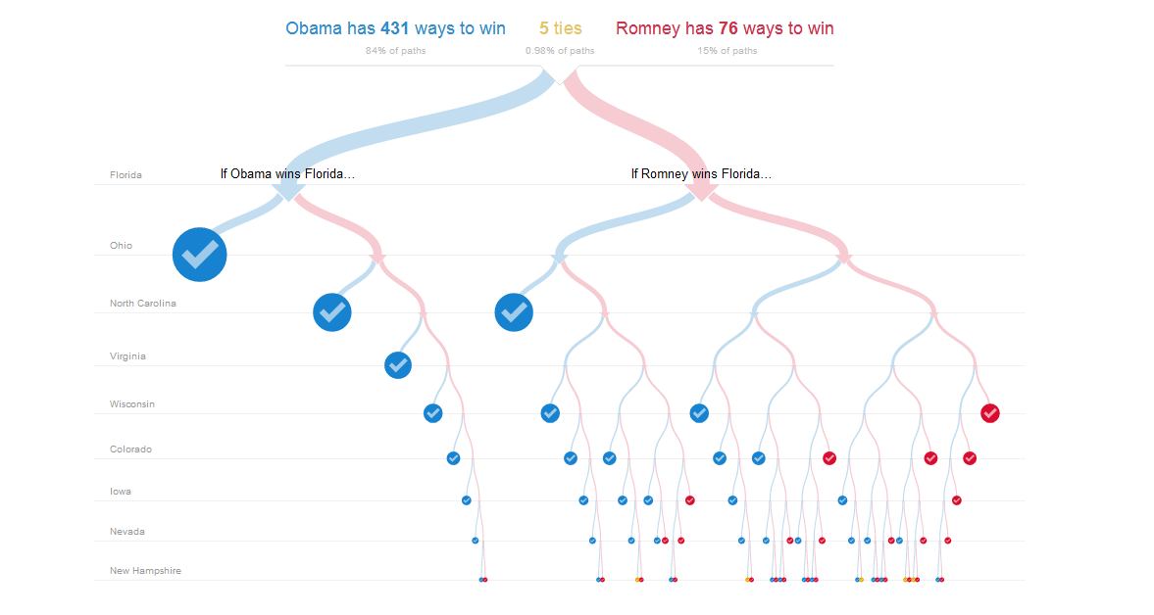
Data Visualization Software: d3

Slide 49
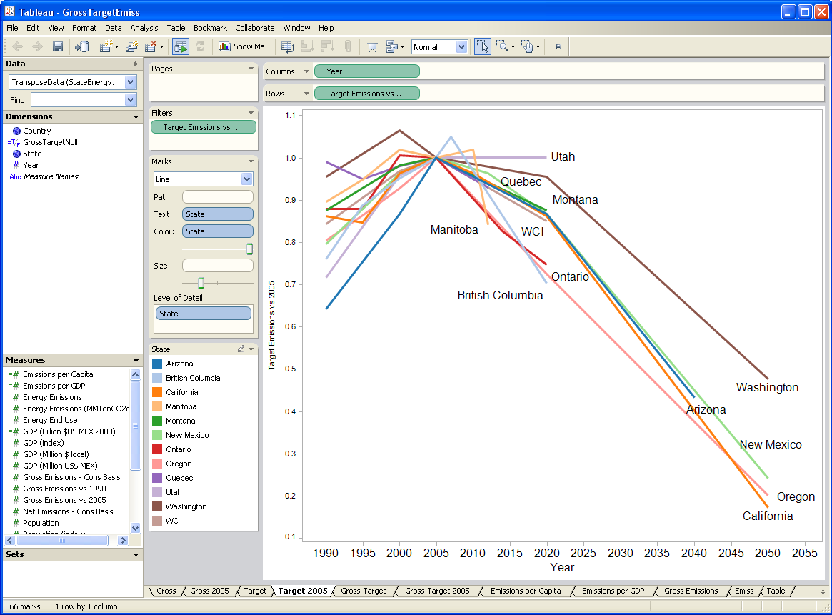
Data Analytics Tools: Tableau

Slide 50
What could the paper have improved?

Slide 51
What could the paper have improved?
Some experiments or evaluation of approach
Some notion of completeness or coverage
Still – none of that stopped them from publishing or even better, starting a publicly traded company!
https://www.youtube.com/watch?v=Z5kQR71yJpE

Slide 52
Future Work
What ways can we improve the system from a data processing standpoint?

Slide 53
Future Work
What ways can we improve the system from a data processing standpoint?
  Redesign the backend database to optimize for queries of the form described
  Use user traces to speculate, optimize, prefetch

