Slide 1
Gestural Query Specification
Arnab Nandi, Lilong Jiang, Michael Mandel
Presented by – Himel Dev

Slide 2
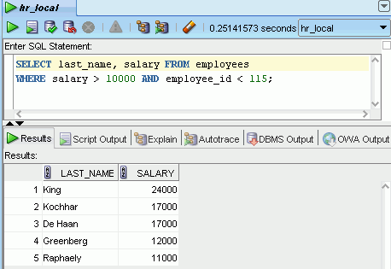
Human Database Interaction
Extremely helpful for driving novice users away

Slide 3
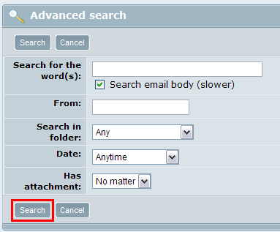
Human Database Interaction [2]
Allows fixed format questions, nothing beyond

Slide 4
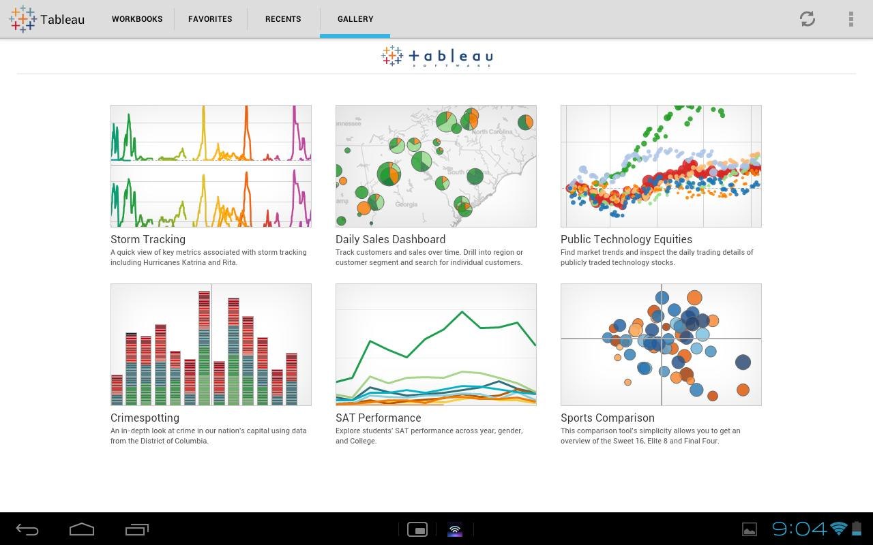
Human Database Interaction [3]
Everyone loves visualizations, but micro-level info missing

Slide 5
Gestures
Natural Interaction
Continuous Interaction
Direct Manipulation
Accessibility
Overwhelming

Slide 6
Gesture Articulation
G = {p₁, p₂, …, p_{n}}
p_{i} = <t, l, m>
t : timestamp
l : locational information in the interface
m : metadata associated with point and time
Continuous feedback

Slide 7
Query Paradigm
Query Intent
Space of articulated queries
User goes from vague to specific intent
Intent transition
Query Context
Direct Manipulation
Session of multiple Query Intent Transition
Intent Feedback

Slide 8
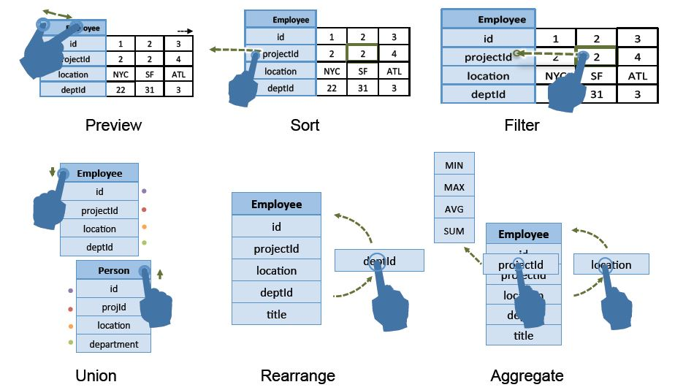
Gesture Vocabulary

Slide 9
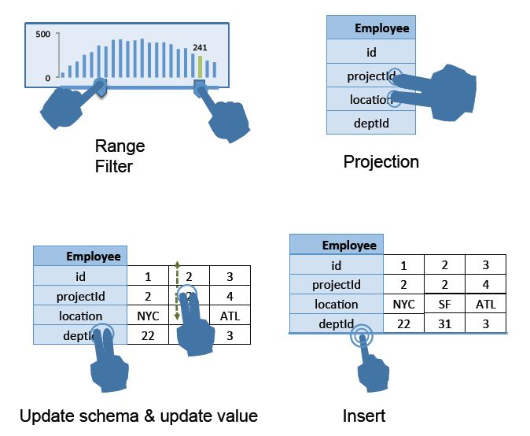
Gesture Vocabulary [2]

Slide 10
Gesture Vocabulary [Alternative]
https://www.youtube.com/watch?v=ZdJgUDBoB4M

Slide 11
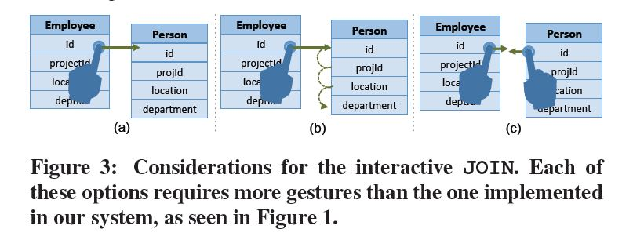
Design Considerations for Join

Slide 12
Design Considerations for Join [2]

Slide 13
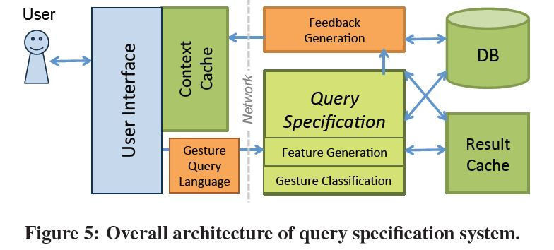
Query Specification System

Slide 14
Gesture Recognition
Classification
Proximity (State-of-the-art)
Compatibility (Semantically meaningful queries)
Maximum entropy

Slide 15
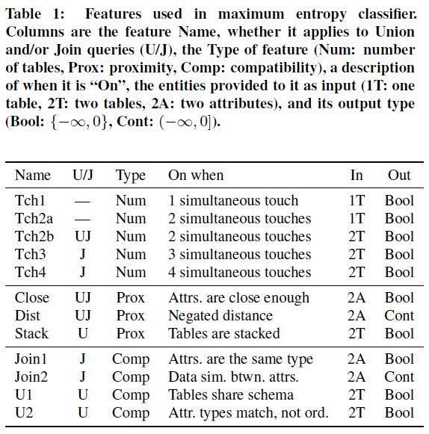
Feature Design

Slide 16
Experimental Study
Mostly user study
within Subjects
Same group of subjects serve more than once
No catching-on effect (convergence)
They claim to avoid all bias
Considerations
Fatigue Effect
Carryover Effect
Consistency

Slide 17
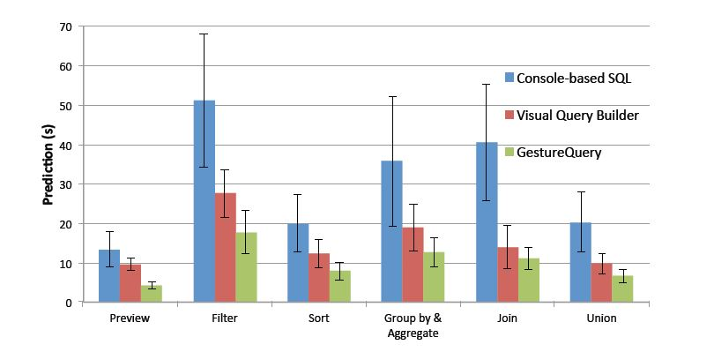
User: Completion Time

Slide 18
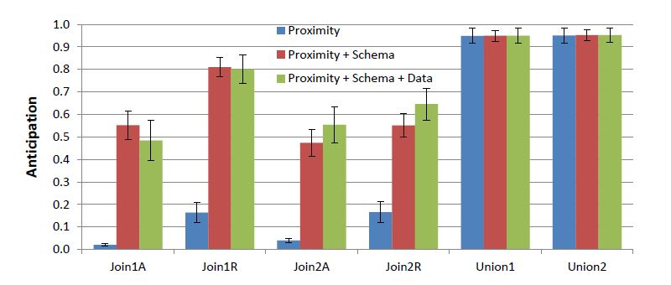
User: Anticipation

Slide 19
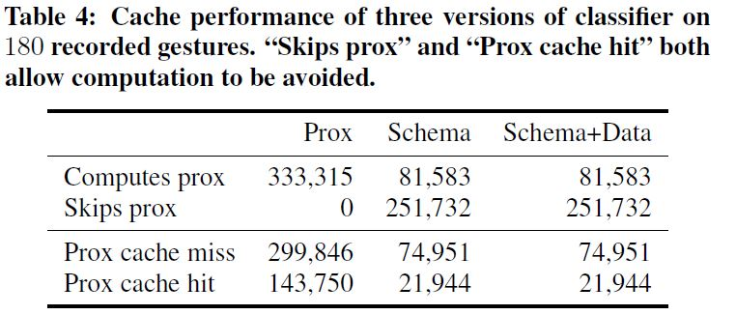
System Performance

Slide 20
Back to HDI
What are our expectations?
Interactive
Expressivity
Supports 3 user groups (Aditya’s categorization)
What more?
Possible solutions
Query recommendation
Natural language feedback

Slide 21
Thank You

