Slide 1
Google Fusion Tables: Web-Centered Data Management and Collaboration
HectorGonzalez, et al. Google Inc.
Presented by Donald Cha
December 2, 2015

Slide 2
The World We See Now
World is “connected.”
Proliferation of connected computing devices.
Computation done on the Cloud
Image Source: http://101ecommerce.com/wp-content/uploads/2015/04/Connected-World-1.jpg

Slide 3
Foundations of DBMS
Established several decades ago.
Focus on high-throughput business transactions.
Processing of complex SQL queries
Data belongs to a single enterprise.

Slide 4
DBMS needs a change
Need data management functionality for connected world
But How?
Needs to support collaboration among multiple users and multiple organizations.
Needs to appeal to a broader audience of users (including those who are non-experts).
Needs to be integrated seamlessly with Web application.

Slide 5
Google Fusion Tables
Cloud-based data management and integration service.
Targeted Audience
Organizations struggling to get their data available online
Communities of users needing to collaborate on data management
Novice users who are passionate about finding useful data and using data for integration
Google Fusion Table can
Upload data
Collaborate data
Visualize data
Combine data
Notes:
Upload data in spreadsheet, CSV, KML format up to 100 MB.
Visualize data in charts, maps, or timelines format
System supports filters and aggregates to query the data
Integration of data from multiple sources to join multiple tables from different users.
Assign appropriate permission to selected users.

Slide 6
Examples of Google Fusion Tables
Notes:
The Ministry of Health in an African country wants to obtain community input on the current status of health clinics dispersed across the country.
Congressional staffers want to visualize data to help a senator make an argument.
Ecologists in the rain forests of Costa Rica collect spec- imens of animal and plant life. They want to maintain records of the specimens and also want to include the related genetic information that is being produced for them by a laboratory in Canada.

Slide 7
Underlying principles of Google fusion tables
Seamless Integration with Web
Ease of Use
Incentives for Sharing Data
Support Collaboration

Slide 8
Provide Seamless Integration with the Web
Publish visualization on the Web
Bar charts, pie charts
Timelines
Display geo-spatial datasets on Google Maps
Public datasets on Fusion Tables can be crawled by Google search engines
Accessible through web search
Can be integrated seamlessly with Google Documents and spreadsheets

Slide 9
Emphasize Ease of Use
Pay-As-You-Go data management principles
Immediate benefit of time invested when using the service
Little or no initial installation to use the service
No need to declare a schema

Slide 10
Provide Incentives for Sharing data
Users desire to share data with others
Users face problem when sharing data
Loss of attribution
Misuse and corruption of data

Slide 11
Facilitate Collaboration
Collaboration among different organizations table can provide valuable insight.
Discuss and comment on the data
Study different dataset of other users

Slide 12
Data Management with fusion tables
Data Acquisition
Data Sharing and Collaboration
Data Manipulation and Visualization

Slide 13
Data acquisition
Upload Capability of Different Formats
CSV (Comma Separated Values)
Spreadsheet (Excel, Open Office, Google Spreadsheets)
KML (Keyhole Markup Language)
Automatic Schema Detection
Which row in the uploaded file is the header row
Make as few query as possible to the users
No need of user-defined schema and import method
No need to specify data type for the column
User can specify any description about the data for other users.
Notes:
Questions: What if data is not in such format?

Slide 14
Problems with Data acquisition
Can we trust Automatic Schema Detection?
What if the data gets misplaced? How will we fix it?
Possibly use human-interact data cleaning system like Potter’s Wheel

Slide 15
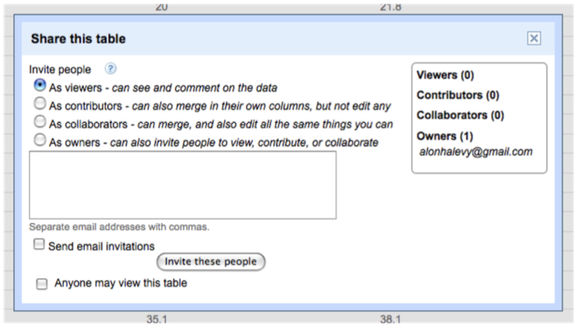
Attribution, Export, Sharing, and Integration
User can choose whom to share the data with.
User can specify static attribute for the data
Owner of the data can control exporting by other users.
User can invite a set of collaborators to view, update, and comment on data.

Slide 16
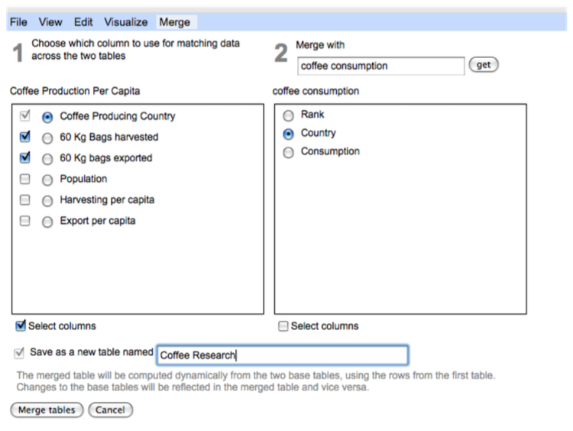
Continued
Supports merging data from multiple sources of same entities.

Slide 17
Problems with data sharing
Users can make mistake
If mistakes accumulate overtime by multiple users, hard to undo
Users may not have the right skill set to contribute to a data
Possible Solution
Coordinate with others
Educate other contributors

Slide 18
Search
Data must easily be discovered by interested users
Public data discoverable by search engine
Create a corresponding HTML page
Advanced Search for tables in Fusion Tables
For those who needs to explore specific dataset
Based on an extension of the WebTables’ relation search

Slide 19
Discussions
Supports in-depth collaborations by elaborating discussions among multiple users about the data.
Users can point out outliers
Users can detect incorrect data
Users can question about the underlying assumptions of data.
Supports commenting data on all levels of granularity
Row, column, and individual data
Gives better context and keep track of the discussions
Discussions are append-only
Changes made are also appended

Slide 20
Data Manipulation and Visualization
System recognizes a type of values in a column
Geographical locations
Date and time
Numeric values
Provides visualizations based on the type of data in a column
Map viewing
Timeline and Motion charts
Bar charts and Pie charts
Provides HTML snippet of generated data visualizations
Allows multiple web property to use it (i.e. blog, e-mail, and etc)

Slide 21
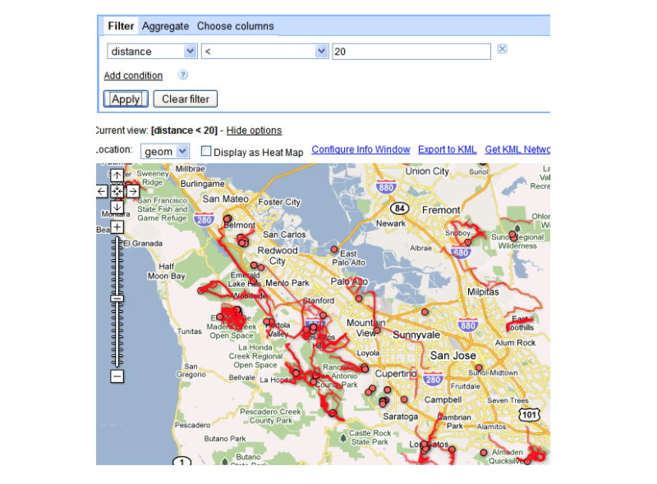
Data Visualization example

Slide 22
Fusion Tables API
Allows external developers to write applications that use Fusion Tables as its main database.
Supports basic query and database modification
SELECT, UPDATE, INSERT, and DELETE
CREATE TABLE
All access to database requires authentication

Slide 23
Related Work
Extended from parts of ManyEyes (multiple users upload data and visualize it)
Several online database management tools
DabbleDB
Socrata
Factual

Slide 24
conclusion
Google Fusion Tables encourage data owners to publish data to public so many others who need data can easily access
Still needs Improvement
Provide more expressive data modeling
Query capability and performance on larger datasets

Slide 25
Image credit: http://saphanatutorial.com/wp-content/uploads/2013/12/SAP-HANA-Questions.jpg

Slide 26
Image credit: http://deedees-jazz.com/wp-content/uploads/2015/06/1421178042197.jpeg

