Slide 1
Crowdsourced Enumeration Queries
Ruihan Shan

Slide 2
Introduction
Motivation

Slide 3
Motivation
Using Crowdsourcing power to leverage human intelligence and activity at large scale

Slide 4
Motivation
Crowdsource for database query processing. (CrowdDB, Qurk)
Crowds to perform query operations like subjective comparison, fuzzy matching, etc.

Slide 5
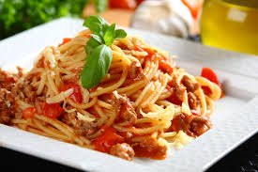
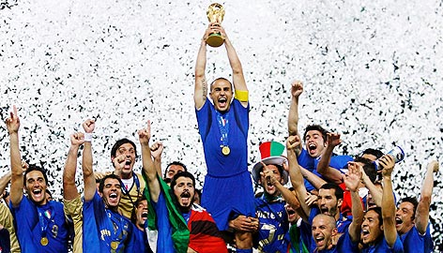
Example: Selecting which entity is “Italy”

Slide 6
Challenges
Latency, cost and accuracy of people
(However, we do not concern about these)

Slide 7
Challenges
Closed-World Assumption does not hold

Slide 8
Closed-World Assumption
Everything we don’t know (or does not show in our database tables) is false.

Slide 9
Example: Traditional Relational Database based on Closed World Assumption
ID | Name | Date | Score
1 | Kobe Bryant | 2006-01-22 | 81
2 | Michal Jordan | 1986-04-20 | 63
3 | Lebron James | 2005-03-20 | 56
SELECT NAME FROM TABLE WHERE SCORE < 60

Slide 10
Wait…
Lebron scores 61 recently in 2014.

Slide 11
Open World Assumption
Everything we don’t know (or does not show in our database tables) is false.
Where real world information database systems (like Crowdsourced system) base on
Additional records come continuously

Slide 12
So, when is the query Complete?
Consider a query for a list of graduating Ph.D. students currently on job market

Slide 13
Some inspiration
Query for the names of the 50 US states.
Each worker provide one or more state name.

Slide 14
Some inspiration
Query for the names of the 50 US states.
Each worker provide one or more state name.
The rate becomes slower as more answers come
Species Accumulation Curve (SAC)

Slide 15
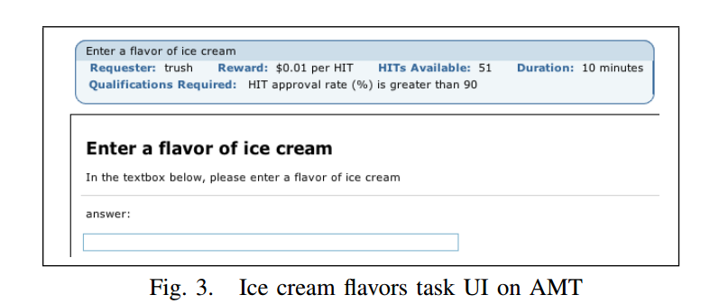
Background: How CrowdDB works
Human Intelligence Tasks (HIT), you can interpret as microtasks or online survey questions
UI Manager, how the HIT displays to the user
Create our table
Collecting answers and pass them to the query execution engine

Slide 16
When can we stop the procedure
Query completeness
Cost

Slide 17
Luckily, we have Chao92
An open-world-safe estimator

Slide 18
Consider a query
List all the names of the 192 United Nations member countries
Lets try using our Chao92

Slide 19
What we got
Chao92 (Actual) does not perform as we expected (SAC).

Slide 20
What is wrong with Chao92
Chao92 assumes individual worker is independent from each other and each of them sample in a with replacement manner (order not important) from a unknown single distribution.
However, the real human (our worker) provide answers without replacement
When our worker answer the question, there is some underlying distributions for the sampling (Alphabetically enumeration, Cultural bias etc)
Individual answer departs/arrives at any time

Slide 21
What is wrong with Chao92
Crowd behaviors impact the sample of answers received, while Chao92 ignores this.

Slide 22
How do we model the impact of humans

Slide 23
Seems work, but…
Why without replacement over-predicts?

Slide 24
Impact of Worker skew
Someone provides too many answers, streakers

Slide 25
Impact of Worker skew
However, we don’t want our workers to be overzealous
We don’t like streakers!

Slide 26
Why work skew matters? Imagine two extreme scenarios
One worker provide all the answers
Infinite “samplers” would provide one answer with a same distribution

Slide 27
Cross impact of worker skew and data distribution
WS: Is there skewness
DD: Is the data distribution diverse

Slide 28
Worker arrival also matter
A very zealous worker who provides all the answers comes when there is 200 HITs.

Slide 29
Our goal: To make Chao92 more fault-tolerant
Especially for the streaker case

Slide 30
Streaker-Tolerant completeness estimator
How basic estimator model works?
How Chao92 estimator works?

Slide 31
How basic model works Some important terms and notions
Suppose we want to estimate how many different majors are there in UIUC.
N – total majors #, from 1 to N, CS is 1, ECE is 2, for example
c - # of distinct majors in a sample, say in a classroom(Siebel 1104)
$n_{i}$- # of elements in the sample belongs to major i, lets say n1 = 20, 20 CS majors in this classroom
$p_{i}$ – Probability that an element from major i is saw in a random classroom.
$f_{i}$– In a sample (classroom (Siebel 1104)), number of majors that have exactly j students. $f_{20}$ is at least 1 in our example

Slide 32
How Chao92 works
C (Capital!) Sample Coverage = $\sum{p_{i}}$ ( i is in our sample)
, but $p_{i}$ is unknown
Good-Turing estimator
$$\hat{C}=1−f_{1}/n$$
Coefficient of variance (CV) $γ$, for measure the skew of different class (major in our example)
Higher CV indicates higher variance
Among $p_{i}$ , if CV = 0, each $p_{i}$ is equal

Slide 33
How Chao92 works
Coefficient of variance (CV) $γ$, for measure the skew of different class (major in our example)
Higher CV indicates higher variance
Among $p_{i}$ , if CV = 0, each $p_{i}$ is equal
Again we need to estimate CV, by

Slide 34
How Chao92 works
is the estimated total major numbers in our example

Slide 35
So, we can see why Chao92 not works so well in a more theoretical views
entirely depends on # of singleton class or $f_{1}$
When a very zealous worker comes and provide so many distinct answers would increase $f_{1}$ , therefore would become smaller, and results in a over estimate of N.

Slide 36
Idea
Since the problem lies on f-statistic, we should alter them to let the estimator more robust.
Find out those worker are $f_{1}$ outliers, streakers or “repeaters”
Traditional Outlier definitions

Slide 37
By some modification of traditional mean and std calculation
Bring into the final equation and we get

Slide 38
Experiment
30000 HITS on both well-defined sets like NBA teams, US states as well as more open ended sets like restaurants in SF serving scallops
Error metric:
error metric depends on both bias and time cost to convergence.
More penalty is given on later bias than on the beginning

Slide 39
Experiment1

Slide 40
Experiment2

Slide 41
List Walking
WS = False, DD = False
All the worker seems to give the answer following a similar pattern, say alphabetically.
An extreme case is list all the months in a year. Most people from Jan, Feb, Mar, Apr….
Result in underestimate

