Slide 1
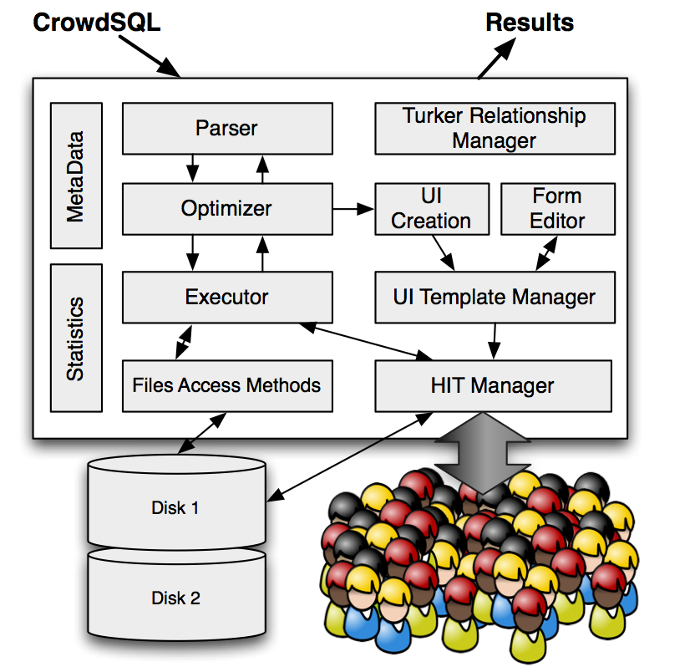
CrowdDB : Answering queries with Crowdsourcing
Michael Franklin et al., SIGMOD’11
Presentation by Parijat Mazumdar

Slide 2
CrowdDB : Motivation
Two fundamental problems with present RDBMSs :
Closed World Assumption
Extremely literal
SELECT market_capitalization FROM company
WHERE name = “I.B.M”
Entity Resolution : easy for humans, difficult for computers
Get the best of both sides :
Human power for subjective compare and finding new data
Traditional RDBMs for heavy lifting data manipulations

Slide 3
Design considerations
Design considerations for CrowdDB
Performance and variability : Humans are slow, inaccurate,
costly, variable
Task design and ambiguity : Natural language is inherently
ambiguous
Affinity and learning : Workers develop relationships with
requesters, skills for certain kind of HITs
Open world : Possibly unbounded number of answers

Slide 4
CrowdDB : Overview
Query database using CrowdSQL : slight extension of standard SQL
Automatic UI generation
Automatic interaction with crowdsourcing marketplace
Automatically store results obtained from crowd into database for future use.

Slide 5
Amazon Mechanical Turk (AMT)
HIT : smallest entity of work a worker can accept to do
Assignment : Replicas of same HIT for majority voting
HIT Group : Similar HITs put together
AMT API :
createHIT(HIT parameters) → HitID
getAssignmentsForHIT(HitID)→list(asnId,workerId,answer)
approveAssignment(asnID)/rejectAssignment(asnID)
forceExpireHIT(HitID)

Slide 6
CrowdSQL : Incomplete data
special keyword : CROWD
Crowdsourced Tables
CREATE CROWD TABLE Professors (
name STRING PRIMARY KEY,
email STRING UNIQUE,
university STRING,
department STRING,
FOREIGN KEY (university, department)
REF Department(university, name) );
Crowdsourced Columns
CREATE TABLE Department (
university STRING,
name STRING,
url CROWD STRING,
phone STRING,
primary key (university, name) );
special keyword : CNULL
Crowd equivalent of NULL
CNULL values get filled during queries
SELECT url from Department
WHERE name = “math”

Slide 7
CrowdSQL : Comparisons
CROWDEQUAL
SELECT name FROM Professor
WHERE department ~= “CS”
CROWDORDER
SELECT p from picture
WHERE subject = “Golden Gate Bridge”
ORDER BY CROWDORDER(p,
“Which picture visualises better %subject”)

Slide 8
Basic UI generation
UI Templates are created at compile time
Instantiated at run-time for each tuple
Can be edited by application developers

Slide 9
Multi-relational UI generation
Foreign key references a non-crowdsourced table:
Drop-down box
Ajax-based “suggest” function
Foreign key references a crowdsourced table:
Normalised interface with “suggest” function
Denormalized interface

Slide 10
Query Processing
Extended operators called crowd operators
CrowdProbe collects missing information in CROWD columns/tables
CrowdJoin collects new tuples from inner relation
CrowdCompare implements CROWDEQUAL, CROWDORDER
Overall task of crowd operators
Create HITs and HIT groups
Collect results from AMT
Quality control through majority voting
Rule-based optimiser
Batch size, number of assignments and price per HIT fixed
Predicate push-down, join ordering, delete optimisation
Better alternative : Cost-based optimiser

Slide 11
Query Processing : Example

Slide 12
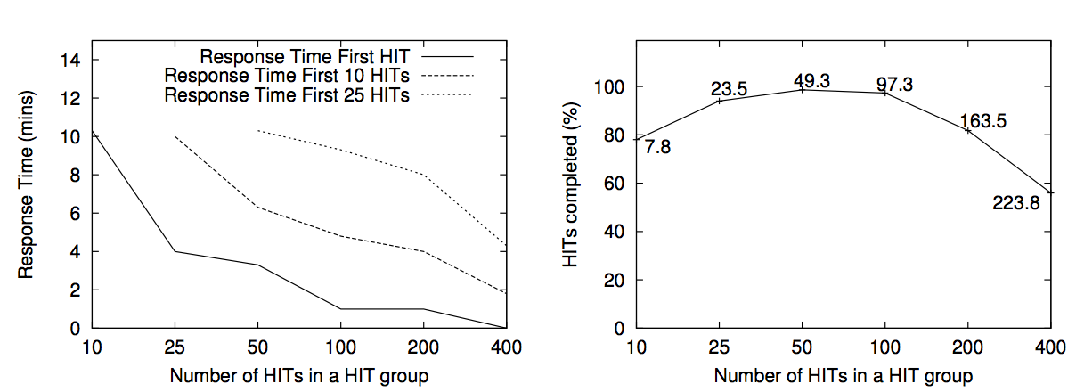
Results : Micro-tasks
HITs Group size vs Responsiveness
Tradeoff between HITs completed per unit time and % completion of HITs

Slide 13
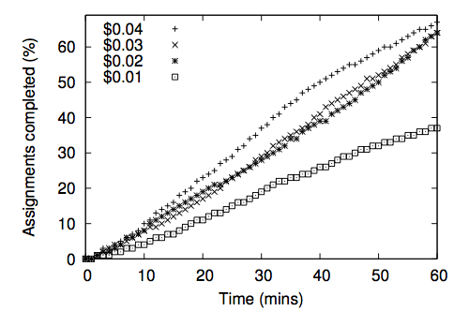
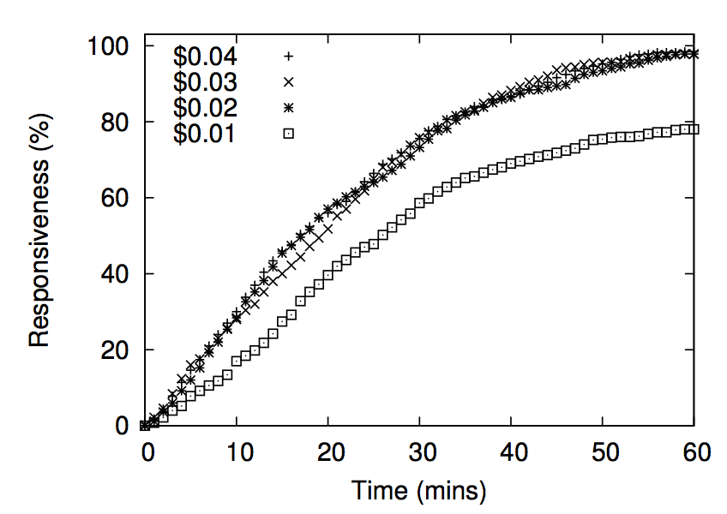
Results : Micro-tasks
Reward vs Responsiveness
% of HITs fully completed
% of HITs with at least 1 assignment done

Slide 14
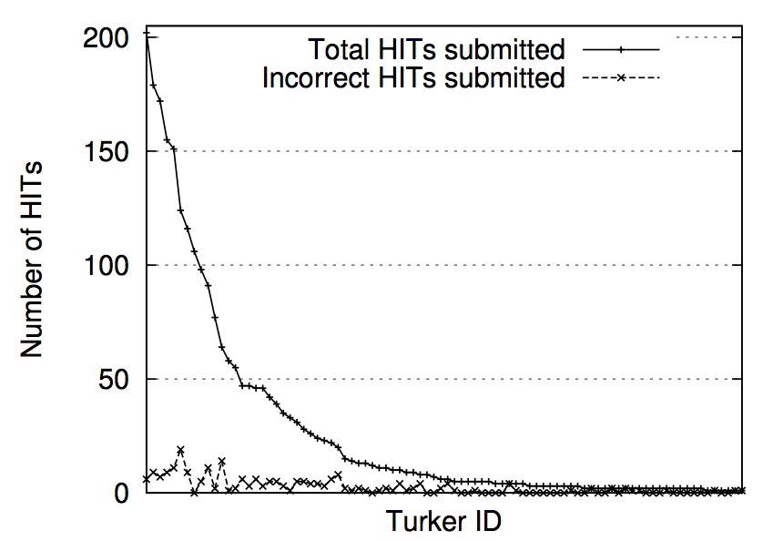
Results : Micro-tasks
Skewed distribution : Community of fan turkers cultivated
No variation in error rate between fan turkers and others

Slide 15
Results : Complex queries
Entity resolution on company names
4 non-uniform company names match to 100 companies (10 per HIT)
Majority vote produces correct result always
Ordering pictures in terms of relevance
Majority voting based ranking matches expert ranking
SELECT p.name, p.email, d.name, d.phone
FROM Professor p, Department d
WHERE p.department = d.name AND
p.university = d.university AND
p.name = "[name of a professor]"
Joining Professors and Departments
Method 1 : first professor details collected, then department details
Method 2 : denormalized version, professor and department details collected together
Method 1 outperforms Method 2 in accuracy
Unclear instructions, turkers submitted professors’ phone numbers

Slide 16
Other observations
Relationship of requester with turkers is long-term
Keep workers happy
Implement less stringent approval standards
Good interface design and precise instructions matter
Simple design changes like adding “None of the above” option
can improve quality dramatically.

Slide 17
Related Works
Related work in database systems :
Oracle forms : Automatic interface generation from metadata
Dealing with open-world nature using operation limiting, top N optimisations
Dealing with performance volatility using adaptive query processing
Related work in CrowdSourcing :
Qurk : SQL plus UDF (Appeared in CIDR’11)
Crowdsourced database using datalog (Appeared in CIDR’11)
TurKit , toolkit for programming iterative algorithms in crowd
Quality control and response time optimisation in CrowdSearch

Slide 18
Thank You!

